Slide 1
Food price and food choice

Slide 2
Global food prices
Year average | 2010 | 2011 | 2012 | 2013 | 2014 | 2015 | 2016 | 2017 | 2018
Food price index | 188.0 | 229.9 | 213.3 | 209.8 | 201.8 | 164.0 | 161.5 | 174.6 | 168.4
Meat | 158.3 | 183.3 | 182.0 | 184.1 | 198.3 | 168.1 | 156.2 | 170.1 | 166.3
Dairy | 206.6 | 229.5 | 193.6 | 242.7 | 224.1 | 160.3 | 153.8 | 202.2 | 192.9
Cereals | 179.2 | 240.9 | 236.1 | 219.3 | 191.9 | 162.4 | 146.9 | 151.6 | 165.3
Vegetable Oils | 197.4 | 254.5 | 223.9 | 193.0 | 181.1 | 147.0 | 163.8 | 168.8 | 144.0
Sugar | 302.0 | 368.9 | 305.7 | 251.0 | 241.2 | 190.7 | 256.0 | 227.3 | 177.5
FAO food price index http://www.fao.org/worldfoodsituation/foodpricesindex/en/

Slide 3
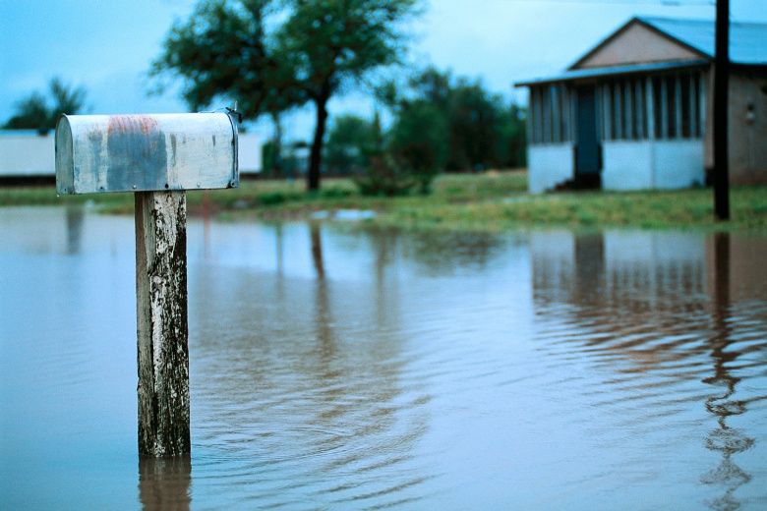
What factors can cause food prices to rise?
Climate change and weather
There are several factors which can cause food prices to rise. One of these is the weather.
Climate change has led to more frequent extreme weather events, such as heat waves, drought and floods. These extreme weather events can destroy or damage crops, affect soil quality, deplete grazing areas and cause the loss of livestock.
This can damage stock levels and stop countries exporting to other countries, causing food prices to increase.

Slide 4
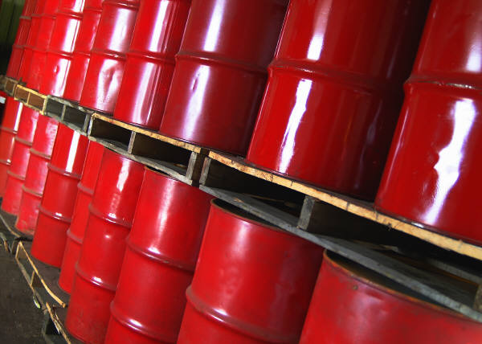
What factors can cause food prices to rise?
Increases in oil and energy prices
Increases in oil and energy prices increase the production and transportation costs for agricultural commodities and food, which may lead to an increase in food costs.

Slide 5
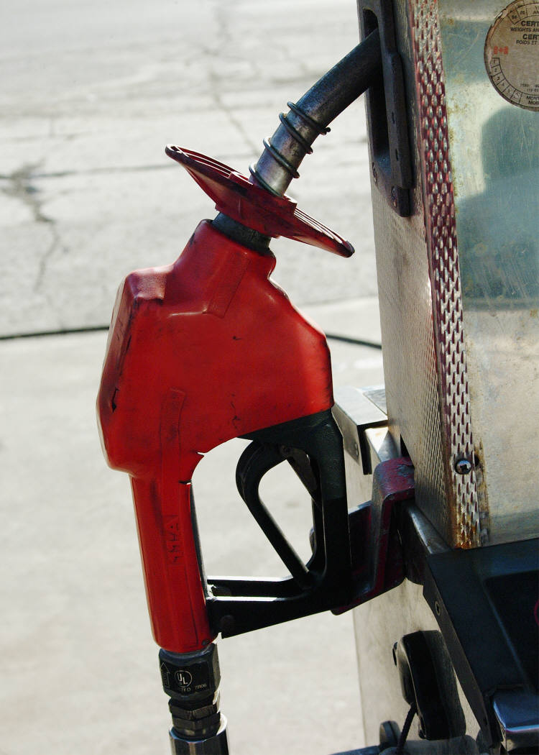
What factors can cause food prices to rise?
Biofuels
Biofuels are any kind of fuel made from living organisms, or from the waste they produce. The increased use of foods such as coarse grains and vegetable oil in the biofuel industry can result in food prices rising.

Slide 6
What factors can cause food prices to rise?
Global food demand
The population is increasing, and it is estimated there will be over 9.6 billion people living in the world by 2050. In some developing countries, there has also been a change in dietary habits, increasing the demand for particular foods e.g. there has been significant increases in meat consumption in developing countries.
https://www.un.org/en/development/desa/news/population/2015-report.html

Slide 7
What is the impact of rising food prices?
There are many possible consequences to rising food prices. If people cannot afford the increased price of food, they may eat less food or switch to lower quality, cheaper foods. This increases the risk of malnutrition.
Increases in food prices can lead to protests and riots. This was seen in numerous countries during the food price crisis of 2007-2008.
In more economically developed countries such as the UK, there have been changes in shopping habits as a result of increasing food prices e.g. less impulse buying.

Slide 8
Reducing the amount spent on food
What strategies can you think of to reduce the amount of money you spend on food?
Discuss with the rest of the class.

Slide 9
Strategies
Consider the following ways to reduce the amount spent on food:
replace branded items with cheaper, non branded (e.g. supermarket own, economy) items;
shop at different places (e.g. discount supermarkets, markets)
compare prices and shop around to find the cheapest items;
stop or reduce purchasing of certain items (e.g. luxury items such as steak);
grow own food (e.g. growing vegetables in the garden);
buy items from reduced food aisles (e.g. wait until end of day when food is marked down, buy foods which are at/almost at their use by date);
purchasing different types of food (e.g. canned vegetables instead of fresh vegetables);
reducing the total amount of food purchased.

Slide 10
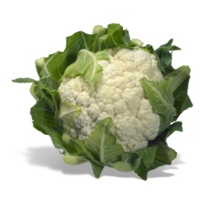
Food price and food choice
When food prices increase and our budget remains the same, we may have a more limited food choice. What different food choices would you make?
For example:
Swapping from fresh fruit and vegetables
To canned and frozen fruit and vegetables

Slide 11
Food price and food choice
For further information, go to:
www.foodafactoflife.org.uk

