Slide 1
Healthy hydration handouts

Slide 2
Activity instructions
Distribute printed copies of the Healthy hydration handouts to small groups of pupils. Ask them to complete the answers for the drink on their card, then share their answers with the class.

Slide 3
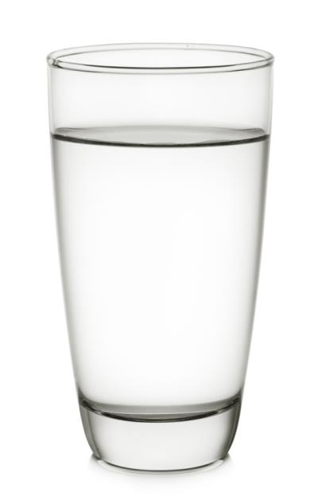
Water
Recommendations:
Drink ‘pros and cons’:

Slide 4
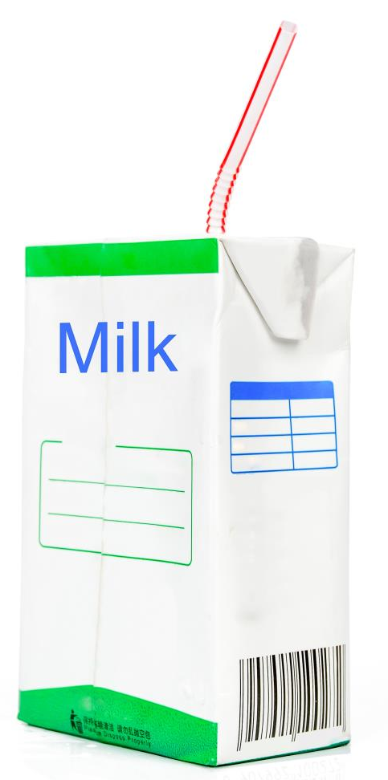
Milk
Recommendations:
Drink ‘pros and cons’:

Slide 5
Tea and coffee
Recommendations:
Drink ‘pros and cons’:

Slide 6
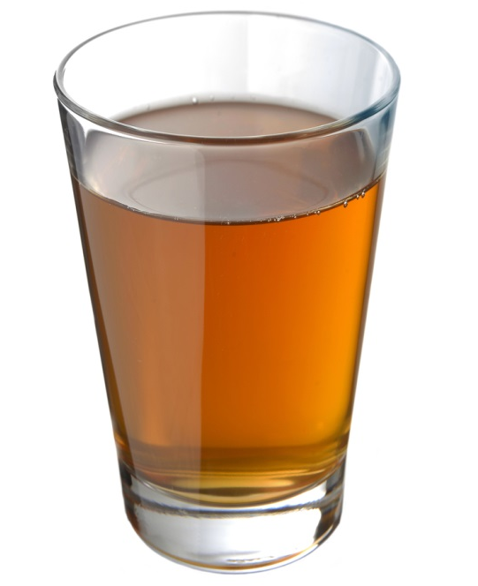
Fruit/vegetable juices and smoothies
Recommendations:
Drink ‘pros and cons’:

Slide 7
Alcohol
Recommendations:
Drink ‘pros and cons’:

Slide 8
Sugary drinks
Recommendations:
Drink ‘pros and cons’:

Slide 9
For further information, go to:
www.foodafactoflife.org.uk

