Slide 1
Assessment
Assessment Criteria | Achieved (Student) | Achieved (Teacher)
I know what Computational Thinking is
I know what abstraction is and how it is used in computational thinking
I know what decomposition is and how it is used in computational thinking
I know what algorithmic thinking is and how it is used in computational thinking
I can read and interpret Flowchart
I can create algorithm with selection and iteration using flowchart
I can create algorithm with selection and iteration using Pseudocode
I can correct a Pseudocode with errors
I can complete an incomplete Pseudocode
I know how linear search algorithm works and can used to find an item in a list
I know how binary search algorithm works and can used to find an item in a list
I know how bubble sort algorithm works and can used to sort an items in a list
I know how insertion sort algorithm works and can used to sort an items in a list
I know how merge sort algorithm works and can used to sort an items in a list

Slide 2
Computational Thinking
Notes:
Please ensure the course title is shown on this slide

Slide 3
Introduction to Algorithms
How many problems, or decisions do you think you make each day?
How many actions do you take?
How many thoughts do you have?
To instruct a computer to perform these actions, or to solve problems involves computational thinking.
Everyone who uses a computer uses computational thinking, to different degrees, without even knowing it.

Slide 4
Why do we need to sort?
Click on the image below to watch the video

Slide 5
Engagement Activity
You need to write a program that simulates the International Space Station.
How are you going to do this?
What do you need to know?
How will you implement it?

Slide 6
Todays learning Intentions
Computational Thinking
Understand the term and processes in computational thinking.
Be able to use the skills of:
Abstraction
Decomposition
Algorithmic thinking.
Keywords
Computational Thinking Abstraction Algorithm Decomposition

Slide 7
Key Words Explained
Computational thinking – the use of computers to solve problems.
Abstraction – representing 'real world' problems in a computer using variables and symbols and removing unnecessary elements from the problem.
Decomposition – breaking down a large problem into smaller sub-problems.
Algorithmic Thinking - identifying the steps involved in solving a problem.

Slide 8
Abstraction
Using symbols, variables etc. to represent a ‘real world’ problem in a computer program...
...and removing unnecessary elements
e.g. a program is to be created to let users play chess against the computer.
How is abstraction used in the creation of the game?
Board is created as an arrays or list.
Players are objects that have positions on the board
The shape and style of the pieces may not be required.

Slide 9
Definitions
Computational thinking:
The use of computers to solve problems.
Development of algorithms to solve problems.
Using abstraction, decomposition and algorithmic thinking (we’ll look at these today).

Slide 10
Activity
Learning Intentions Covered:
Be able to use the skills of:
Abstraction
In your Algorithm folder in your area
Open Algorithm Booklet
Complete:
All Abstraction Task in Part 1: Computational Thinking
Consider how abstraction would be used to represent a map on a computer.
Complete the worksheet by answer the questions and/or drawing the map as it would appear in a computer model.

Slide 11
Activity 1 - Answer
Towns/places would be represented with their name, maybe a circle or shape.
Roads would be lines.
Road names may be on the lines.
Fields, hedges, houses etc. would not necessarily be in the model.

Slide 12
Decomposition
The breaking down of large problems into smaller problems:
Smaller problems are easier to solve.
They can be created independent of the other problems.
They can be tested independently.
Then combined to produce the full problem.
There is not always one right answer. A problem could decomposed in several valid ways.

Slide 13
Using diagrams for decomposition
Decomposition for a game of Battleships:
Battleships
Positioning Ships
Player move
Checking if won
Battleship 1
Destroyer 1
Destroyer 2
Generate random position
Check the spaces are free
Save ship position
Generate random position
Check the spaces are free
Save ship position
Generate random position
Check the spaces are free
Save ship position
Activity
This diagram is incomplete.
Use the worksheet “Activity 2: Decomposition” to complete your own diagram for Battleships:

Slide 14
Activity 2
Complete the diagram to show decomposition for the game of Battleships.
Battleships
Positioning Ships
Player move
Checking if won
Battleship 1
Destroyer 1
Destroyer 2
Generate random position
Check the spaces are free
Save ship position
Generate random position
Check the spaces are free
Save ship position
Generate random position
Check the spaces are free
Save ship position

Slide 15
Activity 2 – Example Answer
Battleships
Positioning Ships
Player move
Checking if won
Battleship 1
Destroyer 1
Destroyer 2
Generate random position
Check the spaces are free
Save ship position
Generate random position
Check the spaces are free
Save ship position
Generate random position
Check the spaces are free
Save ship position
Choose grid position
Check contents of grid position
Display Hit
Display Miss
Check if all ships found
Display won
Battleship 2
Generate random position
Check the spaces are free
Save ship position

Slide 16
Algorithmic Thinking
Identifying the steps involved in solving a problem.

Slide 17
Activity 3
What are the steps involved with making a cup of tea?
What are the steps involved in the calculation $200÷12$?
What are the steps involved in checking if a player has hit part of a ship in battleships?
How could you make the ‘Positioning of Ships’ more efficient in Activity 2?

Slide 18
Plenary
Get into pairs, or groups of 3.
Test each other on definitions for:
Computational thinking
Abstraction
Decomposition
Algorithmic thinking.
Add to each other’s definitions to make sure they are complete and correct.

Slide 19
Flowcharts

Slide 20
Starter Task: Big Picture
An App development company is going to create a new game to be downloaded to mobile devices.
Do the developers start programing immediately?
Task: Discuss the above question with your partner
No, they have to plan and design first.

Slide 21
Todays learning Intentions
Flowcharts
Be able to read an algorithm in a flowchart
Be able to produce an algorithm using a Flowchart.
Keywords
Algorithm Flowchart Input/output Process

Slide 22
What is an Algorithm?
An algorithm is set or sequence of instruction to solve a particular problem
Start
IF age =14
Yes
Stand up
No
ELSEIF age =15
Yes
Clap
No
ELSEIF age =16
Yes
Sing a Song
No
End
Sit on the floor

Slide 23
Keywords Explained
Algorithm – the series of steps to solve a problem or perform an action.
Flowchart – a diagram that shows the inputs, outputs and processes in an algorithms.
Process – an action that takes place.

Slide 24
Flowcharts
A flowchart can be used to represent an algorithm.
It shows the data that is input, and output.
It shows the processes (actions) that take place.
It shows the decisions and repetitions that take place.
Lines are used to show the flow of control.
Set shapes are used to represent different functions.

Slide 25
Flowchart symbols
Process
Start/End
Decision
Input/Output
True/Yes
False/No
Sub-process
A decision has a ‘Yes’ and ‘No’ coming from it.
An Input/Output and process has 1 arrow going in, and 1 arrow coming out.

Slide 26
Reading a Flowchart
Start
Is total > 10?
Yes
INPUT x
No
INPUT y
OUTPUT total
OUTPUT x * y
total = x + y
End
What will be the result if 2 and then 4 are input?
What will be the result if 5 and 8 are input?

Slide 27
Reading a Subroutine
Start
Reduce (num)
Activity
What will be output if the following numbers are entered in this order: 3 1 2 4 1
What will be output if the following numbers are entered in this order: 5 3 4 1 2 5 4
INPUT num1
INPUT value
Count = 0
value = num - value
Reduce(num1)
OUTPUT value
Count = Count + 1
No
Is Count > num1?
Yes
End
Reading a Subroutine

Slide 28
Activity
Learning Intentions Covered:
Be able to read an algorithm in a flowchart
In your Algorithm folder in your area
Open Algorithm Booklet
Complete:
All Task in Part 2: Reading Flowchart

Slide 29
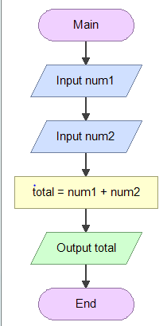
Problem 1 – Adding Two Numbers
Flowcharts
Use Flogorithm to create a flowchart that:
Input two numbers;
Add them together;
Output the result.

Slide 30
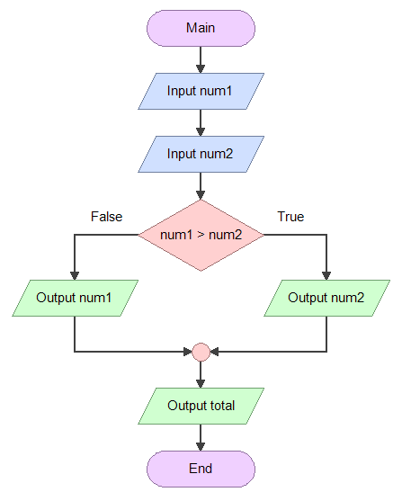
Problem 2 – Bigger Number
Flowchart Example
Use Flogorithm to create a flowchart that:
Input two numbers;
Decide which is larger;
Output the larger.
Output zero they are the same
This uses a decision.

Slide 31
Activity
Learning Intentions Covered:
Be able to produce an algorithm using a Flowchart.
In your Algorithm folder in your area
Open Algorithm Booklet
Complete:
All Task in Part 3: Creating Flowchart

Slide 32
Car Journey
Start
OUTPUT “Enter number of passenger”
INPUT passenger
OUTPUT “Enter number of distance”
Cost = Extra_distance * 2 + 3
Extra_distance = distance - 1
INPUT distance
IF passenger >4
Yes
Extr_Cost = 50/100 *Cost
Cost = Cost + Extra_Cost
No
OUTPUT Cost
End

Slide 33
Dog Year
Start
OUTPUT “Enter age of dog”
INPUT dog_age
IF dog_year < 3
Yes
Human_year = g=dog_year *12
No
Extra_year = dog_year - 2
Dog_year = Extra_year * 6 + 48
OUTPUT Dog_Year
End

Slide 34
Pseudocode

Slide 35
Big Picture
An App development company is going to create a new game to be downloaded to mobile devices.
Do the developers start programing immediately?
No, they have to plan and design first.

Slide 36
Todays learning Intentions
Pseudocode
Be able to produce an algorithm using Pseudocode.
Keywords
Algorithm Pseudocode Input/output Process

Slide 37
What is an Algorithm?
An algorithm is set or sequence of instruction to solve a particular problem
Start
IF age =14
Yes
Stand up
No
ELSEIF age =15
Yes
Clap
No
ELSEIF age =16
Yes
Sing a Song
No
End
Sit on the floor

Slide 38
What is an Algorithm?
An algorithm is set or sequence of instruction to solve a particular problem
IF Age = 13 THEN
Stand up
ELSE IF Age = 14 THEN
Clap
ElSE IF Age = 15 THEN
Sing a song
ELSE
Sit on the floor
END IF

Slide 39
Keywords Explained
Algorithm – the series of steps to solve a problem or perform an action.
Process – an action that takes place.
Pseudocode – simplified programming code that is not language specific, used to design algorithms.

Slide 40
Pseudocode
This means ‘fake code’.
It’s part way between English sentences, and programming code.
It is language neutral (it can be read by programmers who are able to use any language).

Slide 41
Pseudocode Examples
OUTPUT:
OUTPUT “Enter a number”
INPUT:
INPUT num
SELECTION:
IF num = 2 THEN
...
ELSEIF num < 4 THEN
...
ENDIF
FOR i = 1 to 10
...
NEXT i
ENDFOR
WHILE (i != 11)
...
ENDWHILE

Slide 42
Pseudocode Examples
Iteration
FOR i = 1 to 10
...
NEXT i
ENDFOR
WHILE (i != 11)
...
ENDWHILE
DO ...
UNTIL i > 10

Slide 43
Pseudocode Algorithm
OUTPUT “enter mark”
INPUT mark
IF mark => 50 THEN
OUTPUT “Pass”
ELSEIF mark => 70 THEN
OUTPUT “Merit”
ELSEIF mark => 90 THEN
OUTPUT “Distinction”
ELSE
OUTPUT “Fail”
ENDIF
Write an algorithm that takes a user’s mark as input and outputs
“Pass” if they scored on, or over 50
“Merit if they scored on, or over 70
“Distinction” if they scored on, or over 90
or “Fail” if below 50

Slide 44
Pseudocode Algorithm
Write an algorithm that takes a user’s password. The program should
Ask the user to enter a password
The program should display welcome when enter the correct password (unicorn)
Otherwise the program should continues asking for the correct password
Once the correct password the program should stop

Slide 45
FOR Loops
The FOR loop is useful when we need to repeat a block of code a set number of times:
For example, to input a set of five values, add them up and output the average.
The algorithm for this is:
FOR i = 1 TO 5
OUTPUT “INPUT Number “;i
INPUT value
`total = total + value
NEXT i
OUTPUT “Average is “; total/5
Activity Try coding this in Python

Slide 46
Activity
Learning Intentions Covered:
Be able to produce an algorithm using a Pseudocode.
In your Algorithm folder in your area
Open Algorithm Booklet
Complete:
All Task in Part 4: Creating Pseudocode

Slide 47
OUTPUT “How much did you spent?”
INPUT spent
IF spent > 10THEN
discount = 20/100 * spent
OUTPUT “you have” & discount & “discount”
ELSE
discount = 10/100 * spent
OUTPUT “you have” & discount & “discount”
END IF
price = spent – discount
OUTPUT “Your final price is” & price

Slide 48
Example Answer
a) The program asks the user to enter the number of hours they have been working for. The system must output:
the number of minutes they have been working
the number of seconds they have been working.
OUPPUT “Enter the number of hours worked”
INPUT hoursWorked
numberMinutes = hoursWorked * 60
numberSeconds = numberMinutes * 60
OUTPUT “number of minutes = “ & numberMinutes
OUTPUT “number of seconds = “ & numberSeconds

Slide 49
Example Answer
b) The program asks for a user's age, and their favourite number. The system must output:
the two numbers added together
the two numbers multiplied together.
OUTPUT “Enter age”
INPUT age
OUTPUT “Enter favourite number”
INPUT favNum
OUTPUT age + favNum
OUTPUT age * favNum

Slide 50
Example Answer, Low
c) The program asks the user to enter two numbers. Output the largest of these two numbers.
OUTPUT “Enter the first number”
INPUT num1
OUTPUT “Enter the second number”
INPUT num2
IF num1 > num2 THEN
OUTPUT num1 & “ is larger”
ELSEIF num2 > num1 THEN
OUTPUT num2 & “ is larger”
ELSE
OUTPUT “The numbers are the same”
ENDIF

Slide 51
Example Answer, Medium
a) The program that asks the user to enter the number of letters in the alphabet. Output whether they got it correct, or incorrect.
OUTPUT “How many letters are in the alphabet?”
INPUT answer
IF answer = 26 THEN
OUTPUT “Correct”
ELSE
OUTPUT ”Incorrect”
ENDIF

Slide 52
Example Answer, Medium
b) The program asks the user to enter a number.
The program then outputs the 12 times table for that number, e.g.
if they enter 5 it displays 5, 10, 15 etc.
OUTPUT “Enter a number”
INPUT number
FOR x = 1 to 12
OUTPUT x * number
NEXT x
END FOR

Slide 53
Example Answer, Medium
c) The program asks the user for 2 numbers and a symbol (+, -, /, * or ^).
The program then outputs the calculation based on the symbol, e.g. if 2, 3 and + were entered it would output 2 + 3 = 5.
OUTPUT “Enter a number”
INPUT num1
OUTPUT “Enter a number”
INPUT num2
OUTPUT “Enter a symbol”
INPUT symbol
IF symbol = “+” THEN
OUTPUT num1 + num2
ELSEIF symbol = “-” THEN
OUTPUT num1 – num2

Slide 54
Activity 2 – Example Answer, Medium
ELSEIF symbol == “/” then
OUTPUT (num1 / num2)
ELSEIF symbol == “*” then
OUTPUT (num1 * num2)
ELSEIF symbol == “^” then
OUTPUT (num1 ^ num2)
ELSE
OUTPUT (“Invalid symbol”)
ENDIF

Slide 55
Example Answer, High
a) The amount of water in a fish tank, in litres, is calculated using the formulae:
(height x width x depth) / 1000.
The program must take the height, width and depth as input and output a suitable message e.g. The tank holds 221.6 litres of water.
OUTPUT “Enter the tank height”
INPUT height
OUTPUT “Enter the tank width”
INPUT width
OUTPUT “Enter the tank depth”
INPUT depth
water = (height * width * depth) / 1000
OUTPUT “The tank holds “ & water & “ litres of water”

Slide 56
Example Answer, High
b) The program takes a number as input, and then outputs this many # symbols.
OUTPUT “Enter a number”
INPUT number
FOR x = 0 to number
OUTPUT ”#”
NEXT x

Slide 57
Example Answer, High
c) A program asks the user to input a whole number.
If the user enters an invalid input (e.g. a decimal number) then it tells them their input is invalid and asks for the input again.
DO
OUTPUT “Enter a whole number”
INPUT number
check = number MOD 2
IF check == 1 THEN
OUTPUT “This is a whole number”
wholeNumber = true
ELSEIF check == 0 then
OUTPUT “This is a whole number”
wholeNumber = true

Slide 58
Example Answer, High
ELSE
OUTPUT “This is NOT a whole number, try again!”
ENDIF
UNTIL wholeNumber = true

Slide 59
Plenary
What are the differences between Pseudocode and programming code?

Slide 60
Correcting & Completing Algorithm (Pseudocode)

Slide 61
Big Picture
Is everything perfect first time?
No! Especially not in programming.
It is expected and not a weakness.
The challenge is finding and correcting the errors.

Slide 62
Todays learning Intentions
Correcting Algorithm
Be able to find and correct errors in algorithms.
Be able to complete algorithms where code is missing.
Keywords
Dry run Pseudocode Input/output Trace Table

Slide 63
Engagement Activity
You are presented with a pseudocode algorithm that doesn’t work.
How will you find and fix the errors?
What do you do?

Slide 64
Key Words
Dry run – walking through an algorithm which sample data, running each step manually.
Trace Table – a table that follows the values of variables to check for accuracy.

Slide 65
Correcting algorithms
You may be given a description of a problem, and an algorithm to solve the problem.
The algorithm may not work.
You need to find and correct the errors.

Slide 66
Correcting algorithms
Step 1: Read what the algorithm needs to do.
Read it at least twice.
Step 2: Work out what it should do in note form, e.g. draft the steps that should take place.
Step 3: Trace, or read through each step, of the algorithm.
Step 4: Compare what the algorithm does to your notes about what is needs to do.

Slide 67
Example Algorithm to Correct
An algorithm should take two numbers as input, and then output the smallest number.
Step 1: Read the above point twice.
Step 2: Make your own notes for how it should work.
Step 3: Now trace the algorithm, use examples numbers e.g. 5 and 3.
Step 4: Compare Step 3 with Step 2.
There are four errors, identify them
OUTPUT “Enter the first number”
INPUT num1
OUTPUT “Enter the second number”
INPUT num1
IF num1 < num2 THEN
OUTPUT(num2)
ELSEIF num2 < num1 then
OUTPUT(num2)
ELSEIF
OUTPUT(“Same”)
STOP

Slide 68
Example Algorithm to Correct
Correct Algorithm
OUTPUT “Enter the first number”
INPUT num1
OUTPUT “Enter the second number”
INPUT num2
IF num1 < num2 THEN
OUTPUT num1
ELSEIF num2 < num1 THEN
OUTPUT num2
ELSE
OUTPUT “Same”
ENDIF

Slide 69
Activity
Learning Intentions Covered:
Be able to find and correct errors in algorithms.
In your Algorithm folder in your area
Open Algorithm Booklet
Complete:
All Task in Part 6: Correcting Pseudocode

Slide 70
Correcting Pseudocode 1 Answer - Low
OUTPUT "Enter the number of miles”
INPUT miles
cost = miles * 0.3
IF cost > 10 THEN
cost = cost * 0.9
ENDIF
OUTPUT(cost)

Slide 71
Correcting Pseudocode 1 Answer - Medium
total = 0
for x = 1 to 10
OUTPUT "Enter a number"
INPUT number
total = total + number
NEXT x
average = total / 10
OUTPUT(average)

Slide 72
Correcting Pseudocode 1 Answer - High
FOR x = 0 to 19
OUTPUT "Enter a number"
INPUT numbers[x]
NEXT x
OUTPUT "What number are you looking for?"
INPUT numberSearch
quantity = 0
FOR count = 0 to 19
IF numbers[count] == numberSearch THEN
quantity = quantity + 1
ENDIF
NEXT x
OUTPUT(numberSearch &" appears "& quantity &" times")
NB: You could state that the array index starts at 1 and therefore for x = 1 to 20 could also be viewed as correct in an exam!

Slide 73
Completing Algorithms
You may be given an incomplete algorithm.
You will need to complete it.
It may be some elements are missing
Or only part of the algorithm is present.
Follow the same stages as correcting, but this time, add your own code to finish it.

Slide 74
Example
An algorithm should ask the user to input 10 numbers, which are stored in the array or list.
The program then outputs the total of these numbers (added together).
The program then outputs the average number.
count = ......
WHILE count <= .....
OUTPUT “Enter number” INPUT num[count]
.....................
ENDWHILE
total = 0
FOR x = 0 to 9
total = total + ..........
NEXT x
average = total/10
..........................
..........................
count = 0
WHILE count <= 9
OUTPUT “Enter number”
INPUT num[count]
count = count + 1
ENDWHILE
total = 0
FOR x = 0 to 9
total = total + num[x]
NEXT x
average = total/10
OUTPUT(“The total is “ & total)
OUTPUT(“The average is “& average)

Slide 75
Activity
Learning Intentions Covered:
Be able to complete algorithms where code is missing.
In your Algorithm folder in your area
Open Algorithm Booklet
Complete:
All Task in Part 7: Completing Pseudocode

Slide 76
Completing Pseudocode – Answer Low
An algorithm has been written that asks the user to enter the cost of a meal.
The algorithm calculates 10% of the total for the tip.
It then outputs the total cost of the meal, plus the tip.
INPUT "Enter the cost of the meal"
INPUT mealCost
tip = mealCost * 0.1
totalCost = mealCost + tip
OUTPUT "The total cost is " & totalCost

Slide 77
Completing Pseudocode – Answer Medium
OUTPUT "Enter your salary"
INPUT salary
moneyReceived = 0
IF salary > 10600 THEN
moneyReceived = 10600
salary = salary – 10600
ELSE
moneyReceived = salary
salary = 0
ENDIF
IF salary > 21185 THEN
moneyReceived = moneyReceived + (21185 * 0.8)
salary = salary – 21185
ELSE
moneyReceived = moneyReceived + (salary * 0.8)
salary = 0
ENDIF

Slide 78
Completing Pseudocode – Answer Medium
IF salary > 118215 THEN
moneyReceived = moneyReceived + (118215 * 0.6)
salary = salary – 118215
ELSE
moneyReceived = moneyReceived + (salary * 0.6)
ENDIF
IF salary > 0 THEN
moneyReceived = moneyReceived + (salary * 0.55)
salary = 0
ENDIF
OUTPUT “moneyReceived”

Slide 79
Completing Pseudocode – Answer High
FOR x = 0 to 9
array3[x] = array1[x] + array2[x]
NEXT x
largest = 999
smallest = 0
FOR y = 0 to 9
IF array[x] > largest THEN
largest = array[x]
ELSEIF array[x] < smallest THEN
smallest = array[x]
ENDIF
NEXT y
OUTPUT "The smallest is " & smallest
OUTPUT "The largest is " & largest

Slide 80
Trace Table
When testing more complex examples of program or algorithm, it is sometimes necessary to test a number of conditions and sub-conditions at the same time.
A trace table, also called a trace matrix, can be used to record the outcomes of the test.
The trace table for a very simple example, such as x=y+2, would look like this:
Y | X
13 | 15
25 | 27
1200 | 1202

Slide 81
Reading a Flowchart
Start
Is x > 10?
Yes
INPUT x
x = x * y
No
INPUT y
OUTPUT x
OUTPUT x
x = x + y
End
X | Y
What will be the result if x= 2 and then y= 4 are input?
2
4
6
4
6
4

Slide 82
Reading a Flowchart
Start
Is x > 10?
Yes
INPUT x
x = x * y
No
INPUT y
OUTPUT x
OUTPUT x
x = x + y
End
X | Y
What will be the result if x= 5 and then y= 6 are input?
5
6
11
6
66
6
66
6

Slide 83
Reading a Pseudocode
score = 10
OUTPUT score
FOR i from 1 TO 3
score = score + 2
OUTPUT score
OUTPUT “Final” + score
Line | score | i | OUTPUT
1
2
3
4
5
6
10
10
10
12
1
12
12
14
2
14
14
16
3
16
16

Slide 84
Trace Table
A trace table might appear to look very similar to a test plan, but without the other headings like 'expected outcome' and 'actual outcome'.
Y | X
13 | 15
25 | 27
1200 | 1202
Trace Table
What is tested | How and Test Data | Expected Outcome | Actual Outcome | Action
Testing that menu option is valid | Run the code enter “2” | Should go to menu option 2 | Goes to menu option | No action
Test Plan

Slide 85
Trace Table
A primary teacher likes to start her maths lesson by displaying a number sequence maths challenge on the board.
Here are the last three challenges she has used with her class.
Can you solve these?
23
28
39

Slide 86
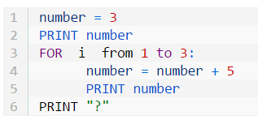
Trace Table
The primary teacher decided to create some Python script to help them create similar number sequences.
Here is the pseudo-code for her first script:

Slide 87
Answer

Slide 88
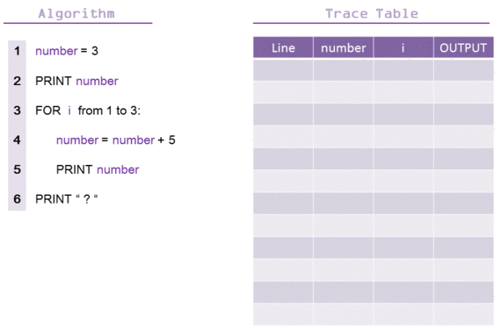
Trace Table
To make sure her script is working she decided to complete a dry run test using a Trace Table.
See animation below:

Slide 89
Plenary
Use multiple choice questions for this unit of work.

Slide 90
Searching Algorithm

Slide 91
Starter
Create a Flowchart and Pseudocode for the following:
A program that convert any whole decimal number between 0 and 255 into a 8-bit digit binary number.

Slide 92
Big Picture
How do you search for an item that you have lost? Or search for a book in a library?
How does a search engine find specific websites?
How would you tell a computer how to search for something?

Slide 93
Todays learning Intentions
Searching Algorithm
Be able to use a linear search to find data.
Be able to use a binary search to find data.
Understand the differences between a linear and a binary search.
Keywords
Linear Search Binary Search Algorithm

Slide 94
Engagement Activity
Shuffle and deal 10 cards upside down on the desk in front of you.
Only 1 card can be turned over at a time.
Do you have a Jack?
Extension: Can you write an algorithm (series of steps) to search for the Jack?

Slide 95
Search Algorithms
Searching Algorithms
Search algorithms are used to find items of data.
There are some standard algorithms that have been developed and each have their own merits.
Over the next few slides we will take a look at two common search algorithms:
Linear Search Algorithm
Binary Search Algorithm

Slide 96
Keywords
Linear search – Each item in the list is checked in order.
Binary search – An ordered list is divided in 2 with each comparison.

Slide 97
Linear Search Algorithm
Linear searching simply involves searching through a set of data, one item after the other, until the item we are looking for is found.
Lets take a look at an example of using a linear search algorithm to find an item of data in an array
Imagine we are searching for the letter ‘D’.
A linear search algorithm will be set up to cycle through each index of the array.
IF it finds a ‘D’, it knows to stop and display the location.
ELSE it will add 1 to the index (move to the next item) and look there.
INDEX | 0 | 1 | 2 | 3 | 4 | 5 | 6
Item | A | F | B | E | D | G | C

Slide 98
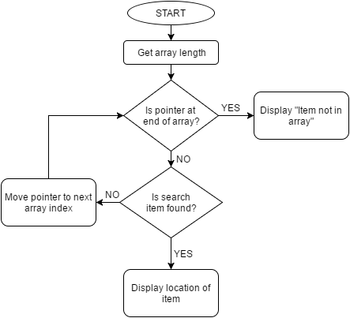
Linear Search Algorithm
Linear Search
The Algorithm presented as a flowchart:
INDEX | 0 | 1 | 2 | 3 | 4 | 5 | 6
Item | A | F | B | E | D | G | C

Slide 99
Linear Search Algorithm
Linear Search
The Algorithm presented as pseudocode:
position = 0
found = False
WHILE (position < length(array)) AND (found == False):
IF search_item == array[counter]
DISPLAY “Item at position” counter+1
found = True
ELSE:
position = position + 1
ENDIF
ENDWHILE
INDEX | 0 | 1 | 2 | 3 | 4 | 5 | 6
Item | A | F | B | E | D | G | C

Slide 100
Activity
Learning Intentions Covered:
Be able to use a linear search to find data.
In your Algorithm folder in your area
Open Algorithm Booklet
Complete:
Activity 1: Linear Search in Part 8: Searching Algorithm

Slide 101
Optional Activity
Deal 10 cards, face side down.
Use a linear search to see if you have the number 8.
Use a linear search to see if you have a King.
Use a linear search to see if you have an Ace.

Slide 102
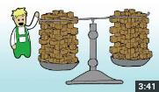
Binary Search Algorithm
Binary Search – DIVIDE AND CONQUER
Binary searching is only possible for sets of data that are in ORDER – THEY HAVE TO BE ORDERED!!
It involves starting the search at the middle so to work out if the search item is positioned lower than the middle or higher than the middle.
If it is positioned lower than the middle, the search is narrowed to the first half of the data set.
If it is positioned higher than the middle, the search is narrowed to the second half of the data set.
Once the data set is halved, the search then continues as it did before, in the middle.
By continually divide the data set until the item is found, the time taken to search for an item can be much faster than using a linear search.

Slide 103
Binary Search Algorithm
Binary Search – DIVIDE AND CONQUER
Lets say that we are searching for the letter ‘G.
We would begin by looking at the middle item.
To do this we would identify the lower bound and the upper bound of the data set.
Then we would add the ‘lower bound’ to the ‘upper bound’ and divide by 2, in order to find the position of the middle item (mid-point): (10-0)/2 = Midpoint = 5
The item at position 5 is the letter “F”.
“F” is lower than the letter “G”.
We now narrow our data set by focusing on the second half of the set.
INDEX | 0 | 1 | 2 | 3 | 4 | 5 | 6 | 7 | 8 | 9 | 10
Item | A | B | C | D | E | F | G | H | I | J | K
LB
UB

Slide 104
Binary Search Algorithm
Binary Search – DIVIDE AND CONQUER
The lower-bound moves to the position one up from the mid-point…
…and we repeat the same process again.
We add the ‘lower bound’ to the ‘upper bound’ and divide by 2, in order to find the position of the middle item (mid-point): (10+6)/2 = Midpoint = 8
The item at position 8 is the letter “I”.
“I” is higher than the letter “G”.
We now narrow our data set by focusing on the first half of this new, smaller set.
INDEX | 0 | 1 | 2 | 3 | 4 | 5 | 6 | 7 | 8 | 9 | 10
Item | A | B | C | D | E | F | G | H | I | J | K
LB
UB

Slide 105
Binary Search Algorithm
Binary Search – DIVIDE AND CONQUER
The lower-bound moves to the position one down from the mid-point…
…and we repeat the same process again.
We add the ‘lower bound’ to the ‘upper bound’ and divide by 2, in order to find the position of the middle item (mid-point): (7+6)/2 = Midpoint = 6.5
ISSUE! WE DON’T HAVE AN INDEX 6.5!
Its OK, what we do is round the answer up to 7 and use this as our midpoint.
The item at position 7 is the letter “H”.
“H” is higher than the letter “G”.
We now narrow our data set by focusing on the first half of this new, smaller set.
INDEX | 0 | 1 | 2 | 3 | 4 | 5 | 6 | 7 | 8 | 9 | 10
Item | A | B | C | D | E | F | G | H | I | J | K
LB
UB

Slide 106
Binary Search Algorithm
Binary Search – DIVIDE AND CONQUER
The lower-bound moves to the position one down from the mid-point…
…and we repeat the same process again.
We add the ‘lower bound’ to the ‘upper bound’ and divide by 2, in order to find the position of the middle item (mid-point): (6+6)/2 = Midpoint = 6
The item at position 6 is the letter “G”.
SUCCESS!!
We have now found them item we were searching for!!
INDEX | 0 | 1 | 2 | 3 | 4 | 5 | 6 | 7 | 8 | 9 | 10
Item | A | B | C | D | E | F | G | H | I | J | K
LB
UB

Slide 107
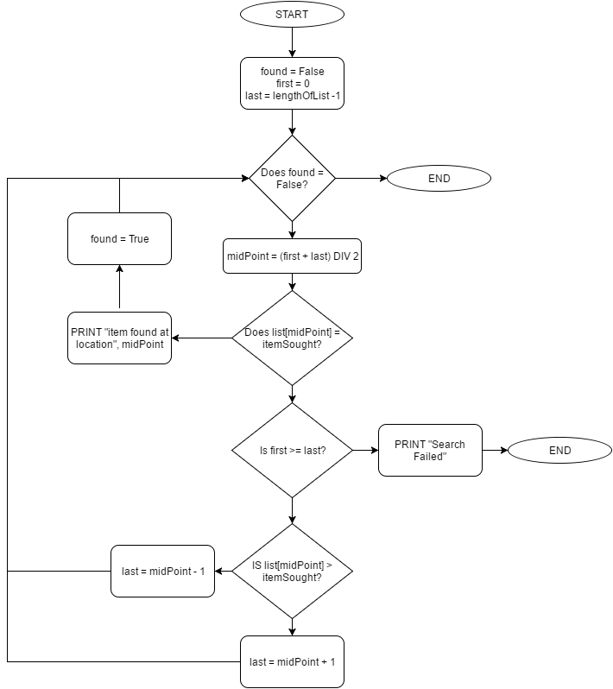
Binary Search Algorithm
Binary Search
The Algorithm presented as a flowchart:
INDEX | 0 | 1 | 2 | 3 | 4 | 5 | 6 | 7 | 8 | 9 | 10
Item | A | B | C | D | E | F | G | H | I | J | K

Slide 108
Binary Search Algorithm
Binary Search
The Binary Algorithm presented as pseudocode:
found = False
first = 0
last = lengthOfList – 1
WHILE found = False:
midPoint = (first + last) DIV 2
IF list[midpoint] == itemSought:
PRINT “item found at location”, midpoint
found = True
BREAK
ELSE:
IF first >= last:
PRINT “Failed”
BREAK
ELSE:
IF list[midpoint] > itemSought:
last = midpoint - 1
ELSE:
first = midpoint + 1
ENDIF
ENDWHILE
INDEX | 0 | 1 | 2 | 3 | 4 | 5 | 6 | 7 | 8 | 9 | 10
Item | A | B | C | D | E | F | G | H | I | J | K

Slide 109
Activity
Questions:
What is the main advantages of using a Binary search algorithm over a Linear search algorithm?
Show the process of finding the team ‘Liverpool’, using a Binary search.
Why will Liverpool never be found using a binary search, in this example?
Arsenal | Chelsea | Liverpool | Man City | Man Utd | Newcastle | Tottenham
Arsenal | Chelsea | Man City | Man Utd | Liverpool | Newcastle | Tottenham

Slide 110
Answers
As data sets get bigger, it takes less time to find your search item than it would using a linear search.
2)
Middle = (7+1)/2 = 4th item: Man City is after Liverpool, so remove items 4 onwards.
Middle = (3+1)/2 = 2nd item: Chelsea is before Liverpool so remove items 2 backwards.
Now we only have 1 item
Middle = (1+1)/2 = 1st item: Liverpool is found!
3) The data set is not in (alphabetical) order. As soon as it find the centre item, it will search in the first half of the data set where Liverpool is not located.
Arsenal | Chelsea | Liverpool | Man City | Man Utd | Newcastle | Tottenham

Slide 111
Extension Activity
Write down a list of instructions for someone who is not in the class to tell them how to perform a linear and binary search.
Extension:
Can you write these in Pseudocode?
Or in a python programming language?

Slide 112
Search Algorithms
Searching Algorithms
Search algorithms are used to find items of data.
There are some standard algorithms that have been developed and each have their own merits.
The two common search algorithms are:
Linear search – Each item in the list is checked in order
Binary search – An ordered list is divided in 2 with each comparison.

Slide 113
Linear vs Binary
The difference between the search algorithms.
 | Binary | Linear
Ordered Data?
Length of Search?
Complexity of Algorithm?
The list does not need to be in order
The list needs to be in order
The worst case scenario is you have to check half the values
The worst case scenario is you have to check all the values
The algorithm is longer and more complex to write
The algorithm is simpler to write

Slide 114
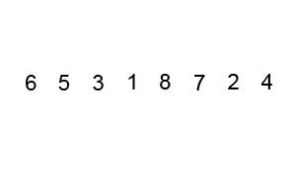
Sorting Algorithm
Bubble Sort

Slide 115
Sorting Algorithm
Insertion Sort

Slide 116
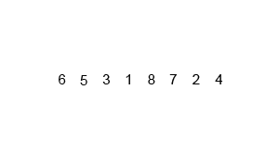
Sorting Algorithm
Merge Sort

Slide 117
Sorting Algorithm
Bubble Sort
Merge Sort
Insertion Sort

Slide 118
Plenary
Get into pairs.
Identify one student as student 1, the other as student 2.
Student 1 needs to give student 2 direct instructions on how to perform a linear, or binary, search.
Student 2 needs to act out the exact instructions on the deck of cards.
Student 2 needs to be ready to correct student 1 if needed.
If you finish, swap over and student 2 needs to tell student 1 how to perform the other type of search.

Slide 119
Plenary
Open Student Portal
Click on Fafl
Click on Year 8 Computer Science
Click on Add Note
Upload the Binary “Year 8 Binary Booklet”
Write a short STAR reflection on what you have covered by answering the following question;
Describe what you have learnt in this lesson
Example: “In this lesson I have been learning how to convert what computer system is.”
Describe four things that went well in this lesson (SUCCESSES)
Example: “I can identify input, output and storage devices”
Describe three thing that you could do better (TARGETS)
Example: “Explain the purpose of the CPU”

