Slide 1
Translators Compiler and Facilities
Lesson 1

Slide 2
Activity
Students Resources
Computing
Year 10
GCSE Computer Science
Unit 2 Computational Thinking
Copy Translators and Facilities folder
Paste it in your Unit 2 Computational Thinking folder

Slide 3
Contextual Video
https://www.youtube.com/watch?feature=player_embedded&v=1OukpDfsuXE

Slide 4
Big Picture Activity
How does code need to be written for a Computer to Understand?
How does code need to be written for a programmer to understand?

Slide 5
Learning Intentions
To be able to describe the different generations of programming language
To be able to describe the differences between Low Level and High Level Languages
To evaluate the benefits of programming in both Low and High Level languages
To state which translator is needed for each and why
Keywords
Assemble
Low Level Language
High Level Language
Machine Code
Interpreter
Compiler

Slide 6
Engagement – Activity
Identify the errors in a section of Machine Code that you have been given.
What are the issues to the programmer?
Imagine if the code was much larger?
What are the advantages of programming in the language that you are familiar with?

Slide 7
Content
There are several Generations of Programming Languages
Low Level
1st Generation (Machine Code e.g. 1010101)
2nd Generation (Assembly Code e.g. INP OUT HLT)
High Level
3rd Generation (e.g. Python, Java, Visual Basic, C++, C#)
4th Generation (e.g. MySQL)

Slide 8
1st Generation
Machine Code (Example Binary - 101010101011)
Directly Executable by the processor
The Generation that “computers understand”
Difficult to program in, hard to understand, hard to find errors (hard to debug)

Slide 9
2nd Generation
Assembly Code
Uses mnemonics
Example LMC codes (INP, OUT ADD, BRP, BRZ etc)
Easier to program in than 2nd Generation but still difficult.
One Assembly Language instruction translates to one Machine Code Instruction (1-1 relationship)

Slide 10
2nd Generation
Needs to be translated into Machine Code for the computer to be able to execute it
Uses an Assembler
Assembler – Assembles Assembly Language

Slide 11
2nd Generation
Despite 2nd Generation being difficult to Debug it still has its uses
Debug means to go through the code to search for where/why an error has occurred
It is most commonly used to program Device Drivers
Device Drivers are loaded into memory by the Operating System and used to control the operation of a Hardware Device e.g. Graphics Card Drivers, Printer Drivers.

Slide 12
3rd Generation – High Level Language
Easier to understand (programmer)
Easier to find errors, easier to de-bug
Uses English-Like Keywords
Example, print(“Hello World”)
One instruction translates into many machine code instructions
E.g.’s Python, Java, Basic, Pascal, C+, Visual Basic

Slide 13
2nd Vs 3rd Generation
2nd Generation
3rd Generation
INP
STA FIRST
INP
STA SECOND
LDA FIRST
ADD SECOND
STA ANSWER
LDA ANSWER
OUT
HLT
FIRST DAT 0
SECOND DAT 0
ANSWER DAT 0
first = int(input(“Please enter a number”))
second = int(input(“Please enter a number”))
answer = first + second
print (answer)
Both code allow the user to enter two numbers
These numbers are then add together and display the result
3rd generation has 4 lines while 2nd generation translate to 13 lines

Slide 14
Opcode and Operand
8 | 4 | 2 | 1
1 | 0 | 0 | 1
Assembly Code(2nd Gen) – Low Level | Machin Code (1st Gen) – Low Level | Opcode and Operand
00 INP | 1001 0000 0001 = 901 | Opcode Only
01 STA first | 0011 0000 1001 = 309 | 0011 = Opcode 0000 1001 = operand
02 INP | 1001 0000 0001 = 901 | Opcode Only
03 STA second | 0011 0001 0000 = 310 | 0011 = Opcode 1000 000 = operand
04 ADD first | 0001 0000 1001 = 109 | 0001 = Opcode 0000 1001 Operand
05 STA answer | 0011 0000 0001 = 311 | 0011 = Opcode 0001 0001 = Operand
06 LDA answer | 0101 0001 0001 = 511 | 0101 = Opcode 0001 0001 = Operand
07 OUT | 1001 0000 0010 = 902 | Opcode Only
08 HLT | 0000 = 0 | Opcode Only
09 first DAT | 0000 1001 = 09 | Operand
10 second DAT | 0001 0000 = 10 | Operand
11 answer DAT | 0001 0001 = 11 | Operand

Slide 15
3rd Generation
Translated using:
Compiler
Interpreter

Slide 16
4th Generation
Known as a Declarative Language
Facts and Rules are stated
It describes what computation should be performed and not how to perform it
Examples include:
SQL
Expert Systems
Artificial Intelligence

Slide 17
Activity – Identify the generation
Dim Num1, Num2, Tot as Integer
Num1 = Console.Readline()
Num2 = Console.Readline()
Tot = Num1 + Num2
Console.Writelein(“Total is: “ & Tot)
High Level
(3rd Generation – Programming Language)
01010101010100101010100101010101010011111001000100001010100101
Low Level
(2nd Generation – Assembly Language)
LOAD r1, c
LOAD r2, d
ADD r1, r2
DIV r1, #2
Low Level
(1st Generation – Machine Code)

Slide 18
Activity - Answer
Dim Num1, Num2, Tot as Integer
Num1 = Console.Readline()
Num2 = Console.Readline()
Tot = Num1 + Num2
Console.Writelein(“Total is: “ & Tot)
High Level
(3rd Generation – Programming Language)
01010101010100101010100101010101010011111001000100001010100101
Low Level
(2nd Generation – Assembly Language)
LOAD r1, c
LOAD r2, d
ADD r1, r2
DIV r1, #2
Low Level
(1st Generation – Machine Code)

Slide 19
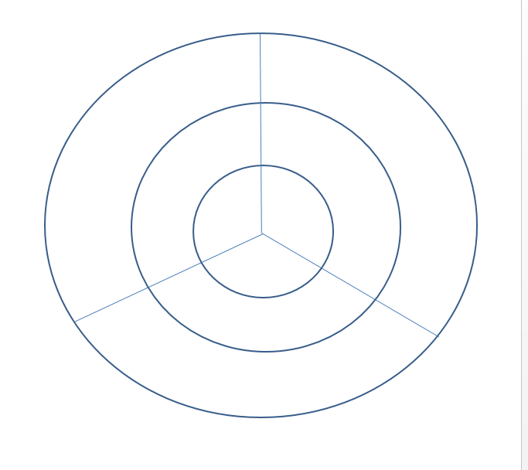
Activity
Open “4-Language Generation Activity”
Produce Graphics organiser to identify the differences between the different Generations of Programming Languages using the following method:

Slide 20
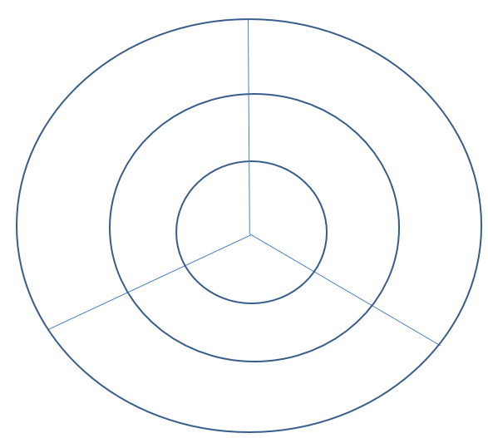
Activity 4 - Answer
Machine code:
Directly Executable by CPU
Doesn’t need a translator
0’s and 1’s
Difficult to program in, Hard to understand, Hard to De-Bug
Low Level
Needs translating into Machine Code
1-1 relationship between Assembly Instruction and Machine Code
No Translator
Assembler
1st
2nd
High Level
Easier for programmer to understand,
de-bug and write
1-Many relationship
Use’s English like Key words
3rd
Compiler / Interpreter

Slide 21
Plenary
Programming Parliament
Split class into groups
Each group is given a generation of programming language (1st, 2nd or 3rd)
They have 10 minutes to prepare an argument as to why their generation is best
Students then vote on which argument ‘won’ at the end of the debate

