Slide 1
Computer System
1.8 Legal, Ethical and Environmental Issues
Mr A Jalloh ICT/Computing@MCA

Slide 2
Big Picture
Why so much development is occurring?
Does this development have any impact on our environment and does it pose any issues to our privacy?

Slide 3
Regulation
IT systems store vast amounts of data about individuals.
If this data is not correct then there may be serious consequences:
If credit information is incorrect, then there may be problems obtaining a mortgage or bank account.
If an individual is associated incorrectly with a crime, then obtaining employment may be impossible.
Mr A Jalloh Computing@MCA

Slide 4
Regulation
If data is lost or stolen then there may well be issues with identity theft:
Following a security breach at an American data broker in 2005, a Connecticut salesman had his identity stolen. The thief bought cars, motorcycles, furniture and other items under the salesman’s name over four months, spending $265,000.
The victim has spent over 2,000 hours trying to reclaim his life after having his identity stolen.
There are around 10 million cases of identity theft in the USA every year.
Mr A Jalloh Computing@MCA

Slide 5
Learning Intentions
Understand the rules and implications of the legislation that is relevant to computer science
Understand what privacy issue could arise through the use of technology
Keywords
Ethics
Legal Issues
Implications
Privacy
Legislation

Slide 6
Legal
Computer Science may be used to break a range of legislation
You must learn about 5 different legislations in Computer Science
The Data Protection Act 1998
Computer Misuse Act 1990
Copyright Designs and Patents Act 1988
Creative Commons Licensing
Freedom of Information Act 2000
You need to be able to discuss issues and state whether these legislations/acts would be broken

Slide 7
Activity
Find out what The Data Protection Act 1998 (DPA) and what the legislation cover
Describe the 8 principles of The Data Protection Act 1998

Slide 8
The Data Protection Act 1998
Data is valuable and must be protected, and the Data Protection Act (1998) attempts to regulate organisations that store data.
Data should:
be processed fairly and lawfully;
be obtained for a specified and lawful purpose and used accordingly;
be limited to the specified data and be adequate.
Accurate and up to date.
be kept only for as long as necessary for the specified purpose;
Processed in accordance with the “data subject’s” (the individual’s) rights.
be kept securely;
not be transferred outside the EU.

Slide 9
Activity
Find out what Computer Misuse Act 1990
Describe the four major offences covered by Computer Misuse Act 1990

Slide 10
The Computer Misuse Act 1990
The Computer Misuse Act became law in 1990 and covers four major offences:
Unauthorised access to computer material;
Unauthorised access with intent to commit or facilitate a crime;
Unauthorised modification of computer material;
Making, supplying or obtaining anything which can be used in computer misuse offences.
Mr A Jalloh Computing@MCA

Slide 11
Activity
Find out what Copyright Designs and Patents Act 1988 is and what its cover

Slide 12
Regulation
Intellectual Property
Developers spend a lot of time and money creating applications.
If people share this software then the developer will not recoup the costs of development and will not be able to continue developing software.
Estimates suggest almost half of all software is copied, costing thousands of jobs and billions of pounds in revenue.
The Copyright, Designs and Patents Act protects intellectual property by making it illegal to copy software or music, images or photographs from the web, or to copy text from web pages to use as your own work.
Mr A Jalloh Computing@MCA

Slide 13
Copyright Designs and Patents Act
Protects people’s written, dramatic, musical, film, broadcasts property
Makes it an offence to copy or distribute other people’s intellectual property without permission

Slide 14
Activity
Find out what Creative Commons Licensing is and what its cover
Freedom of Information Act 2000

Slide 15
Creative Commons Licence
Allows people with protected work to allow free distribution of the work
They may want to do this to allow say Remixing of their songs
It may be an author wants other people to edit and improve their book.
They may allow Commercial, or non-Commercial use of their work

Slide 16
Activity
Find out what Freedom of Information Act 2000 is and what the legislation covers

Slide 17
Freedom of Information Act 2000
This allows members of the public to access information that is held by public services
Public services may include:
Public Services are required to publish information under this Act
Members of the public can request information under this Act
Fire
Police
Telecommunications
Secondary Schools
Town Planning
Health Care

Slide 18
Freedom of Information Act
Investigate the types of things you could request, and where from using the following link:
https://www.gov.uk/make-a-freedom-of-information-request/the-freedom-of-information-act
What information could you/would you ask for?
Is it already published?
What would you use that information for?
Discuss what you find with the person next to you

Slide 19
Copyright Designs and Patents Act - Activity 2
4-types of licences
https://creativecommons.org/
Find out what licences you can get – and what you may use them for
Create an A4 poster on one of the licences

Slide 20
Privacy of Data
The internet means that millions of people could potentially access our data
The Data Protection Act helps to stop our data being misused… but are we always safe?
We often give away key data without realising it:
E.g. Ellie98 as a username…
May identify you as female
May suggest you were born in 1998
Activity :
Discussion: What bits of data do you put online? Could they leave you open to attack?

Slide 21
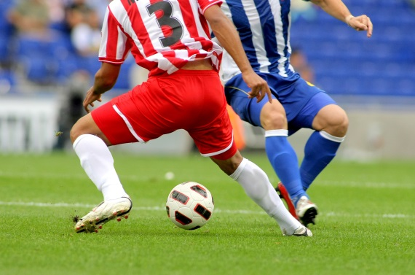
Privacy of Data – Activity 4
James has the following data available publically in different areas:
His favourite football team
User Name: JamesF1997
Location History through his phone, shows where he checks in
James has a public photo on Facebook
Metadata on the photo shows where/when the photo was taken
What dangers has James put himself in – and what could you recommend for him to do to protect against any of these risks?

Slide 22
Privacy of Data – Activity 5
Search for yourself using Google, Bing and one other search engine:
List all of the things you find… Inlcude
Videos
Pictures
Weblinks
Usernames
Read the descriptions of the first 20 searches to really see what comes up
Could you build a profile about yourself, simply through searching your name?

Slide 23
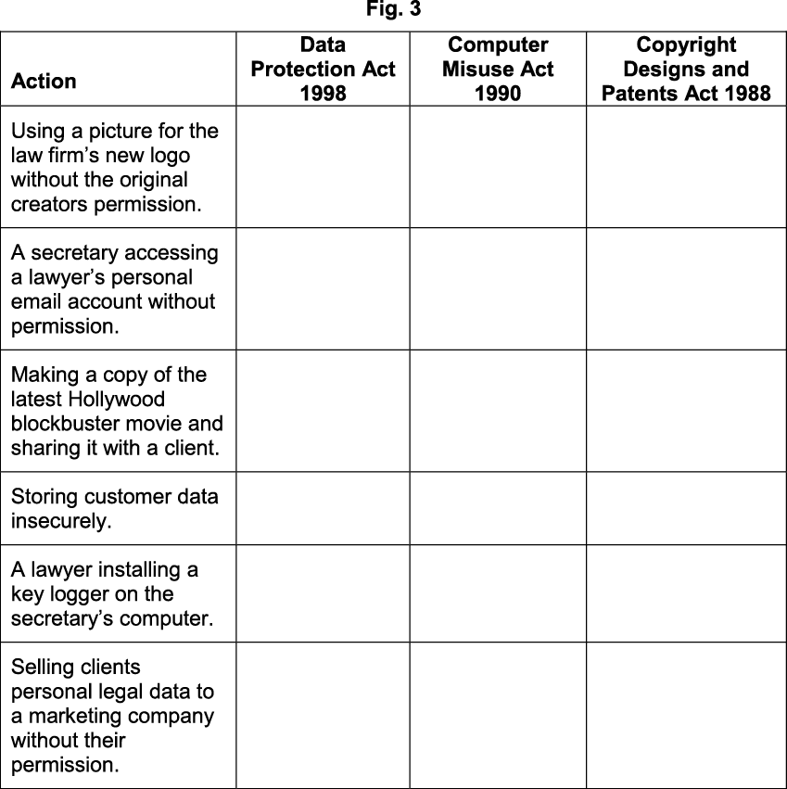
Exam Style Questions
A law firm currently use a Local Area Network (LAN) linked to a Wide Area Network (WAN). Fig. 3 lists some actions that may take place in the law firm's office. Tick (✓) one box in each row to show which legislation applies to each action.

Slide 24
Exam Style Questions - Answer

Slide 25
Exam Style Questions – Data Security
A doctor's surgery stores hundreds of patients' details on its computer network. The surgery is concerned about the security of its patients' sensitive medical data.
Staff are already required to use strong passwords to protect systems.
Explain, with reference to system security, three other ways that the surgery could protect the system. [6 marks]

Slide 26
Exam Questions – Data Security Answer 1
Firewall – This will help prevents unauthorised access to the network
Anti-malware – This will removes viruses/spyware from infecting the system
Encryption – This ensures that any intercepted data is rendered useless
User access levels – some users have restricted access to some part of the network
Network policies - Rules that define acceptable use of any devices within the network
1 mark to be awarded for each correct type to a maximum of 3 marks.
1 mark to be awarded for each correct explanation to a maximum of 3 marks.

Slide 27
Exam Style Questions – Data Security 2
A doctor's surgery stores hundreds of patients' details on its computer network. The surgery is concerned about the security of its patients' sensitive medical data.
Identify three errors that the surgery's staff could make, that may endanger the security of the network and outline a procedure that could be put in place to prevent each error. [6 marks]

Slide 28
Exam Questions – Data Security Answers 2
Brings in files via any medium such as USB, CD/DVD ROM
Allowing/ not stopping external devices being used on the network
Downloading infected files from the internet
Not blocking/restricting access insecure websites
Allowing physical access to the surgery's network
Not locking of doors/key cards/any physical security procedure
Sending/sharing sensitive data with third parties
Not blocking/restricting access to USB ports/email/internet/printing
1 mark to be awarded for each correct identification to a maximum of 3 marks. 1 mark to be awarded for each correct outlining of a procedure to a maximum of 3 marks.

Slide 29
Plenary
Create a Poster on one of the pieces of legislation you have covered
Include as much detail as you can
Add some pictures!
https://www.youtube.com/watch?v=eUxUUarTRW4

