Slide 1
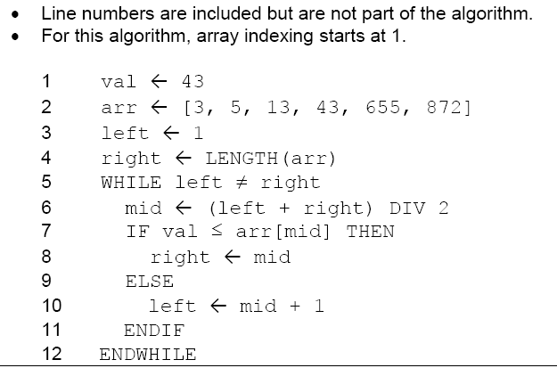

Slide 6
GCSE Computing
Algorithms

Slide 7
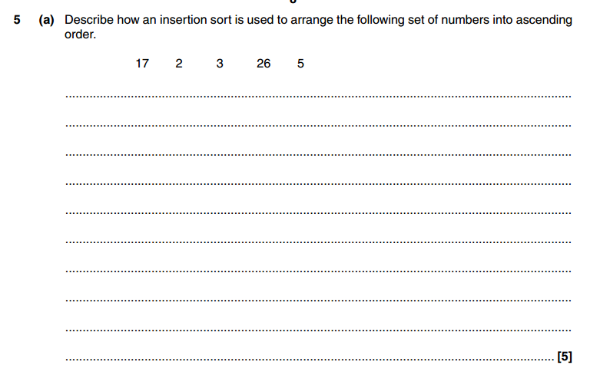

Slide 8
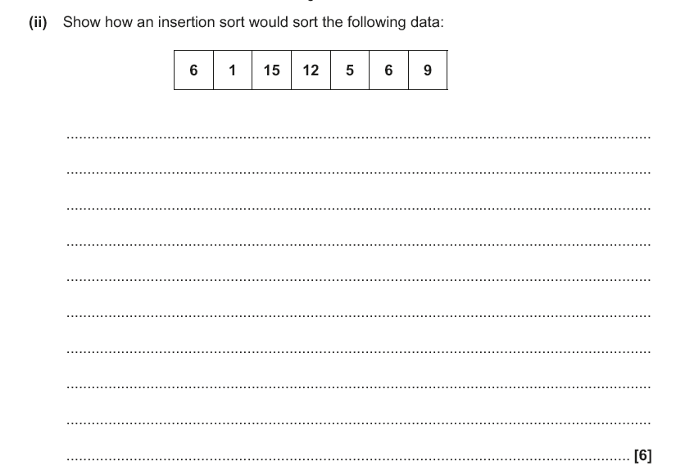

Slide 9
it is important on this question that the progression of the insertion sort is show and you have included a commentary showing what has changed from the previous iteration to show where the new data items is going to be placed

Slide 14
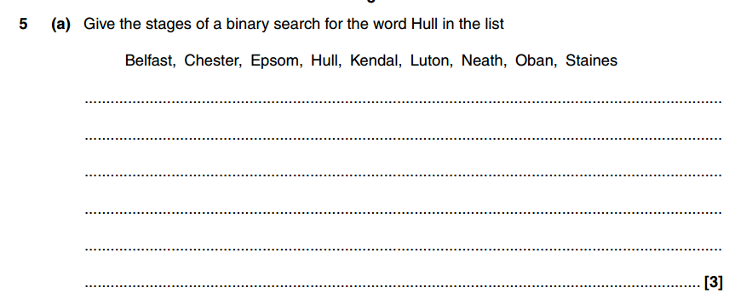

Slide 16
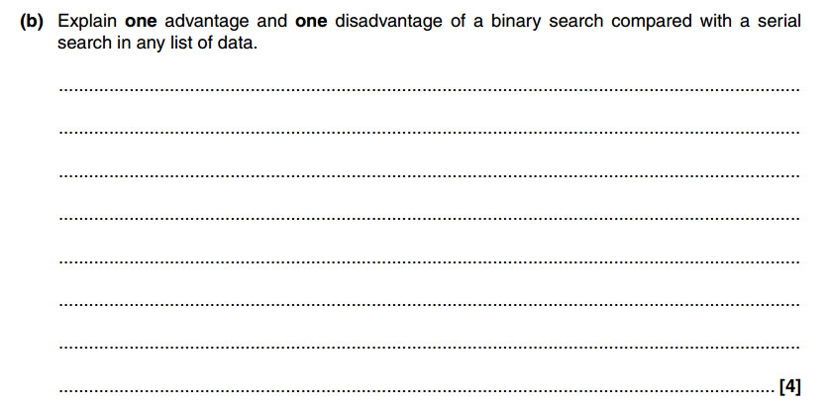

Slide 17
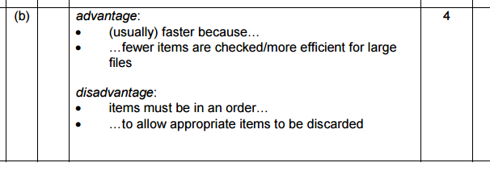

Slide 18
6 marks

Slide 19
6 marks

Slide 20
5 marks

Slide 21
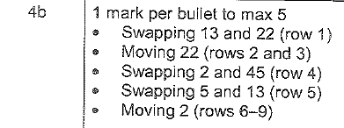
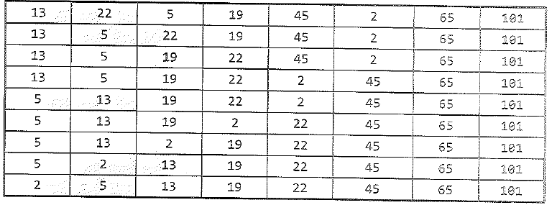
5 marks

Slide 23
4 marks

Slide 24
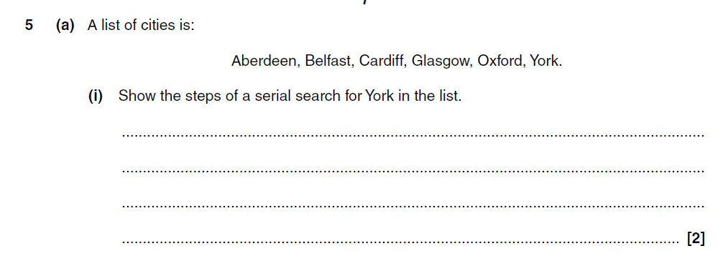

Slide 25
start at ‘Aberdeen’…
look at each word in turn/then ‘Belfast’, ‘Cardiff’ etc…
…until ‘York’ is found

Slide 26
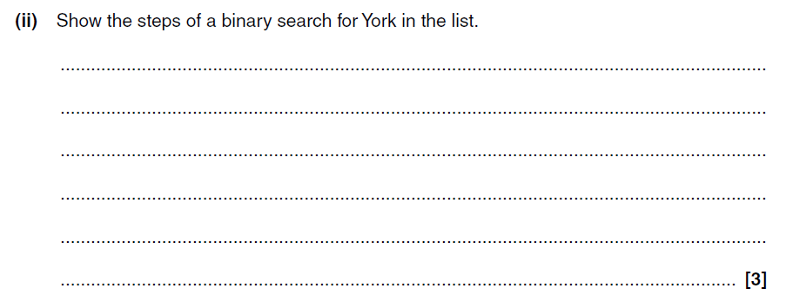

Slide 27
look at middle/‘Cardiff’/‘Glasgow’
‘York’ is in second half of list
repeated halving…
…until ‘York’ is found

Slide 29
usually) faster because…
• …half of data is discarded at each step/fewer items are checked

Slide 30
Start at bluebell
• Compare each item in turn with tulip.

Slide 31
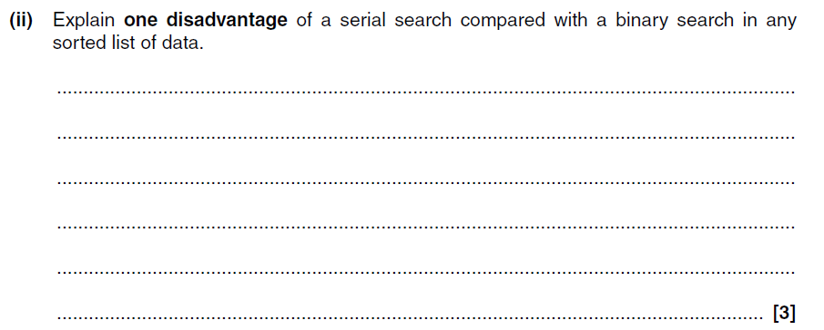

Slide 32
Three from:
• Generally slower/Faster for binary (especially for
large set of data)…
• …as all data must be checked…
• …until item found/or end of list is reached.
• Binary search halves the list each time

Slide 33
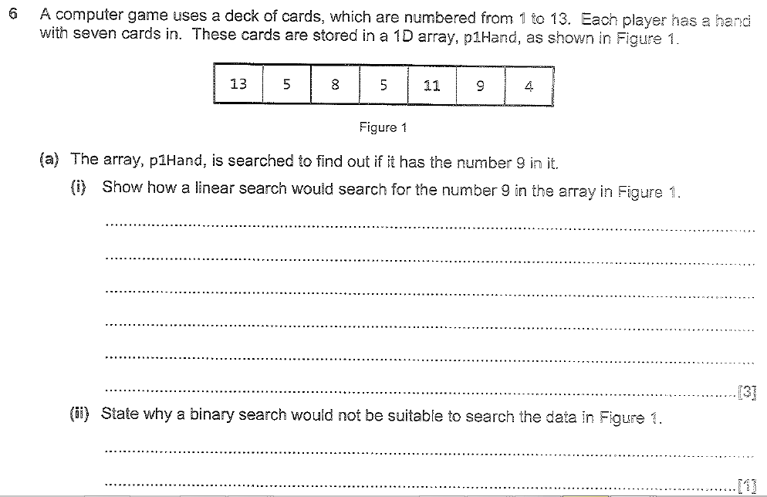

Slide 35
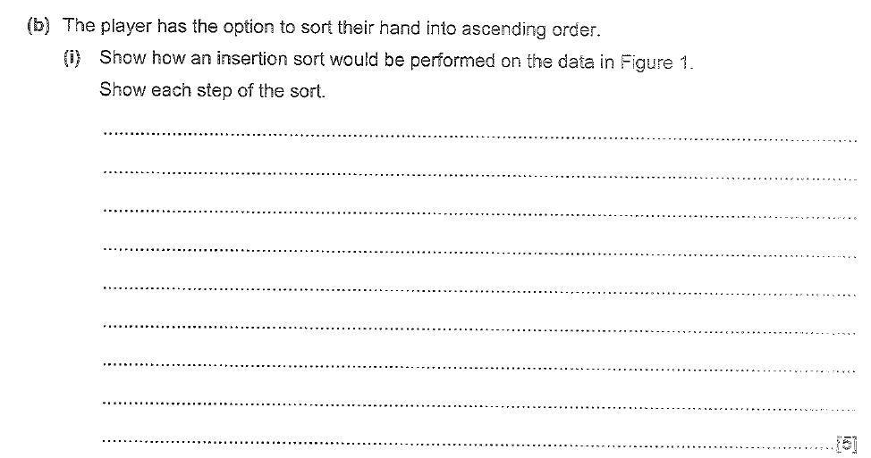

Slide 36
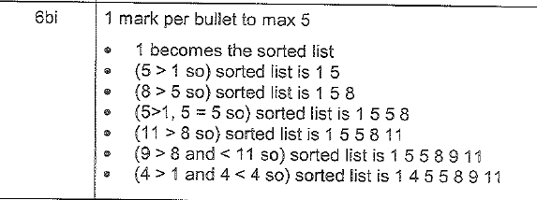

Slide 37
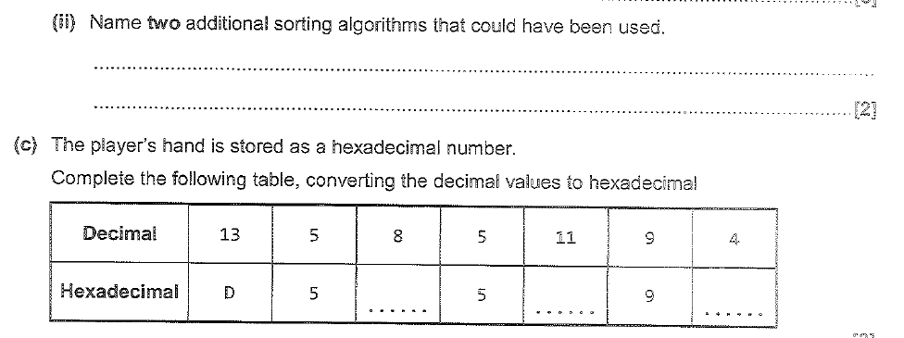

Slide 39
7 marks

Slide 40
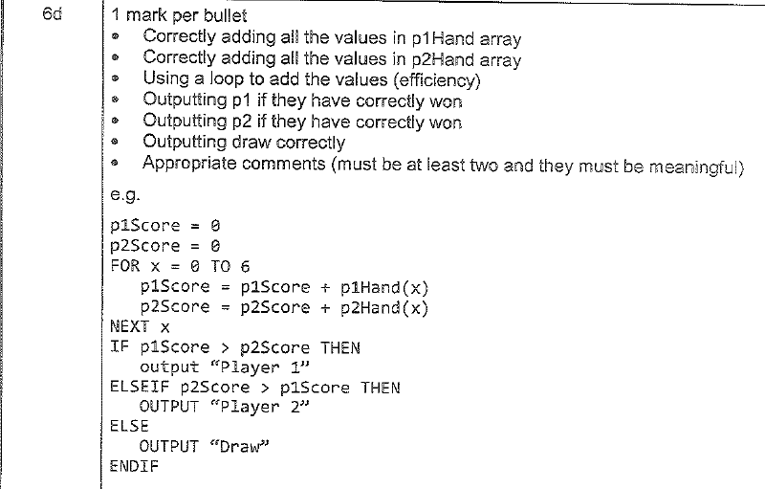
7 marks

Slide 41
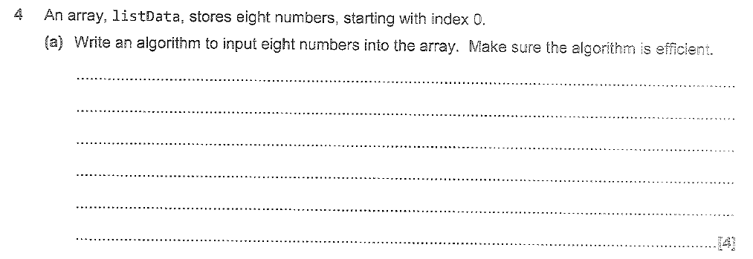

Slide 42
5 marks

Slide 43
5 marks

Slide 44
5 marks

Slide 45
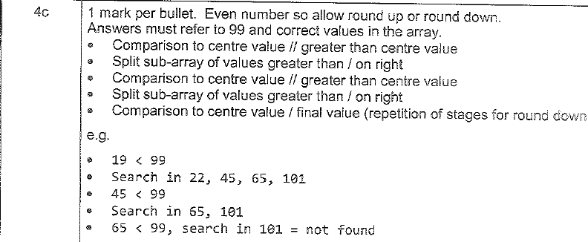
5 marks

Slide 46
4 marks

Slide 47
6 marks

Slide 48
6 marks

Slide 49
6 marks

Slide 50
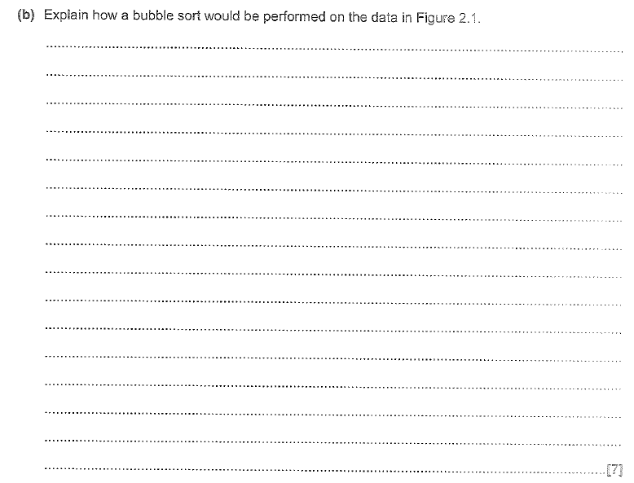

Slide 51
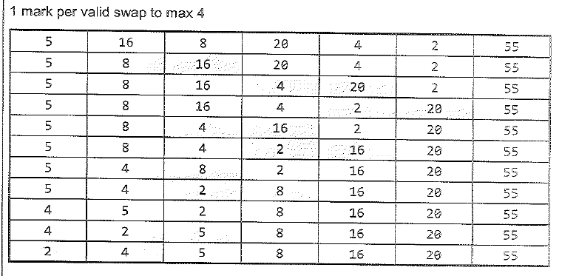

Slide 54
Regular Algorithms

Slide 55
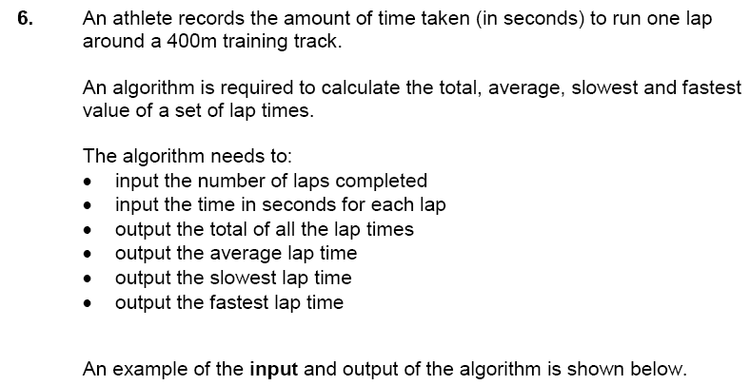
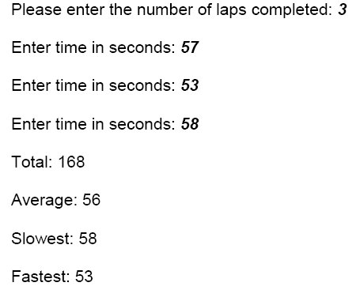

Slide 56
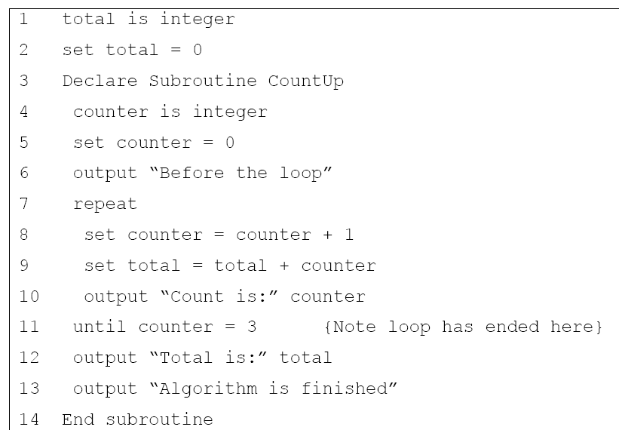

Slide 59
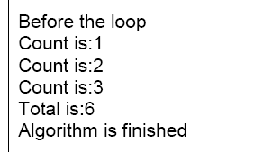

Slide 60
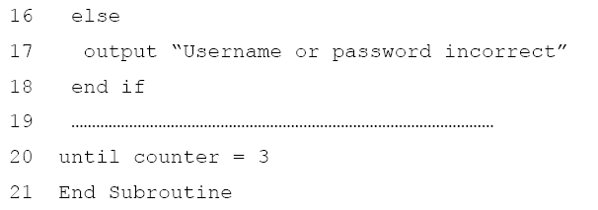

Slide 62
2 username is string
3 password is string
4 counter is integer
5 flag is boolean
6 set flag = false
7 set counter = 0
8 repeat
9 output “Type in username”
10 input username
11 output “Type in password”
12 input password
13 if username = “User1” AND password = “Pass1” then
14 output “Username and password correct”
15 set flag = true
16 else
17 output “Username or password incorrect”
18 end if
19 set counter = counter + 1
20 until counter = 3
21 End Subroutine

Slide 64
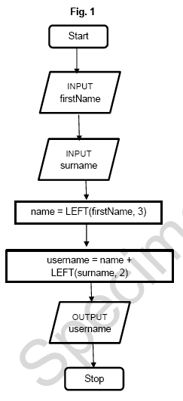

Slide 66
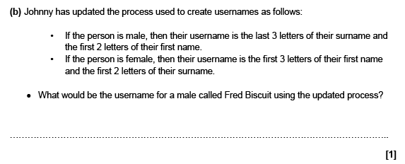

Slide 69
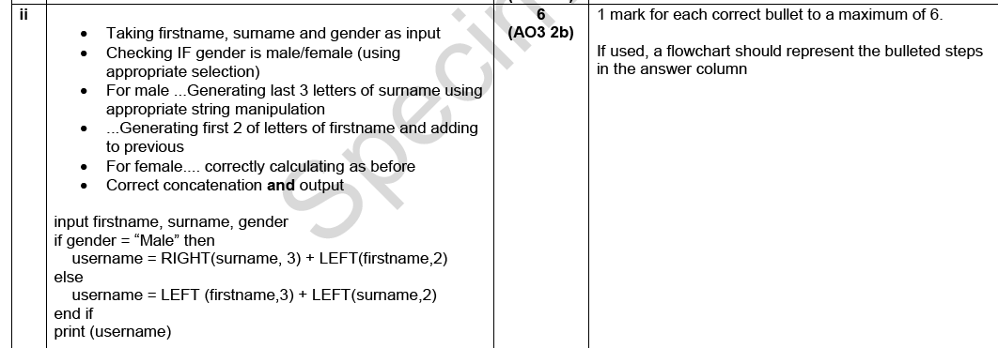

Slide 70
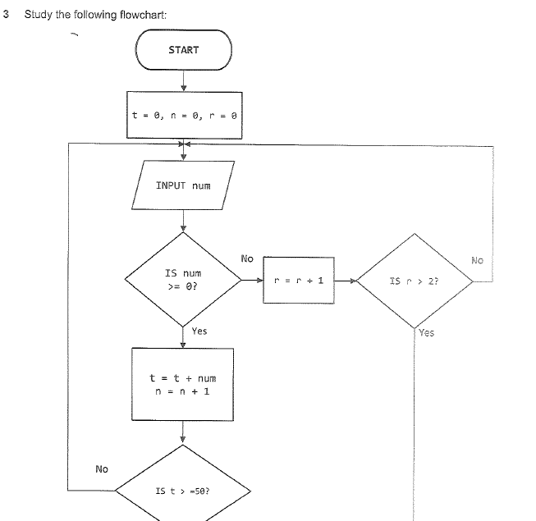
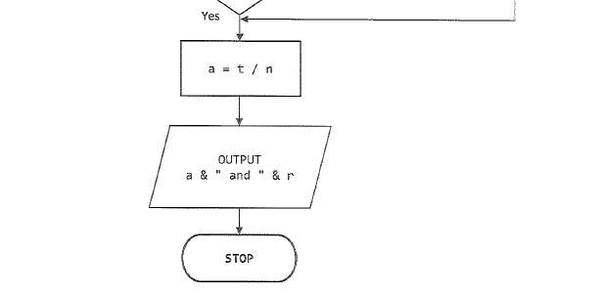

Slide 71
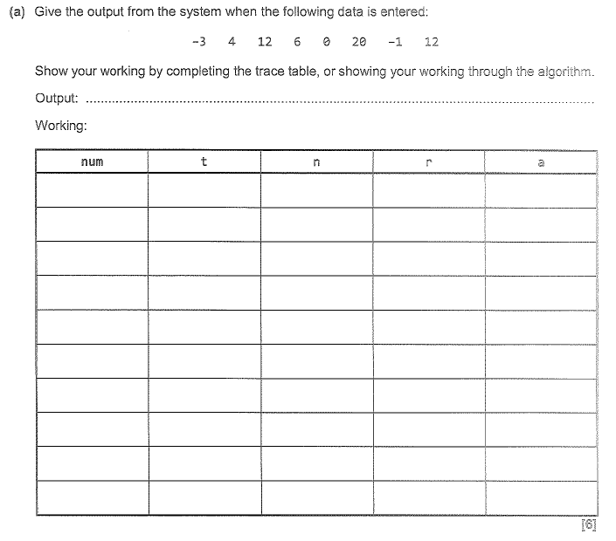

Slide 72
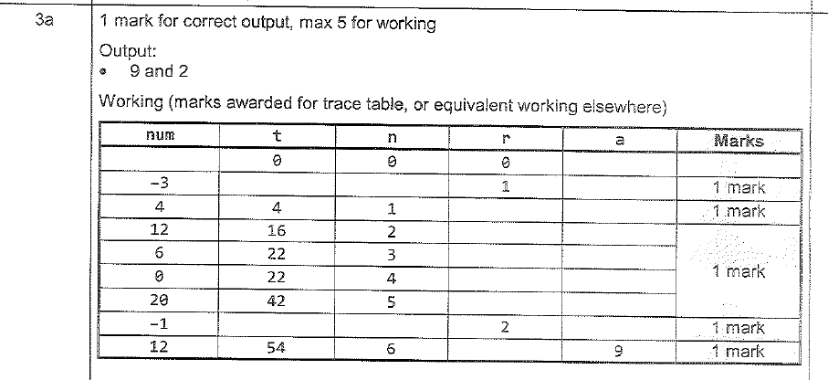

Slide 75
5 marks

Slide 76
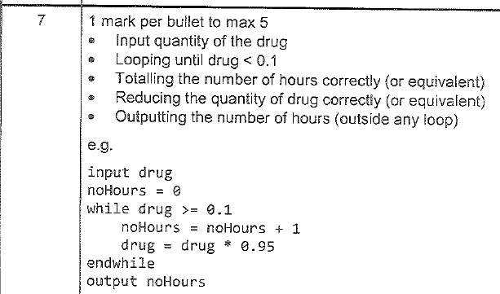
5 marks

Slide 77
5 marks

Slide 78
6 marks

Slide 79
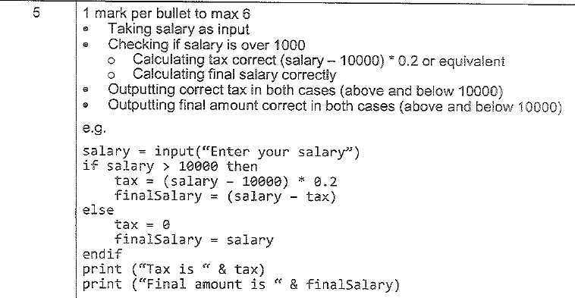
6 marks

Slide 80
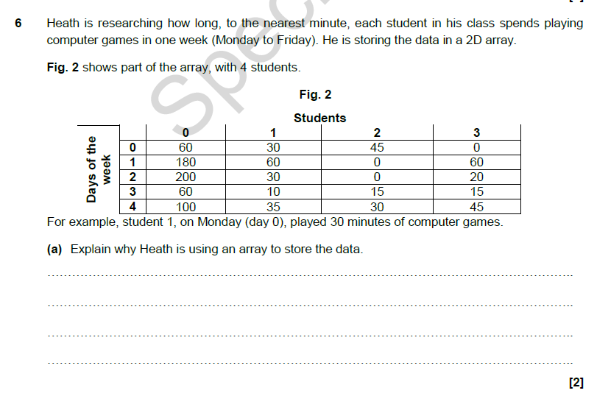

Slide 84
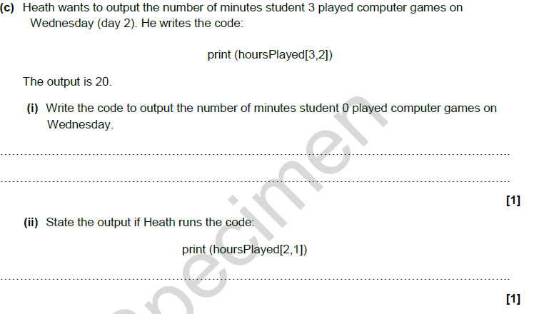

Slide 86
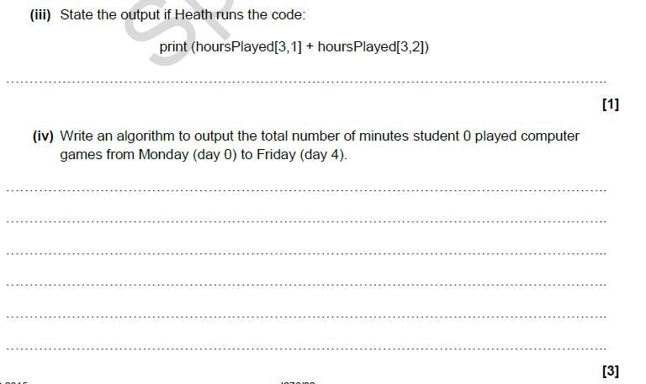

Slide 87
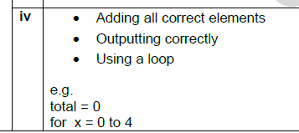

Slide 89
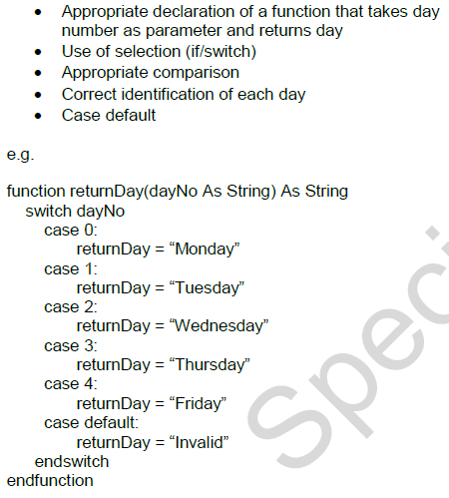

Slide 92
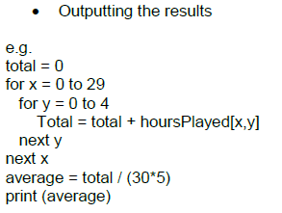

Slide 93
Question 2
Write an algorithm for which is going to simulate the game of Russian roulette. The computer will select a random number between 1 and 6. The user then has to enter 3 guesses if any of the guesses match computer number the game ends and the computer wins else the user wins. (6)

Slide 94
Question 2
Write an algorithm for which is going to simulate the game of Russian roulette. The computer will select a random number between 1 and 6. The user then has to enter 3 guesses if any of the guesses match computer number the game ends and the computer wins else the user wins. (6)
ComputerNumber := randomNumber(1,6)
FOR i = 1 TO 3
INPUT Usernumber
IF Usernumber = computerNumber THEN
OUTPUT “Computer Wins”
EXIT FOR
END IF
NEXT I
OUTPUT “User wins”
END
BEGIN
ComputerNumber := randomNumber(1,6)
won=:FALSE
K:=0
WHILE K<3 AND won=FALSE
OUTPUT “Input a number between 1 and 6”
INPUT Usernumber
IF Usernumber = computerNumber THEN
OUTPUT “Computer Wins”
won:=TRUE
END IF
k:=k+1
END WHILE
IF won=FALSE THEN
OUTPUT “User wins”
END IF
END

Slide 95
Question 3
A developer is concerned about the security of his office. He wants to create a programs that asks for a 4 digit code and if the password is correct it unlocks the door. Draw a flowchart that carries out the following steps
Asks the user for a password
Allows the user to enter a guess
Ensures that the number entered is 4 characters in length
If the password is 2001 outputs door opened
Else outputs wrong password and loops back again
The program should give the user 3 attempts to guess the user code
6 marks

Slide 96
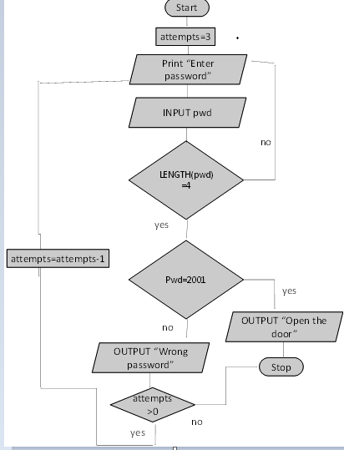
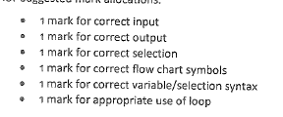
Question 3
A developer is concerned about the security of his office. He wants to create a programs that asks for a 4 digit code and if the password is correct it unlocks the door. Draw a flowchart that carries out the following steps
Asks the user for a password
Allows the user to enter a guess
Ensures that the number entered is 4 characters in length
If the password is 2001 outputs door opened
Else outputs wrong password and loops back again
The program should give the user 3 attempts to guess the user code
8 marks
Need to allocate marks also for
checking length of input and for user attempts for user attempts

Slide 97
Begin
SET DOORPASSWORD TO 2001
SET ATTEMPTS TO 3
SET CORRECT TO FALSE
WHILE CORRECT == FALSE AND ATTEMPTS > 0
INPUT USERGUESS
IF LENGTH(USERGUESS) == 4
IF USERGUESS == DOORGUESS
OUTPUT SUCCESSFUL
CORRECT = TRUE
ELSE
OUTPUT INVALID PASSWORD
END IF
ELSE
OUTPUT INVALID LENGTH
END IF
ATTEMPTS = ATTEMPTS - 1
END WHILE
HALT

Slide 98
Question 4
Produce an algorithm for a program which takes the radius of a circle as input and outputs the circumference of a circle. The circumference can be calculated by multiplying the diameter by 3.14. The diameter is equal to twice the radius. All numbers are floats (5)

Slide 99
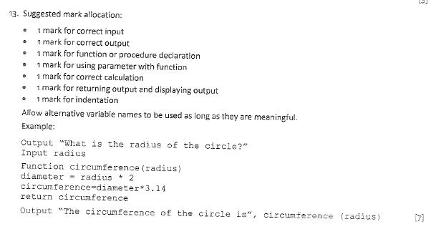
Question 4
Produce an algorithm for a program which takes the radius of a circle as input and outputs the circumference of a circle. The circumference can be calculated by multiplying the diameter by 3.14. The diameter is equal to twice the radius. All numbers are floats (7)

Slide 101
7) Write a suitable algorithm for a program which has to store a pre-determined number of numbers picked by the user. The number of numbers must not exceed 5 or be less than 0. The program must output the highest and lowest numbers of the list of numbers and output also the average and totals.

Slide 102
7) Write a suitable algorithm for a program which has to store a pre-determined number of numbers picked by the user. The number of numbers must not exceed 5 or be less than 0. The program must output the highest and lowest numbers of the list of numbers and output also the average and totals.
Begin
Set Highest to 0
Set Lowest to 0
Set Counter to 1
Input Number of Numbers
If Number of Numbers < 0 or Number of Numbers > 7
Print “out of range”
End if
For counter = 1 to Number of Numbers
Input mynumber (counter)
If mynumber(counter) > Highest
Highest = mynumber(counter)
Elseif mynumber(counter) < lowest
Lowest = Mynumber(counter)
Endif
Total = total + mynumber
Next counter
Average = total / number of numbers
Print “the total is” & total, “the average is” & average “the highest is” & highest & “the lowest is” & lowest”
End

Slide 103
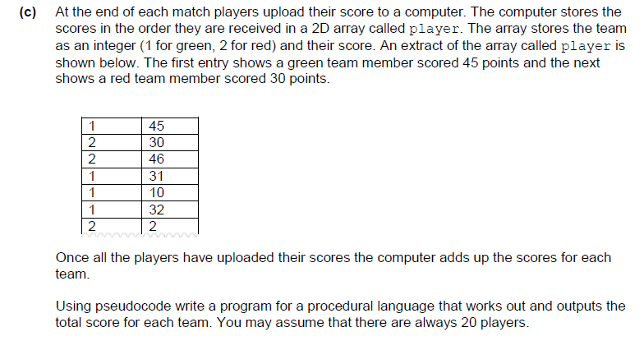

Slide 104
Team scores are initialised (prior to loop) (1).
Iterates through array correct number of times (1).
Checks the team the player is on (1).
If the player is green adds score to the greenTeam (1).
If the player is red adds score to the redTeam (1).
Outputs result in a sensible manner (1).
Up to 6 marks - 1 mark for each correct step in process. Any program with the specified functionality should receive full marks.
Example:
greenTeam = 0
redTeam = 0
for i=0 to 19
if player[i,0]==1 then
greenTeam=greenTeam+players[i,1]
else
redTeam=redTeam+players[i,1]
endif
next i
print(“Green Team: “+greenTeam)
print(“Red Team: “+redTeam)

Slide 105
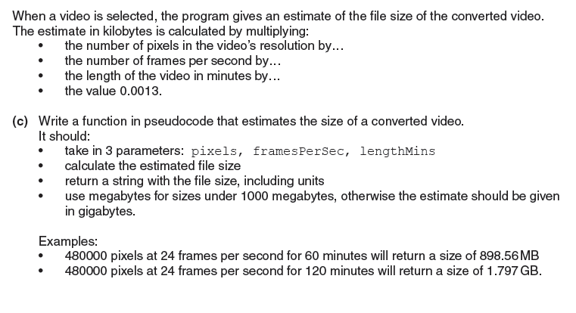

Slide 106
function takes in all three parameters and returns a string.
• Calculates file size correctly.
• Files under 1000MB quoted in MB
• Files 1000MB or over quoted in GB
Example
function estimateFileSize(pixels, framesPerSec, lengthMins)
output = ””
fileSize = pixels * framesPerSec * lengthMins * 0.0013
if fileSize > 1000000 then
fileSize = fileSize / 1000000
output = str(fileSize) + ”GB”
else
fileSize = fileSize / 1000
output = str(fileSize) + ”MB”
endif
return output
endfunction
allow 1024 or 1000 KB to MB and MB to GB.

Slide 107
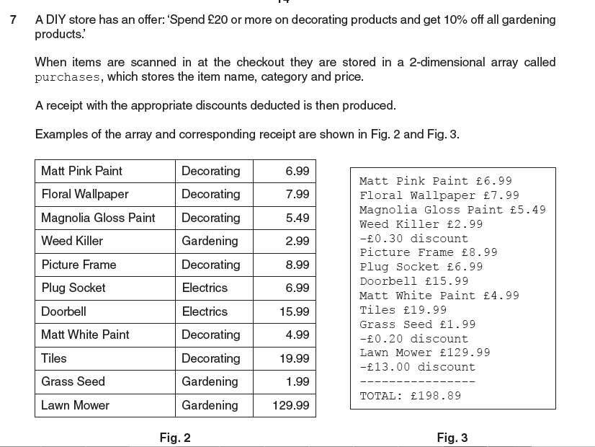

Slide 108
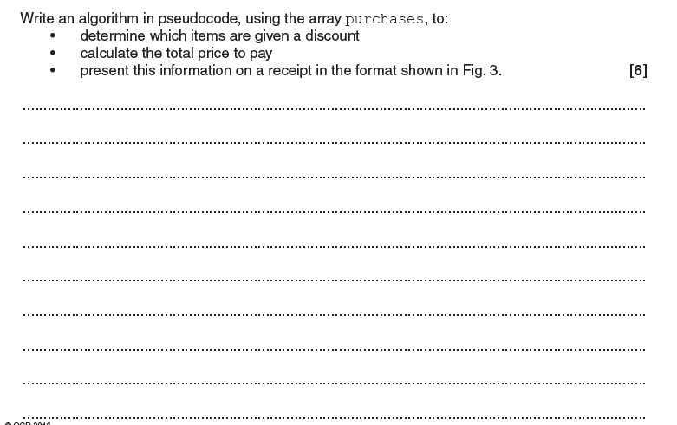
Example
decoratingSpend = 0.0
for i = 0 to purchases[].size()
if purchases[i,1] == ”Decorating” then
decoratingSpend = decoratingSpend + float(purchases[i,2])
endif
next i
total = 0.0
disc = 0.0
for i = 0 to purchases[].size()
print(purchases[i,0] + ” £” + purchases[i,2])
total = total + float(purchases[i,2])
if decoratingSpend >= 20 AND purchases[i,1] == ”Gardening” then
disc = round(float(purchases[i,2]) * 0.1, 2)
print(“-£” + str(disc) + ” discount”)
total = total - disc
endif
next i
print(“------------“)
print(“TOTAL: £“ + str(total))
Question Answer Marks Guidance
Prints receipt with item name and price on each line. (AO3.2)
• Applies a 10% discount to gardening purchases. (AO3.2)
• If decorating spend is £20 or more. (AO3.2)
• Displays each discount on the receipt. (AO3.2)
• Displays the correct total. (AO3.2)
• Correct addressing of a 2D array (A02.1)

Slide 109
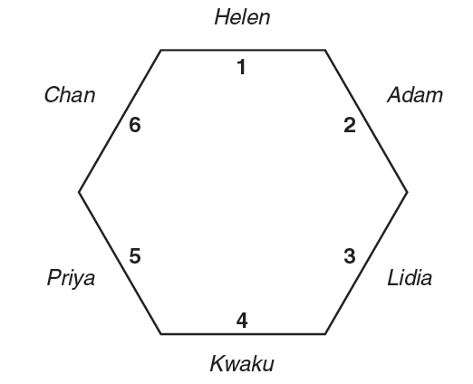
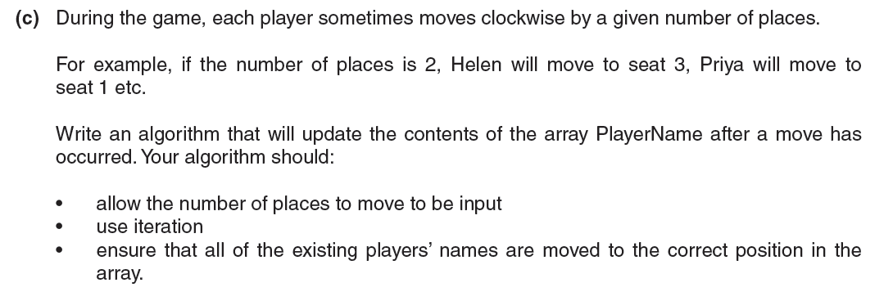

Slide 110
Award marks for:
• Input the number of places to move (e.g. Num)
• Use of temporary variable(s) or second array to avoid overwriting values in the array
• Sensible use of a loop
• ... with correct end condition
• Correctly deals with moving from position 1 (e.g. 1 + Num)
• Correctly deals with moving from position 6 (e.g. Num
INPUT Num
For i = 1 to Num
Temp = PlayerName(6)
PlayerName(6) = PlayerName(5)
PlayerName(5) = PlayerName(4)
PlayerName(4) = PlayerName(3)
PlayerName(3) = PlayerName(2)
PlayerName(2) = PlayerName(1)
PlayerName(1) = Temp
Next

Slide 112
e.g.
INPUT move
IF numbers(move) = “” then
numbers(move) = “A”
ELSE
output “taken”
ENDIF
free = 0
FOR x = 0 TO 100
IF numbers(x) = “” then
free = free + 1
ENDIF
NEXT x
OUTPUT free
e.g.
INPUT move
IF numbers(move) = “” then
numbers(move) = “A”
numberFree = numberFree - 1
ELSE
output “taken”
ENDIF
OUTPUT numberfree
1 mark per bullet
Taking the move as input
Checking if array element input is free …
…Outputting if it is taken
Writing “A” to the correct array element
Counting how many free space there are…
…Outputting the number of free spaces (if good attempt at counting free spaces
The output mark can only be awarded if a reasonable attempt at adding the free spaces have been performed
Counting how many free spaces there are can be done by either:
Looping through each element of the array and updating a variable if free/taken
Subtracting 1 each time an element is taken (this must work, i.e. there is no initialisation of the variable e.g. to 101, as that would run every time and reset the variable).
If Initialisation is used, this must be outside a loop and must be 101

Slide 114
Example:
FUNCTION ACL
Input RealAge
IF RealAge <= 2
DogYears = RealAge * 12
ELSE
ExtraYears = RealAge – 2
DogYears = 24 + ExtraYears * 6
END IF
END
Award marks for an algorithm which:
Allows real age to be input
If age <=2, multiply real age by 12
If age >2
Works out extra years (real age – 2) …
… multiply by 6
… adds 24 (for the first 2 years)

Slide 116
EXAMPLE:
INPUT Distance
INPUT Passengers
Extra = Distance – 1
CostofExtra = Extra * 2
Cost = 3 + CostofExtra
IF Passengers > 4 THEN
Surcharge = Cost / 2
Cost = Cost + Surcharge
END IF
OUTPUT COST
Award marks for:
Inputs distance and passengers
Calculates distance – 1 (or equivalent)
Calculates previous answer * 2(or equivalent)
Calculates previous answer + 3
Checks if more than 4 passengers…
… and adds 50% correctly
Outputs cost

Slide 118
Example
INPUT Length1
INPUT Length2
INPUT Length3
IF Length1 = Length2 THEN
Output “Isosceles”
ELSE
IF Length1 = Length3 THEN
Output “Isosceles”
ELSE
IF Length2 = Length 3 THEN
Output “Isosceles”
ELSE
OUTPUT “Not Isosceles”
END IF
END IF
END IF
Award marks for:
• Inputting three lengths
• Comparing lengths in pairs
• … for all three ways correctly
• … outputting “Isosceles” for all valid cases
• … outputting “Not Isosceles” for all cases and only in cases where the three lengths are different.

Slide 120
Choice = “”
REPEAT
INPUT Button
IF Button is between 0 and 9 THEN
Choice = Choice & Button
OUTPUT Choice
ELSE IF Button = CANCEL THEN
Choice = “”
END IF
UNTIL Button = OK
IF Choice is between 1 and 20 THEN
IF drink chosen available THEN
Dispense drink
OUTPUT “Collect your drink”
ELSE
OUTPUT “Drink not available”
END IF
ELSE
OUTPUT “Invalid selection”
END IF
Wait
OUTPUT “Ready”

Slide 121
6 marks

Slide 122
6 marks

Slide 123
6 marks

Slide 124
6 marks

Slide 125
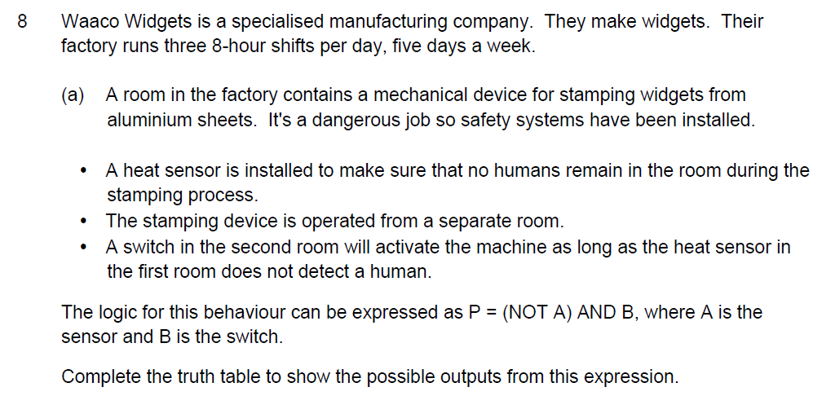

Slide 137
The manager of a cricket teams wants some information on the performance of the teams batting over the course of the last season. The team have played 15 matches and the scores of each of the 11 players in the team need to be analysed. The scores are stored in a 2D array
Write an algorithm for a program which is going to work out
1)Players total number of runs scored in the season over the 15 matched
2) Players average, highest and lowest scores
The algorithm should output the players number with the highest average score

Slide 138
highestAveragescore = 0
For i = 1 to 11
total = 0
average = 0
highestscore = 0
lowestscore = 0
for j = 1 to 15
input score
scoresArray[i,j] = score
total = total + scoresArray[i,j]
if j ==1
set highestscore to score
set lowestscore to score
end if
if scoresArray[i,j] > highestscore
set highestscore to scoresArray[i,j]
else if scoresArray[i,j<lowestscore
set lowestscore to scoresArray[i,j]
end if
average = total /15
output average score for player i is str(Average)
if i = 1
set Average to highestAveragescore
set playerpos to j
if Average > highestAveragescore
set highestAveragescore to average
set playerpos to j
end if
end for
print("the player with the best average is "+str(playerpos) "+ the best average was highestAveragescore )

Slide 139
PrimeMinister(Index) | Years in Office | Number of terms
1 | 3.1 | 1
2 | 2 | 1
3 | 7 | 2
4 | 1 | 1
5 | 8 | 3
6 | 4 | 1
7 | 3 | 1
8 | 11 | 3
9 | 6.5 | 2
10 | 10 | 3
11 | 3 | 1
12 | 6 | 2
13 | 1.5 | 2
The present Queen has been on the throne since 1952 making her the longest reigning monarch in British History. During her time she has had 13 Prime Ministers serve under her the details of their stay in office are stored in a 2 d array PMS. Write an algorithm which will output the Prime Minister who served the longest and shortest and shortest time in office.

Slide 140
ArrayPMS(12,2)
PMLongestYears = 0
PMShortestYears =0
PMMostTerms =0
PMLeastTerms =0
for i = 0 to 12
if i = 0
PMLongestYears = ArrayPMS(i,0)
PMShortestYears = ArrayPMS(i,0)
PMMostTerms = ArrayPMS(i,1)
PMLeastTerms= ArrayPMS(i,1)
end if
if ArrayPMS(i,0) > PMLongestYears
PMLongestYears=ArrayPMS(i,0)
else if ArrayPMS(i,0) < PMShortestYears
PMShortestYears=ArrayPMS(i,0)
end if
if ArrayPMS(i,1) > PMMostTerms
PMMostTerms = ArrayPMS(i,1)
else if ArrayPMS(i,1) = ArrayPMS(i,1)
PMLeastTerms= ArrayPMS(i,1)
end if
End for
output (PMLongestYears, PMShortestYears, PMMostTerms, PMMostTerms)

Slide 141
match | Wycombe Town FC | Away Team
1 | 2 | 4
2 | 3 | 2
3 | 7 | 4
4 | 5 | 3
5 | 3 | 5
6 | 6 | 1
7 | 2 | 3
8 | 6 | 8
9 | 0 | 5
10 | 5 | 3
11 | 4 | 6
12 | 1 | 0
13 | 6 | 3
14 | 5 | 4
15 | 4 | 1
16 | 5 | 3
17 | 6 | 3
18 | 5 | 5
The following table represents the goals scored by Wycombe Town FC during the season. These are stored in a 2d array called Scores. In the first column are the number of goals scored by Wycombe each match and in the second column are the number of goals Wycombe conceded. If Wycombe scored more goals than the opposing team they are deemed to have won and score 3 points, if the points are even then the game was drawn and 1 point is awarded otherwise the game is deemed lost and there are no points. Write an algorithms to work out the number of points Wycombe won during the seasons and the number of games won

Slide 142
teamScores(17,2)
points = 0
wins = 0
loss = 0
draw = 0
for i = 0 to length(teamScores)
if teamScores(i) > teamScores(i)
points = points +3
wins= wins + 1
else if teamScores(i) = teamScores(i)
points = points + 1
draw = draw + 1
else
loss = loss +1
end if
end for
Output(points, wins,draw "and" loss)

Slide 170
The formula for converting centigrade to Fahrenheit
Fahrenheit = centigrade * 1.8 + 32
write an algorithm as a function that will perform this calculation, the function will need to take in 1 parameter values and return the result of this based on this calculation

Slide 171
The formula for converting centigrade to Fahrenheit
Fahrenheit = centigrade * 1.8 + 32
write an algorithm as a function that will perform this calculation, the function will need to take in 1 parameter values and return the result of this based on this calculation
Function converttoFahrenheit(centigrade)
Fahrenheit = centigrade * 1.8 + 32
return Fahrenheit

Slide 172
The volume for calculating a cone is
Write an algorithm as a function that will perform this calculation, the function will need to take in 2 parameter values and return the result of this based on this calculation

Slide 173
The volume for calculating a cone is
volume = 3.14*radius ^2 *height /3
write an algorithm as a function that will perform this calculation, the function will need to take in 2 parameter values and return the result of this based on this calculation
Function calculateConeVolume(radius, height)
volume = (3.14*radius ^2) * height / 3
return volume
marks for
Creating and identifying the function name
passing in 2 parameter values
calculating the volume using these parameters
returning the volume value

