Slide 1
Networking Questions
Revision

Slide 2
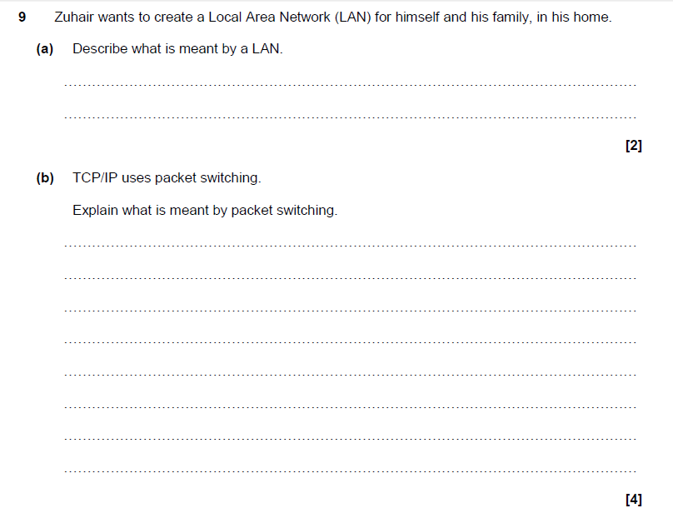
Questions

Slide 3
Questions
A group of computers/devices (1 – AO1.2) connected over a small geographical area (1 – AO1.2). The infrastructure is usually owned by the network owner
Data is split into chunks called packets (1 – AO1.1) which have labels (1 – AO1.1) including address being sent to (1 – AO1.1) and order (1 – AO1.1). Each packet is sent on the most convenient/avoidable route (1- AO1.2) meaning they may arrive in a different order to which they were sent (1 – AO1.2). Once packets arrive at receiver they are reordered (1 – AO1.2).

Slide 4
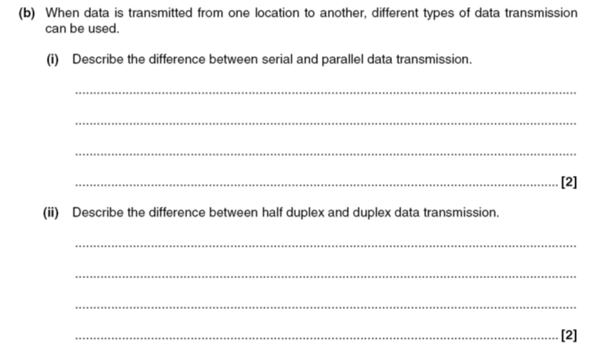
Past Examination Questions

Slide 5
Past Examination Questions
• Serial is one bit transmitted at a time/single wire
• Parallel is multiple bits transmitted at a time/many wires
• Half duplex is communication in both directions but one at a time
• Duplex is communication in both directions simultaneously

Slide 6
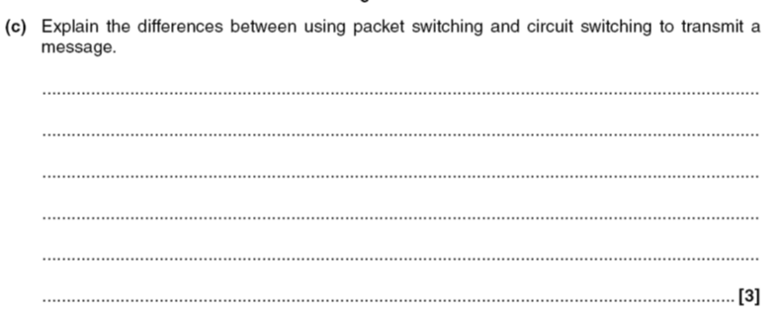
Past Examination Questions

Slide 7
Past Examination Questions
PS has no established route/CS establishes a route along which to send packets
• PS means packets being sent on individual routes/CS has packets all on same route
• PS message cannot be (easily) intercepted/CS message can because all on same route
• PS packets need to be reordered/CS packets remain in correct order
• PS maximises use of network/CS ties up large areas of network

Slide 8
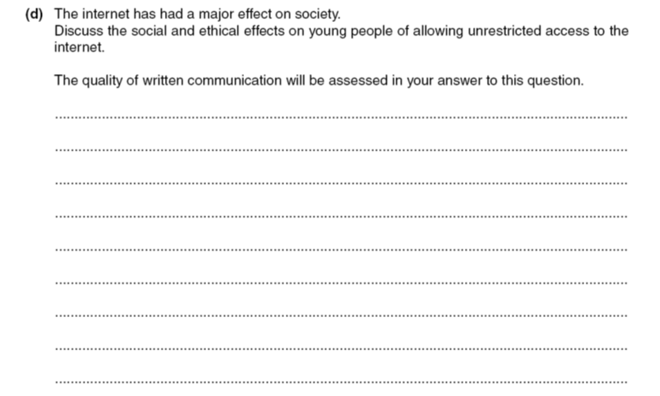
Past Examination Questions

Slide 9
Past Examination Questions
Answers may include: Social:
• Less socialising because on computer all the time
• Sees other societies which will cause friction with…
• Parents and other figures of authority
• Will raise expectations/wants
• Will increase knowledge of other societies…
• Give opportunity to learn about others/communicate directly
Ethical:
Use of other people’s work:
• Copyright…
• Plagiarism
• Use for educational purposes…
• Use to spread understanding

Slide 10
Past Paper Questions
451 2 110
2) (a) When data is transmitted between machines on a network, the data can be sent using either packet switching or circuit switching
(i) Describe what is meant by packet switching (2)

Slide 11
Past Paper Questions
451 2 110
2) (a) When data is transmitted between machines on a network, the data can be sent using either packet switching or circuit switching
(i) Describe what is meant by packet switching (2)
Packets sent onto network
• Find their own routes to destination/use different routes
• Packets must be reordered at destination/arrives in wrong order
• Packets have identity on label

Slide 12
Past Paper Question
(ii) Describe what is meant by circuit switching (2)

Slide 13
Past Paper Question
(ii) Describe what is meant by circuit switching (2)
• Route reserved before transmission...
• for the duration of the transmission
• All packets follow same route/in order
• Packets must be reassembled at destination/arrives in order

Slide 14
Past Paper Questions
(iii) Give one advantage and one disadvantage of using packet switching rather than circuit switching

Slide 15
Past Paper Questions
(iii) Give one advantage and one disadvantage of using packet switching rather than circuit switching
Advantage:
• Does not tie up a proportion of the network/Secure because impossible to intercept all packets.
• /loss of part of communication will not be fatal/if message does not arrive safely only one packet needs to be resent
Disadvantage:
• Must be reordered at destination/only as fast as its slowest packet

Slide 16
Past Paper Question
b) Describe the transfer of a file of data from a primary memory to a storage device. The quality of written communication will be assessed in your answer to this question

Slide 17
Past Paper Question
b) Describe the transfer of a file of data from a primary memory to a storage device. The quality of written communication will be assessed in your answer to this question
Points include:
Physical:
• Buffer...
• a temporary storage
• Interrupt...
• message sent to processor/control unit
• Type of communication medium
• Serial/parallel communication
Logical:
• Buffer filled by primary memory
• Processor can continue other tasks
• Buffer emptied to storage
• Interrupt sent to request buffer is refilled
• Interrupt priority compared with priority of present task
• Use of priority to assign interrupt with position in queue
• Data arranged in packets/blocks
• Data error checked on arrival
• Method of error checking explained

Slide 18
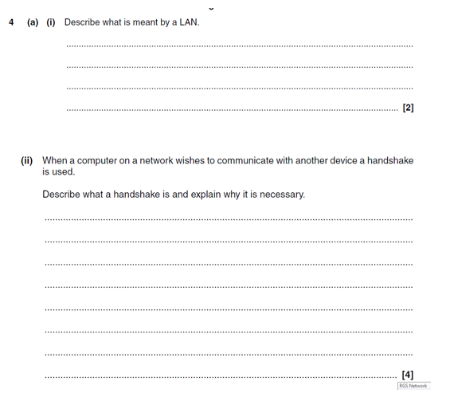
Past Paper Questions

Slide 19
Past Paper Questions
Local area network.
Computers linked together over a small area.
Shared devices.
May be hard-wired or wireless.
Local area network.
Computers linked together over a small area.
Shared devices.
May be hard-wired or wireless.
The exchange of signals between devices to signify that they are ready for communication.
• A number of rules/protocol will be agreed prior to the communication beginning...
• ...example given eg agree on baud rate.
• Necessary because without agreement on rules the two devices cannot understand each other’s signals.
• One device may not be ready for communication eg may be switched off.

Slide 20
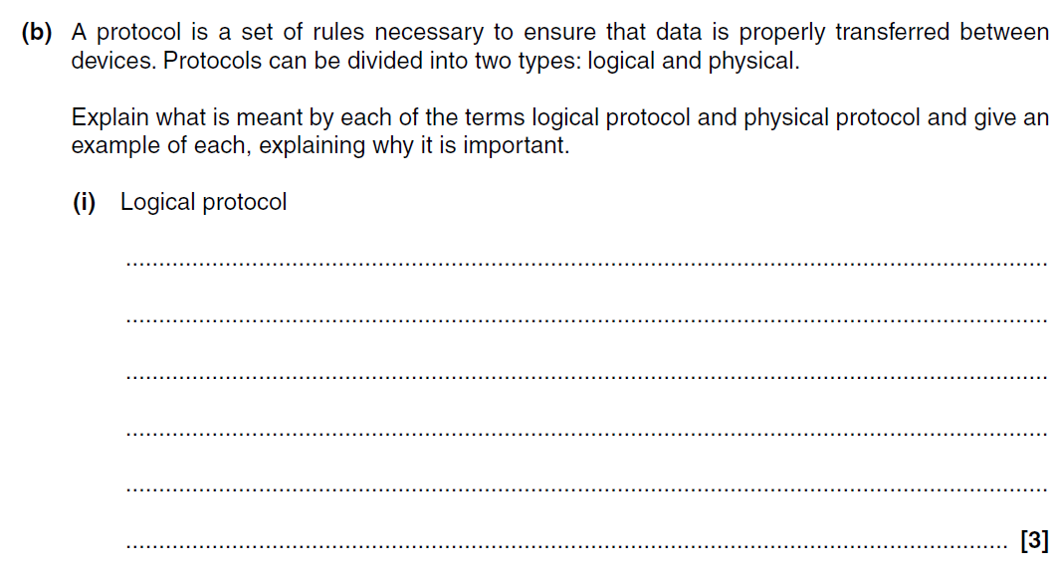
Past Exam Questions

Slide 21
Past Exam Questions
The rules which the data has to follow.
• Suitable example eg baud rate.
• Suitable explanation eg if one device transmits data at a different rate than it is received, the bits in the data will be mixed up.
Acceptable: TCP/IP/FTP/HTTP for second mark with explanation for third mark.

Slide 22
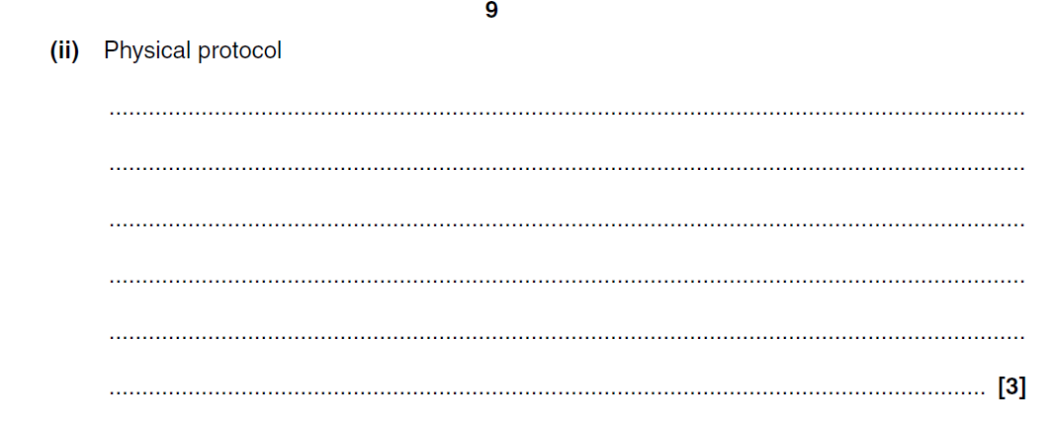
Past Paper Questions

Slide 23
Past Paper Questions
The rules that are used to govern the methods used to set up the communication / medium of communication.
• Suitable example eg what frequency will be used in a wireless network.
• Suitable explanation eg because if different frequencies are used then the receiving device will never receive the (communication as it will be listening to different parts of the frequency which do not contain the communication).
Acceptable: Serial / Parallel
Acceptable: Duplex / half duplex / simplex
Not: ‘What can be touched’

Slide 24
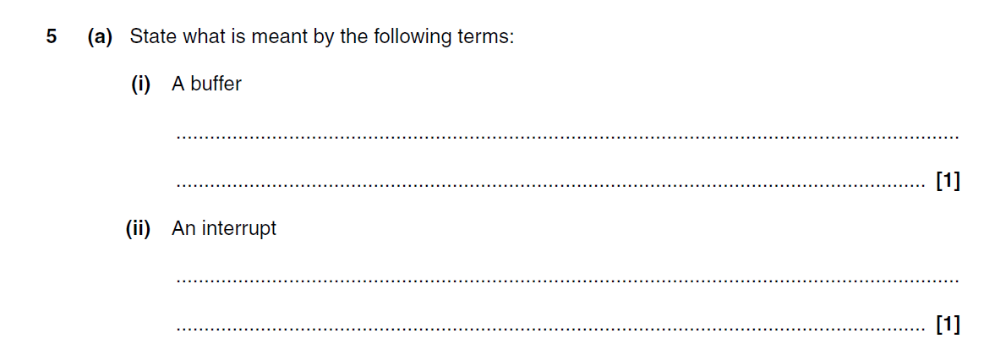
Past Exam Questions

Slide 25
Past Exam Questions
A small area of computer memory / temporary storage / holds data.
A signal or message sent to the processor/It stops the current activity of the processor.

Slide 26
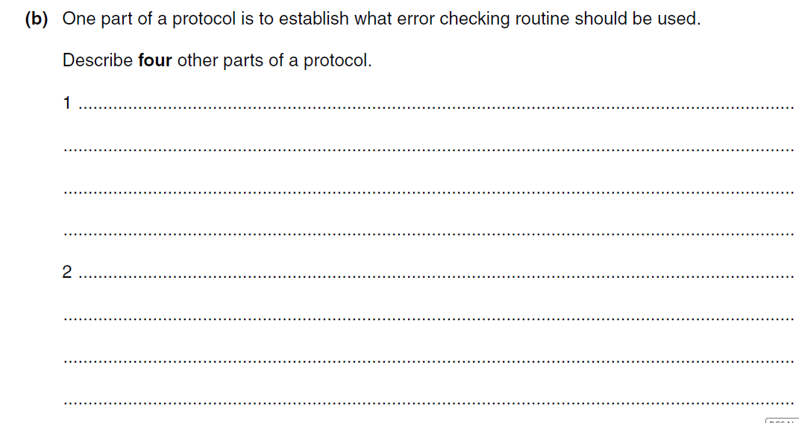
Past Examination Questions

Slide 27
Past Examination Questions
A set of rules…
• …to allow communication between devices
Bit rate/Baudrate
• …to ensure transmitting and receiving devices are both using the same rate/states the rate at which data is transmitted
• Character set to be used
• …if the sets are different then the receiving device will misinterpret the data that is sent/decide whether to use ASCII or Unicode or …
• Software used
• …to ensure that the data is compatible with the software
• Form of data encryption
• …to allow data to be decrypted at destination

Slide 28
Past Examination Questions
Type of transmission to be used
• …eg parallel or serial/duplex or simplex/ frequency of wireless transmission/packet size
• Type of medium used to carry the transmission
• …eg single/multiple wires or cable/wireless or copper/fibreoptic or radio/microwave or frequency if wireless transmission used

Slide 29
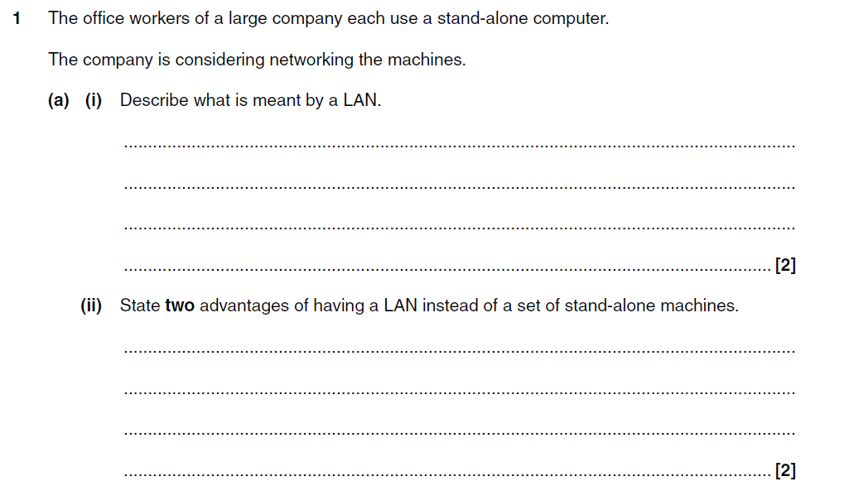
Past Examination Papers
Local Area network
• (Over) a small geographical area
• Use of hard-wiring/ wireless communication
Communication between machines/workers
• Any machine can be used
• Easier to maintain/add/delete software/files
• Sharing of peripheral devices/software/data
• Monitoring of workers
• Simplifies backup procedures

Slide 30
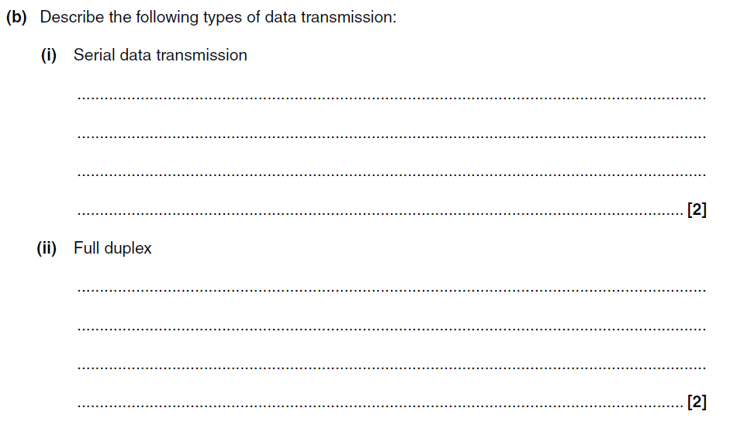
Past Examination Questions

Slide 31
Past Examination Questions
Individual data bits sent…
• …one after another along the communication medium/one wire/as a single stream
Communication can be done in both directions…
• …at the same time

Slide 32
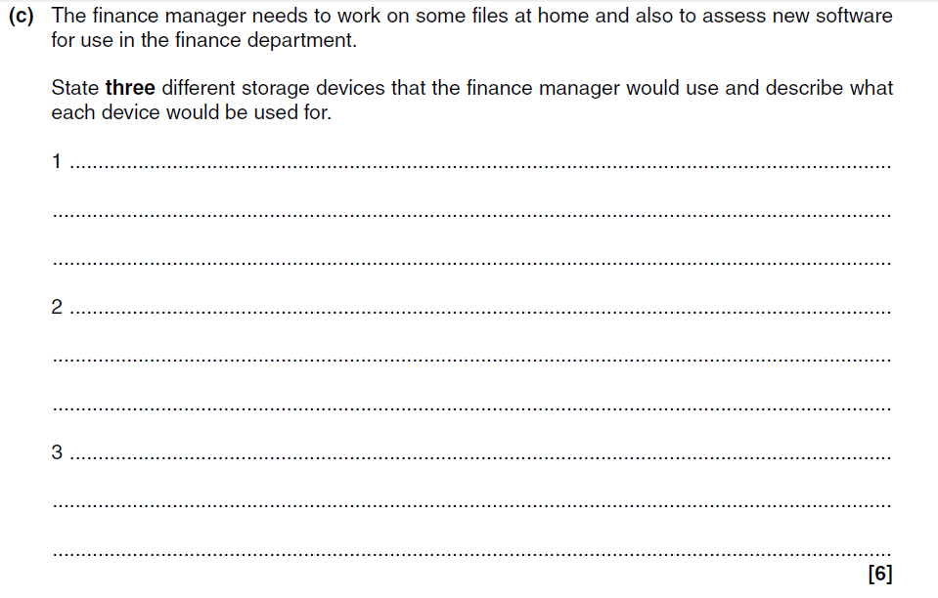
Past Examination Questions

Slide 33
Past Examination Questions
Hard drive…
• …to store files and software
• Removable hard drive…
• …to store archive of files
• CDROM/DVDROM reader…
• …for the importation of software
• Memory stick/solid state device…
• …to allow transport of materials between office and home
• CD(R)/DVD(R) (reader/writer…)/optical disk
• …to store back-up of files/software/portability of files
• Cloud storage…
• …to make files available to others in the dept/from anywhere/on any
device/backup
Mark as three pairs of marks. Second mark is
dependent on getting the first
Uses are all examples, other sensible uses
should be credited.
Uses can be generic, but if specific they need
to be about the finance manager
Not: USB on its own
Only allow the same reason once e.g. ‘to store
files’

Slide 34
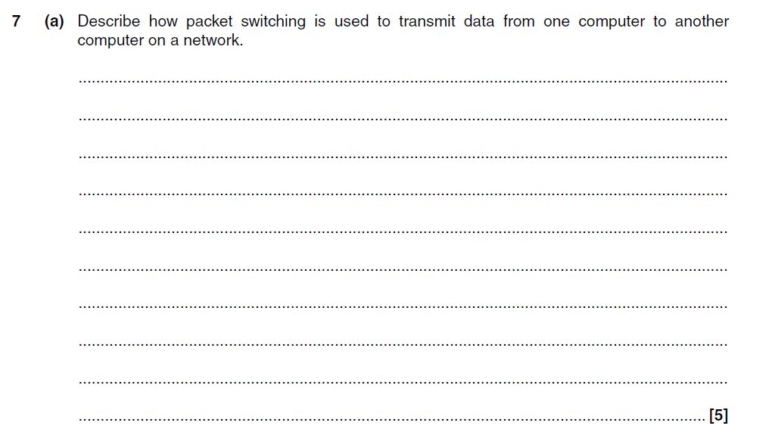
Past Examination Questions
• Data is split into equal sized blocks (called packets)
• Each packet has a header of information( including destination
address and the place of the packet in the complete message)
• (Each packet is placed on the network and) each may travel by a
different route
• (At each node on the network the destination address is read and
the) best route is found
• Packets need to be reordered at the destination

Slide 35
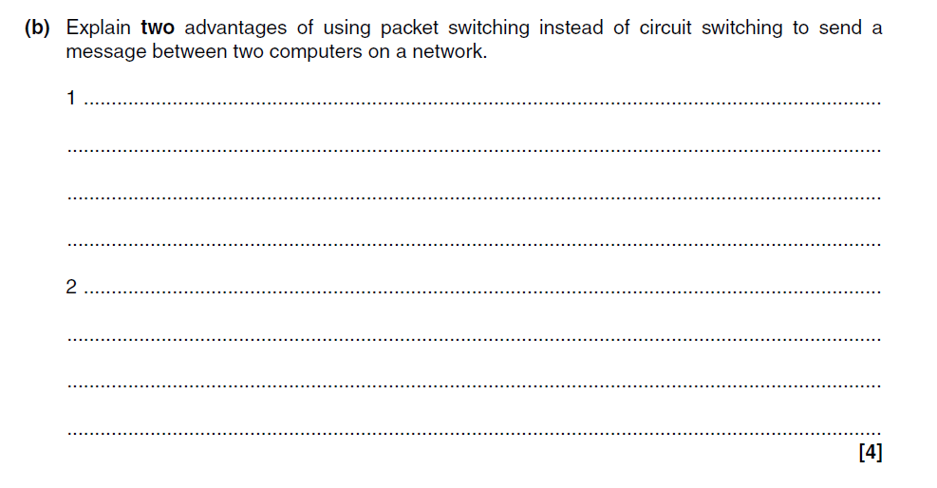
Past Examination Questions

Slide 36
Past Examination Questions
Transmission is safer from interception…
• …because it is impossible to intercept all the packets as they use
different routes
• Very efficient use of network…
• …as each channel only used for short time/ does not tie up a part of
the network
• If there is an error then only a small, identifiable, part of the data is
affected…
• …this can be retransmitted easily

Slide 37
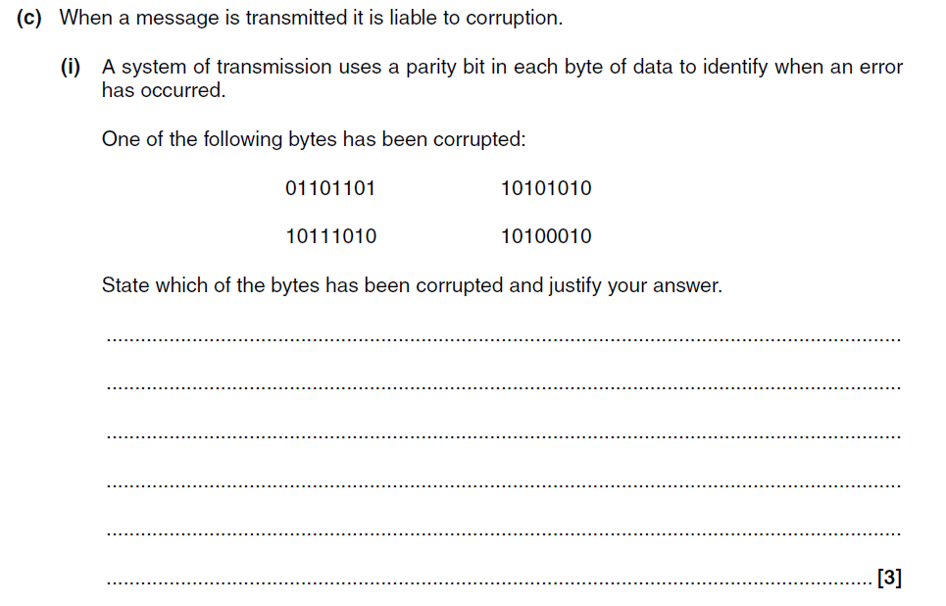
Past Examination Questions

Slide 38
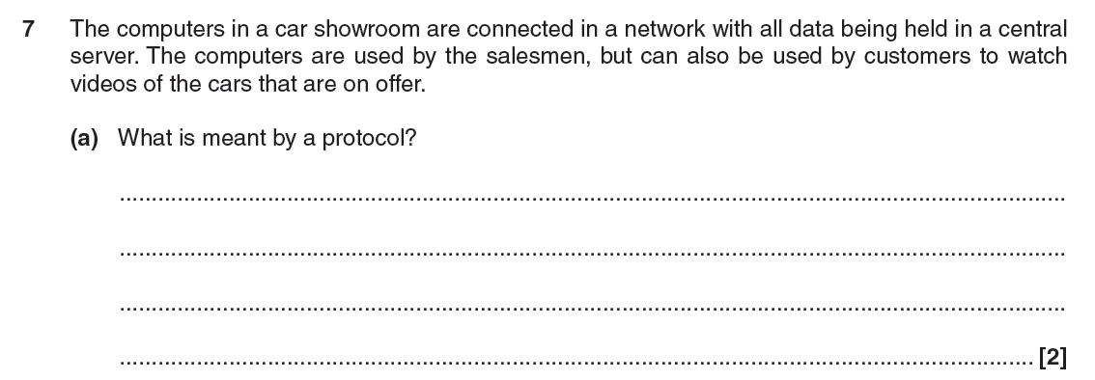
Past Examination Questions

Slide 39
Past Examination Questions
A set of rules…
-…to govern data transmission (between devices)

Slide 40
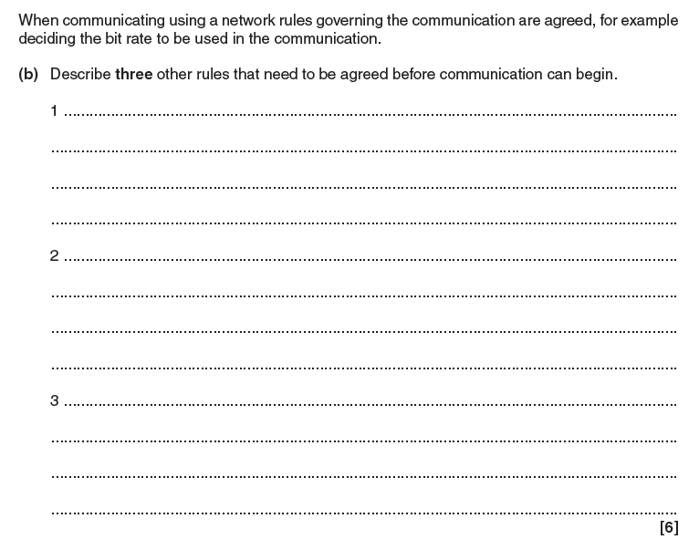
Past Examination Questions

Slide 41
Past Examination Questions
Answers may include:
-Error correction
-odd or even parity/checksum/echoing
-Medium for communication
-Use of cable/wireless/…/type of cable for communication
-Mode of transmission
-simplex/duplex/serial/parallel
-Coding used for characters
-Whether ASCII/UNICODE/…

Slide 42
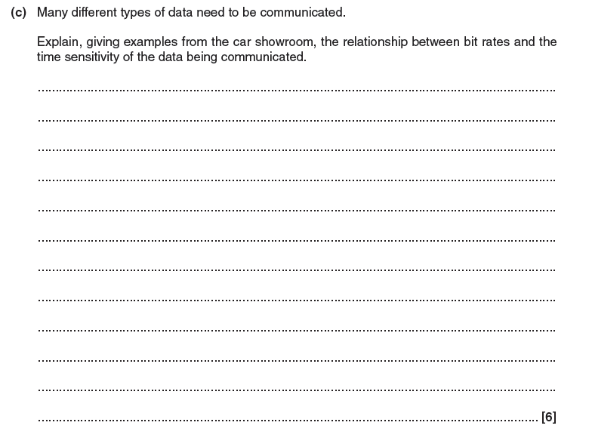
Past Examination Questions

Slide 43
Past Examination Questions
Some data does not need to be used immediately…
-…therefore does not require a high bit rate
-e.g. car sales data
-Some data needs to be used immediately…
--…otherwise loses its value
-…therefore requires a high bit rate/to avoid buffering
-e.g. streaming car videos

Slide 44
Past Examination Questions New Model

Slide 45
Past Examination Questions New Model

Slide 46
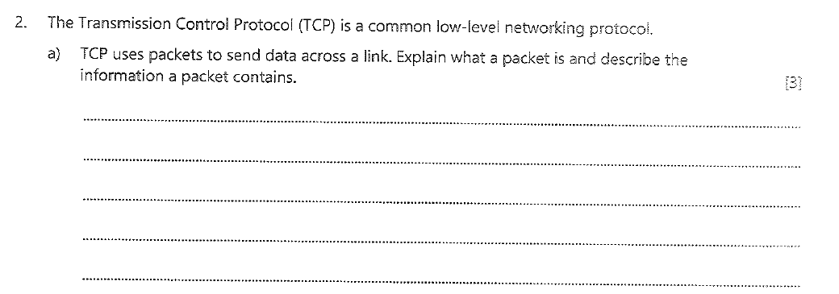
Past Examination Questions New Model

Slide 47
Past Examination Questions New Model

Slide 48
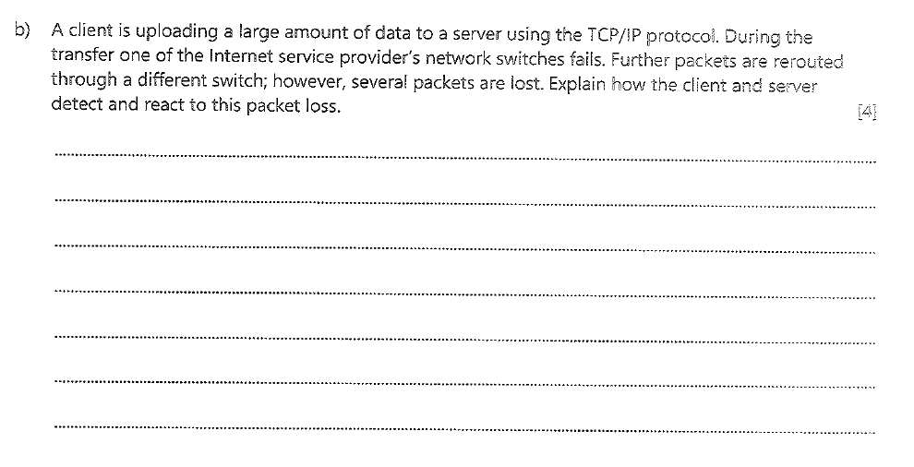
Examination Questions New Model

Slide 49
Examination Questions New Model

Slide 50
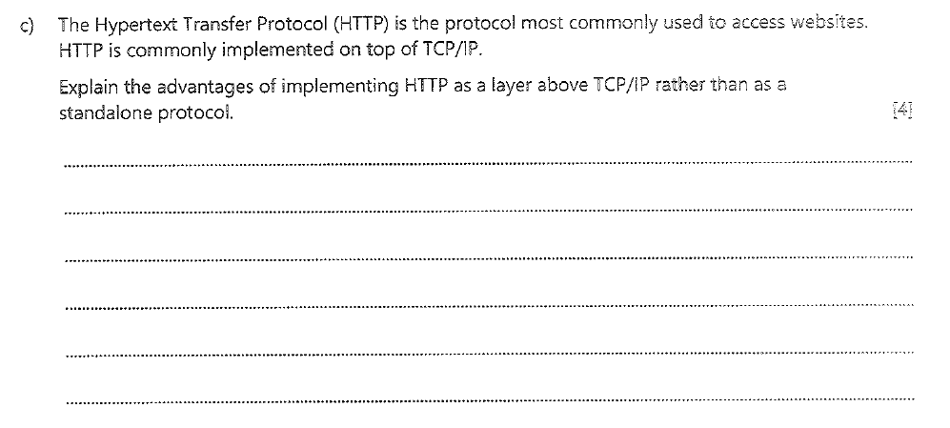
Examination Questions New Model

Slide 51
Examination Questions New Model

Slide 52
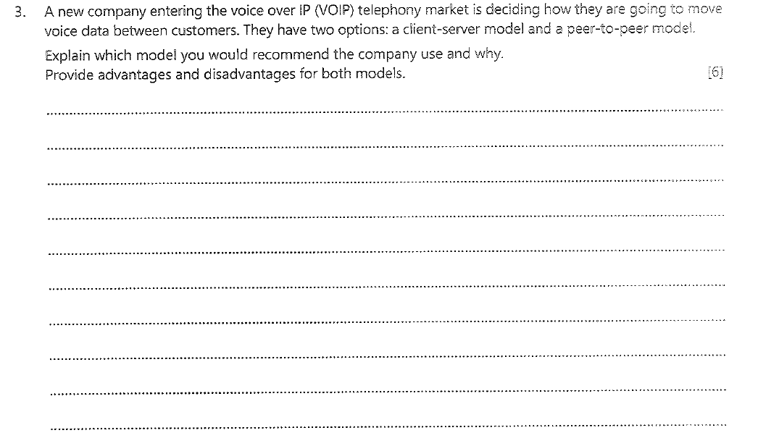
Examination Questions New Model

Slide 53
Examination Questions New Model

Slide 54
Past paper questions new models

Slide 55
Past paper questions new models
Concept that data passed up/down between layers; A by example – just one needed but must be correct NE just describing the layers in the correct order
Application layer selects appropriate protocol for the communication / protocol mentioned by example;
The role of the application layer is to interact with the user via appropriate application software (eg web browser / ftp client) or the users system (eg synchronising files);
Transport layer establishes end to end communication // Transport layer establishes a virtual path;
Transport layer deals with error control (acknowledgements\retransmission) / segmentation / flow control
Communication split into packets by transport layer // re-assembled by receiver;
Packets are numbered by transport layer;
Transport chooses a Port number for client and destination;
Network/IP layer supplies appropriate IP addresses for source and destination (when sending packets);
Network/IP layer involved with packet routing / moving datagrams to the next network node (router);
Combination of IP address and Port = Socket / described;
Link layer receives packets from network layer and adds MAC addresses; A hardware address for BOD
Link layer moves packets between 2 internet hosts;
Link layer adds frame header and footer to packets;
Link layer deals with physical connection/cabling;
A Link layer includes network card / drivers;
Network/IP layer strips IP addresses (if receiving packets) // Link layer strips MAC address (if receiving);

Slide 56
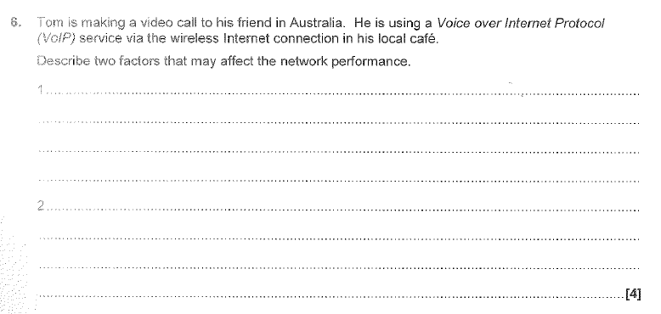

Slide 58
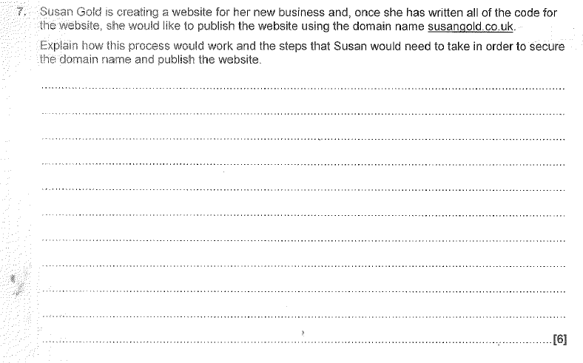

Slide 59
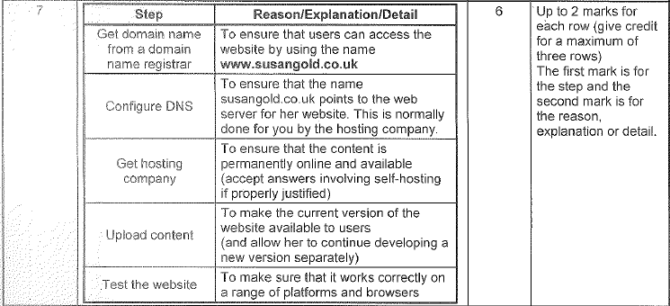

Slide 60
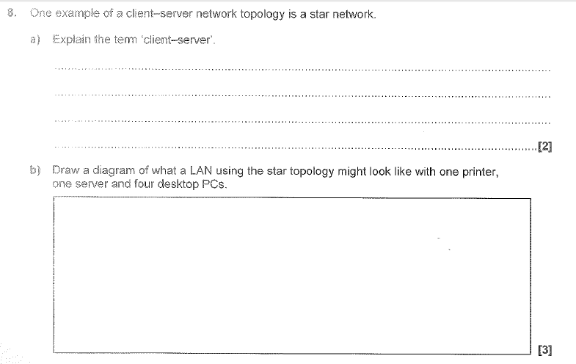

Slide 61
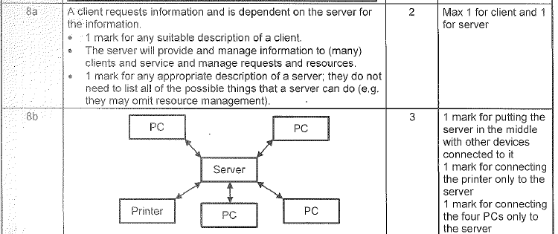

Slide 62
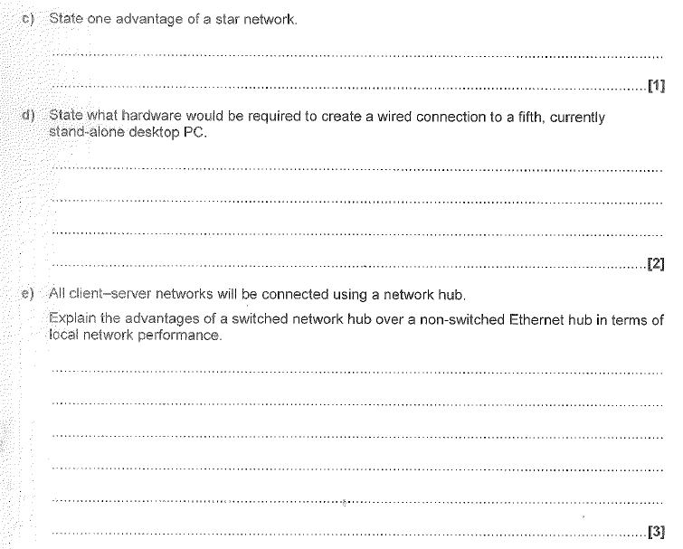

Slide 65
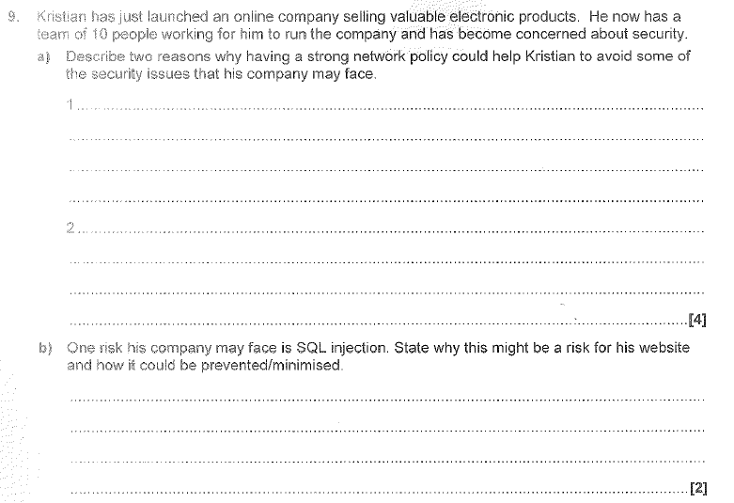

Slide 66
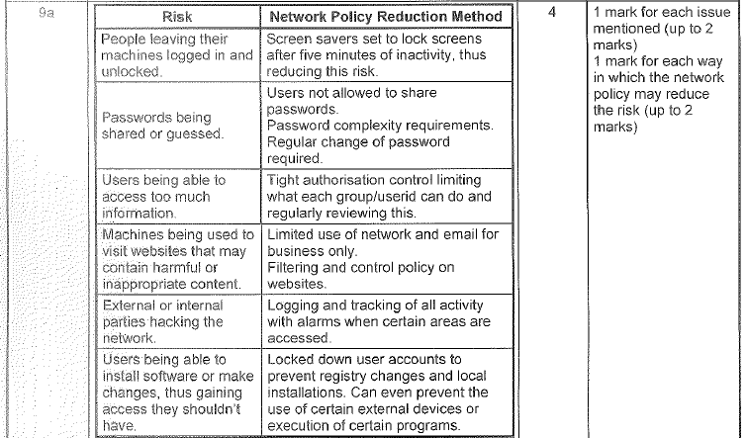

Slide 69
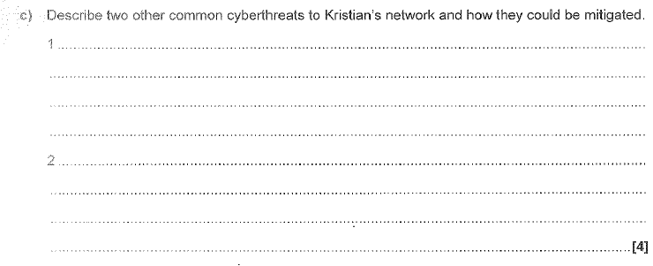

Slide 71
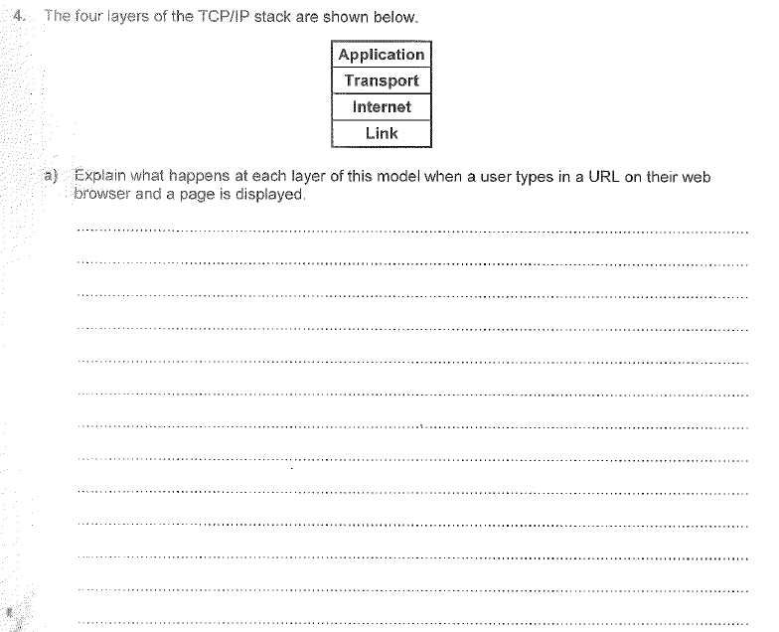

Slide 73
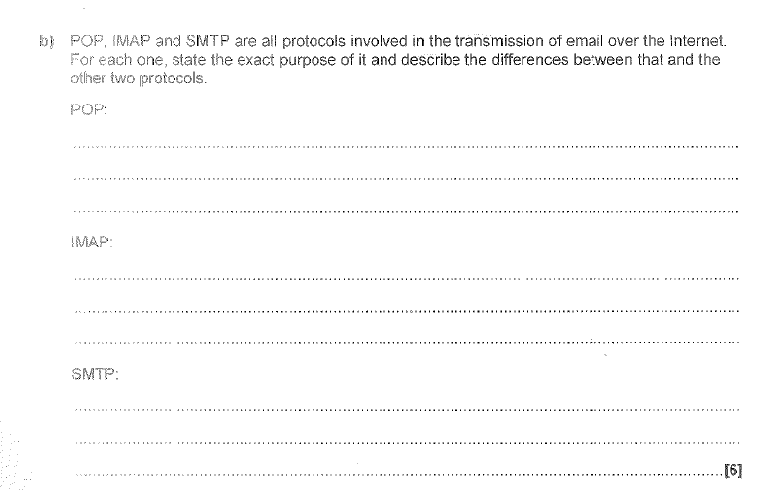

Slide 74
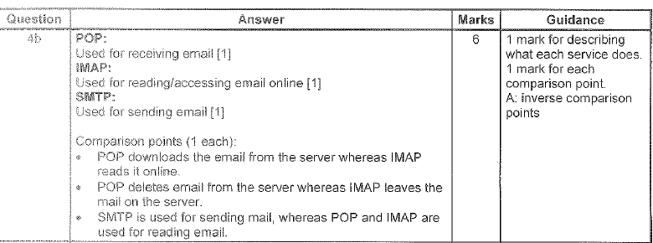

Slide 75
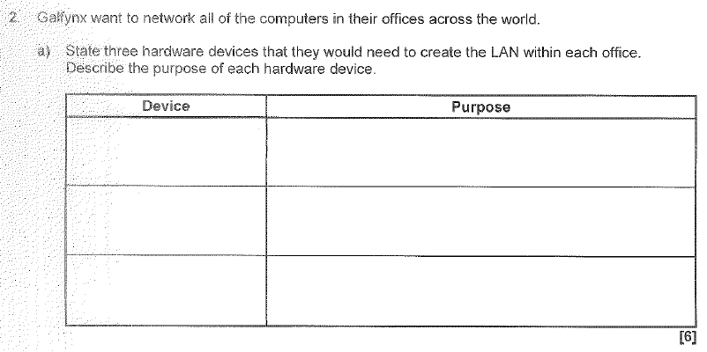

Slide 77
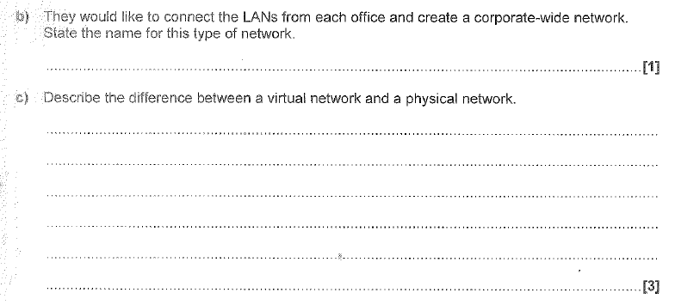

Slide 78
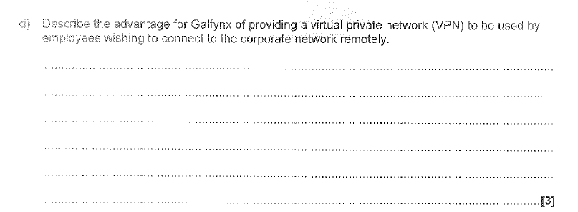

Slide 80
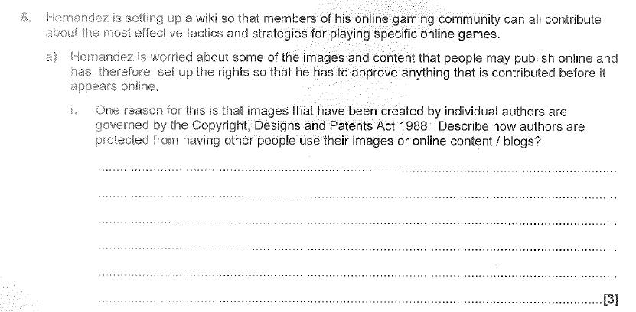

Slide 81
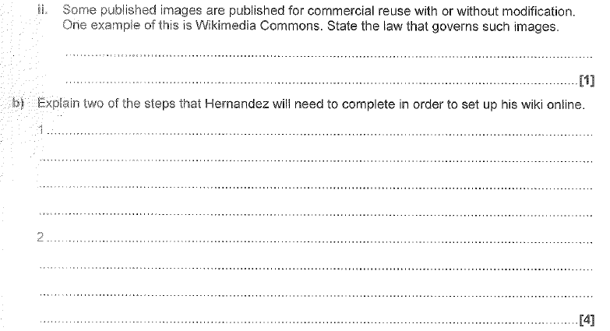

Slide 83
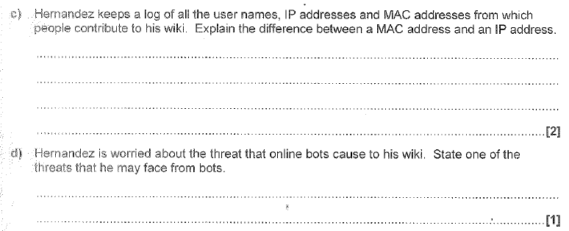

Slide 89
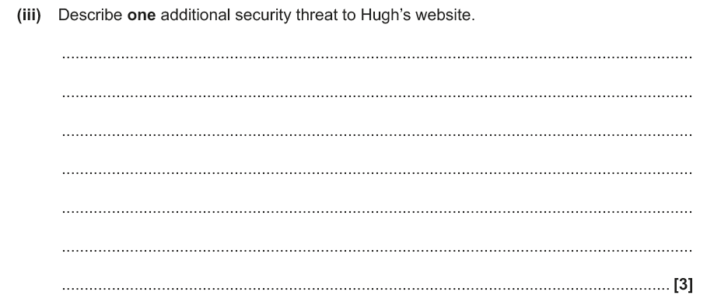

Slide 90
By using trial and error / exhaustive effort

Slide 91
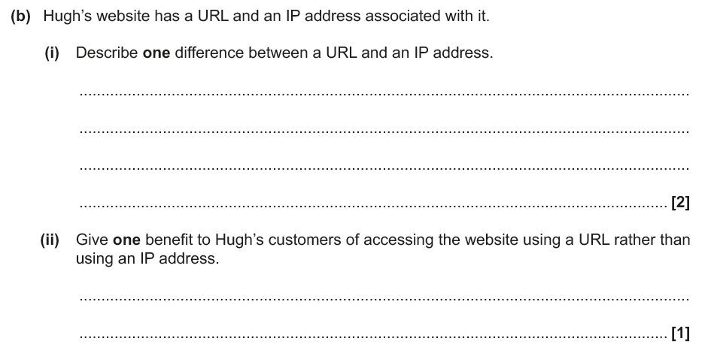

Slide 93
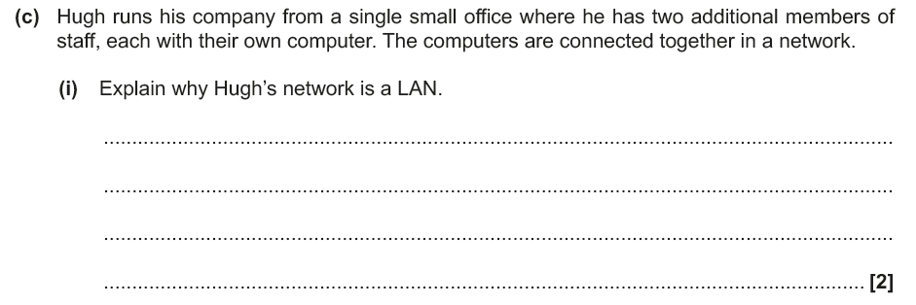

Slide 97
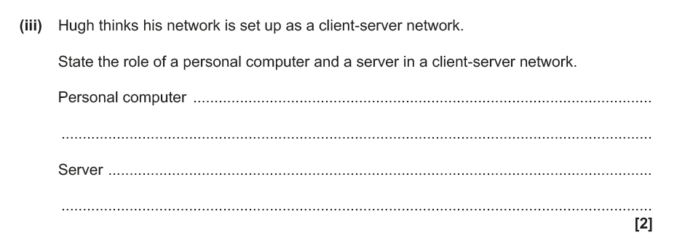

Slide 99
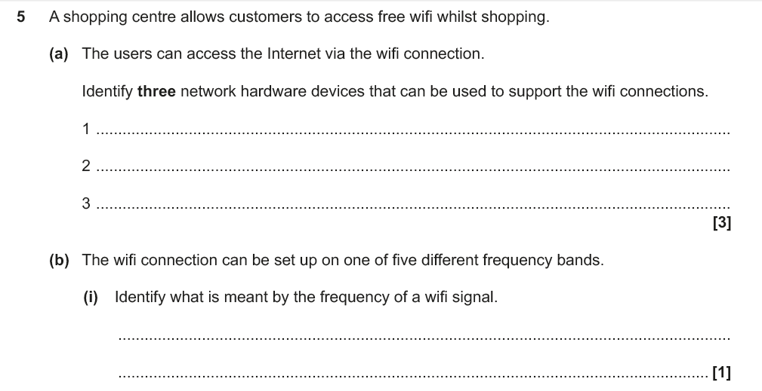

Slide 103
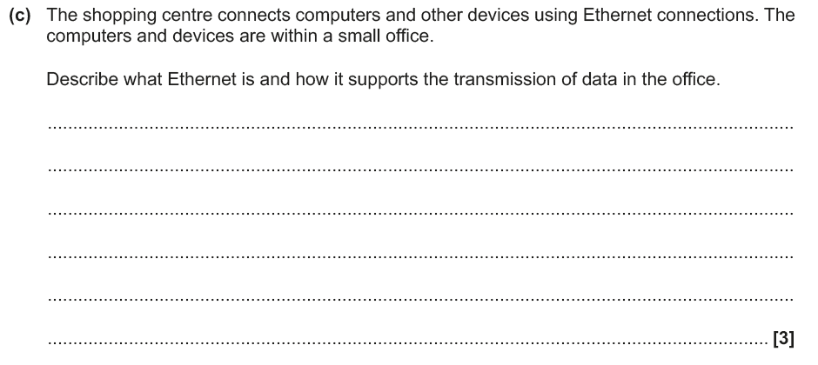

Slide 105
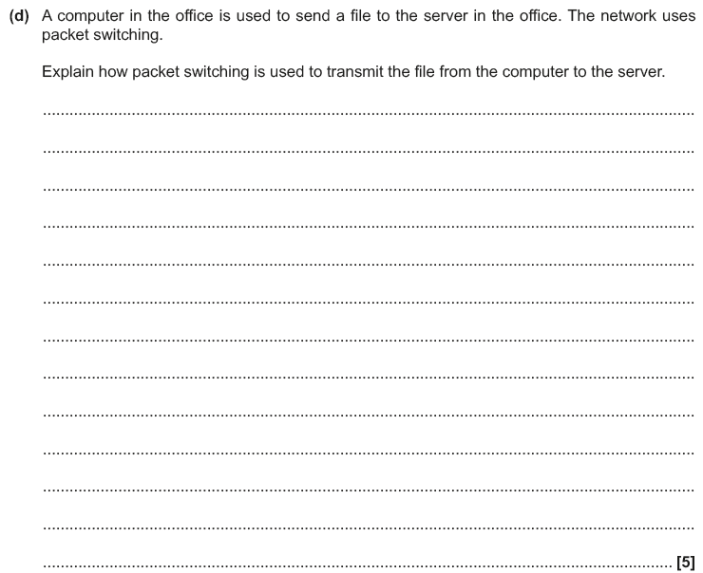

Slide 107
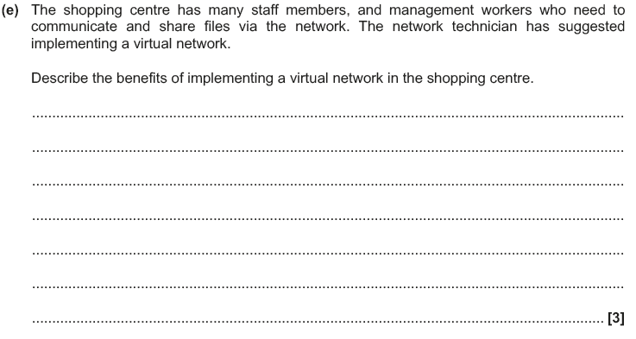

Slide 109
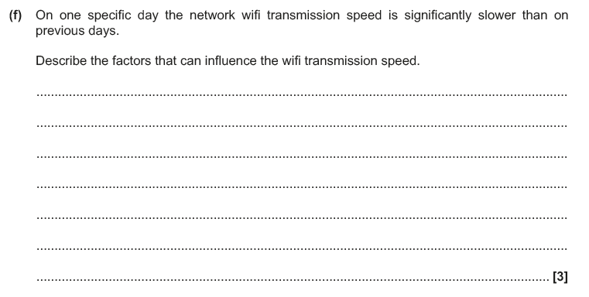

Slide 111
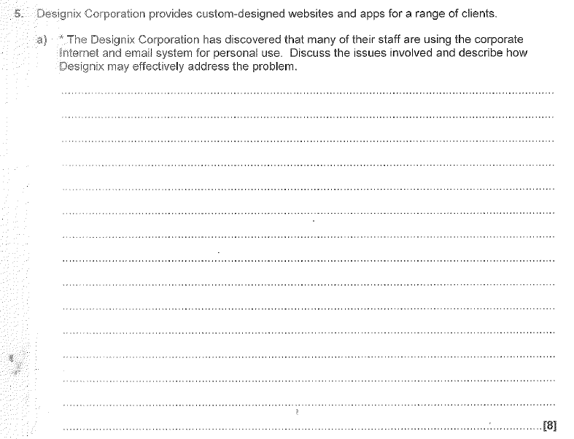

Slide 121
1. Using electronic e-mail over the Internet is an example of a client–server system.
(a) Explain the term client-server.
....................................................................................................................................
....................................................................................................................................
....................................................................................................................................
(3)
(b) The sending and receiving of e-mails uses various protocols.
(i) Explain the term protocol.
.........................................................................................................................
(1)

Slide 122
1. Using electronic e-mail over the Internet is an example of a client–server system.
(a) Explain the term client-server.
....................................................................................................................................
....................................................................................................................................
....................................................................................................................................
(3)
(b) The sending and receiving of e-mails uses various protocols.
(i) Explain the term protocol.
.........................................................................................................................
(1)
A network of computers (known as ‘clients’).
- Organised and controlled around one server.
- The server’s main jobs are to provide security for the network.
- And to store everyone’s files.
A set of rules to make data transmission possible between computer

Slide 130
Sending;
• Bill’s computer splits data into equal sizes packets (1)
• Each packet is given the address of Ben’s computer (1)
• Each packet is given a number (1)
• Each packet is given error checking data (1)
• The packets are sent across the network (1)
Receiving;
• Ben’s computer checks if all packets have been received? (1)
• If No…
• …Check again (1)
• …Increment timer (1)
• …If timer > max wait (1)
• …Send timeout to Bill’s computer (1)
• If Yes…
• …Reorder packets based on their number (1)
• …Display the document (1)
• …Send receipt confirmation (1)
• …Each packet is checked for errors (1)…
• … if corrupt a message is sent back to sender (1 )
Mention layers

Slide 131
The computers are geographically remote/ distanced/ more than a mile apart
• Communication medium is not owned by the law firm

Slide 132
The computers are geographically remote/ distanced/ more than a mile apart
• Communication medium is not owned by the law firm (have to use Internet provider, like Virgin to connect)
Two advantages from:
• It would offer additional storage (1) so the firm can take on more cases (1)
• It is a very efficient method of backing up data (1) and so saves the firm time and money (1)
• It would allow their employees to work from anywhere (1) so they can take cases from other countries (1)
• It is environmentally friendly (1)
• Easy to increase availability of storage (1)
• You don’t need specialist network skills (1) so the firm don’t need to employ more staff (1)
• The third party provides security (1) so the firm saves money on staff and software/hardware (1)
• The third party provides backup (1) so the firm saves money on staff and software/hardware (1)
• Cheaper as don’t need own infrastructure (1)
Must be specific to lawyers!

Slide 135
Two disadvantages from:
• You need a constant internet connection (1) which lawyers who travel a lot may not always have (1)
• Reliant on third party to carry out security procedures (1) but the firm are still legally responsible if things go wrong (1)
• Reliant on third party for back up connection (1)
• Data stored in the cloud will be vulnerable to hacking and other threats (1) which the firm have no control over (1)
• Issues regarding data ownership (1)
• Implications of Data Protection Act (1)
Each disadvantage need to be contextualised to gain 2 marks

