Slide 1
Translators Compiler and Facilities
Lesson 2

Slide 2
Big Picture Activity 1/2
What are the key differences between the different levels of Programming Languages?
What differences are there between the different Language Translators?

Slide 3
Learning Intentions
To be able to describe how an Assembler works
To be able to describe the differences in operation between a Compiler and Interpreter
To be able to describe the common tools and facilities in an Integrated Development Environment (IDE)
Keywords
Assembler
Sources Code
Executable Code
IDE
Translator
Interpreter
Compiler

Slide 4
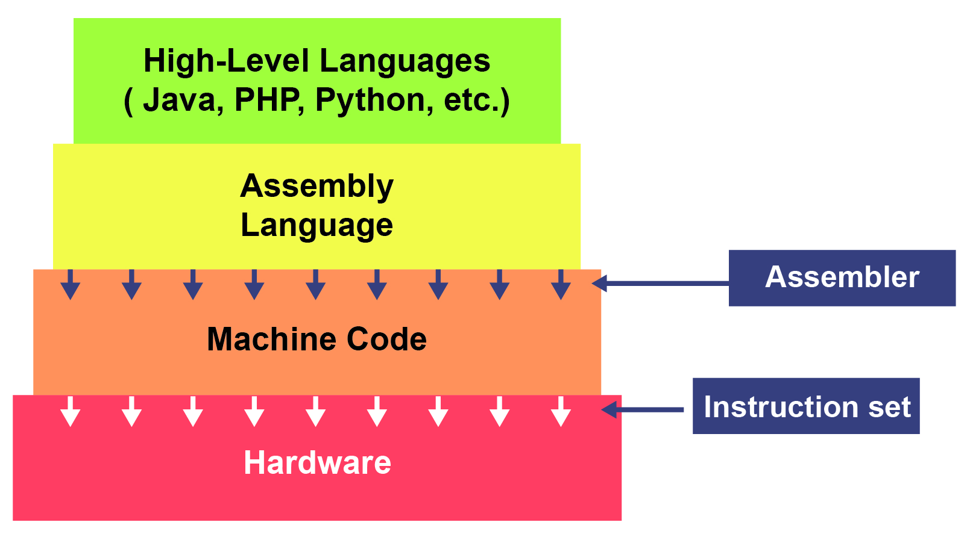
Content
Language Translators are used to translate a language into a form that the will be able to directly execute
  Assemblers are used for 2nd Generation
  Compilers/Interpreters are used for 3rd Generation

Slide 5
Activity
You will be handed either a sheet on Compilers or Interpreters:
Spend 10-15 minutes completing the task given on the sheet to produce a diagrammatic form of the text (e.g. MindMap, Cartoon etc).
Work with a partner to explain to them what is meant by Compiler/Interpreter using only your notes.
Check understand (peer assess each other)

Slide 6
Content
Assemblers
  Translate Assembly Language code into Machine Code
  Used for Device Drivers
  Used when fast execution is required or limited memory/file size
  Difficult to write in (easier than Machine code)

Slide 7
Content
Compilers
  Translate entire source code all in one go into Machine Code
  Optimise code
  Used at the end of development (ready for shipping)
  Error Reports created along with Object Code

Slide 8
Content
Interpreters
  Translate and execute source code
  Line by Line, Statement by Statement
  Source code is checked for syntax – if correct, code is executed. If incorrect interpreting is stopped.
  Used for development (aide debugging)

Slide 9
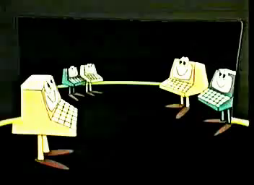
Interpreters Vs Compiler

Slide 10
Content
Integrated Development Environment (IDE)
  Editor (for writing the code)
  Error Diagnostics (such as de-bug facilities)
  Run-Time Environment
  Translators

Slide 11
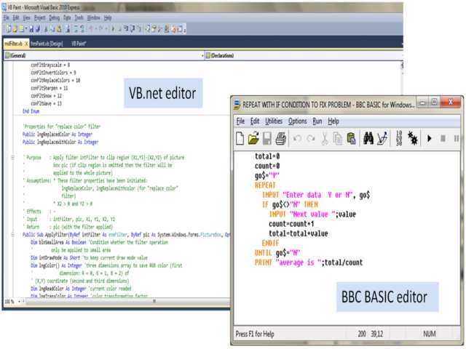
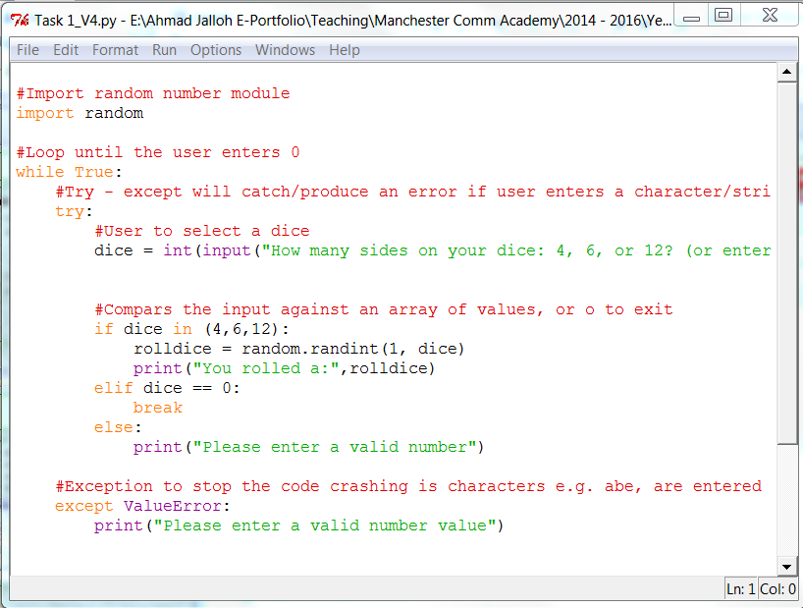
IDE (integrated development environment)
Code editor: text editing area to organise the code by managing the layout, indenting structures and colour-coding the command words, variables and comments so that they can be easily identified.
Python

Slide 12
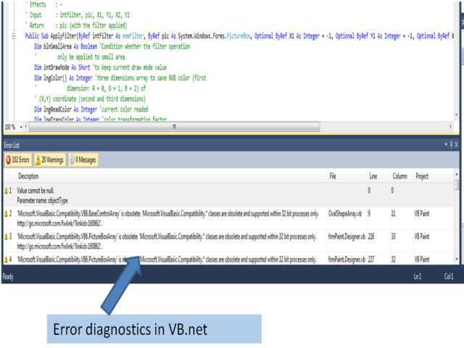
IDE (Integrated Development Environment)
Error diagnostics include an error and warnings list to identify any problems in the code.

Slide 13
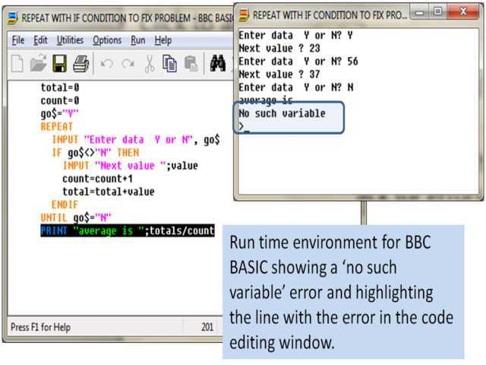
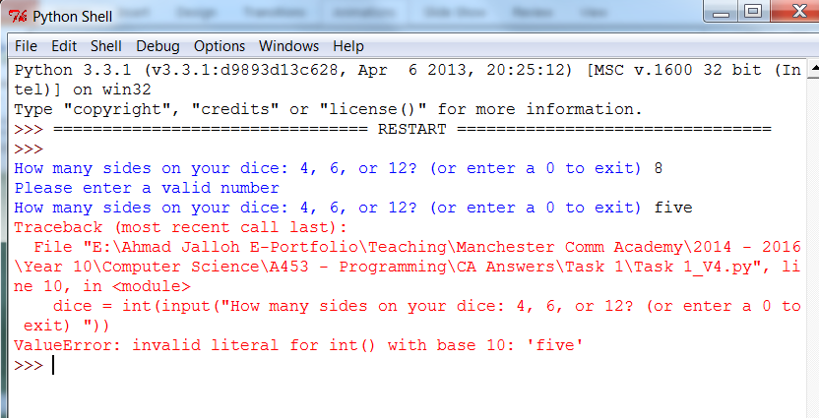
IDE Run Time Environment
Python
IDE
Run time environment to run the code during development to check for errors.

Slide 14
Some other Features of an IDE
Translator compiles or interprets the source code into suitable machine code instructions that can be run on the computer.
Auto documentation takes a note of all the variables, modules, subroutines and comments as the project is developed and tidies this up into a text file that can be used during any maintenance of the program.

Slide 15
Activity
Open up a programming language that you are familiar with and produce a series of screen shots / notes that identify:
- Where the editor is located and how it is used
- Where the error diagnostics can be found and used
- How the run-time environment looks and the features of this
- Examples of using the Compiler and Interpreter

Slide 16
Plenary
Questioning Round
Homework:
Produce a short report describing the differences between the language translators, how these apply to generations of languages and where each would be used

Slide 17
Plenary
Flowchart
Pseudocode
Facilities and Translators
Programming Techniques
  Sequence (variable, data type, Input and Output)
  IF Statement
  Loops
  List

