Slide 1
Energy

Slide 2
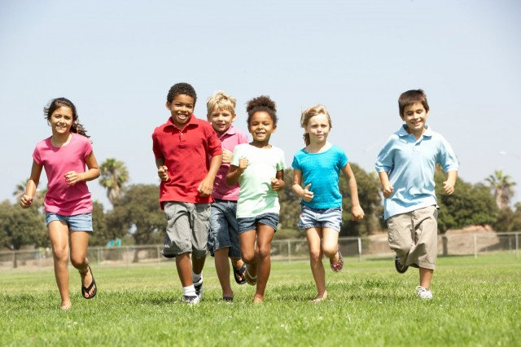
Energy
Energy is the power to do work. It is measured in kilojoules (kJ) and kilocalories (kcals). We all need energy to grow, stay alive, keep warm and be active. Energy is essential for life, and is required to fuel many different body processes, growth and activities.
These include:
keeping the heart beating;
keeping the organs functioning;
maintenance of body temperature;
muscle contraction.

Slide 3
Energy
Different people need different amounts of dietary energy
depending on their:
age;
gender;
body size;
level of activity;
genes.

Slide 4
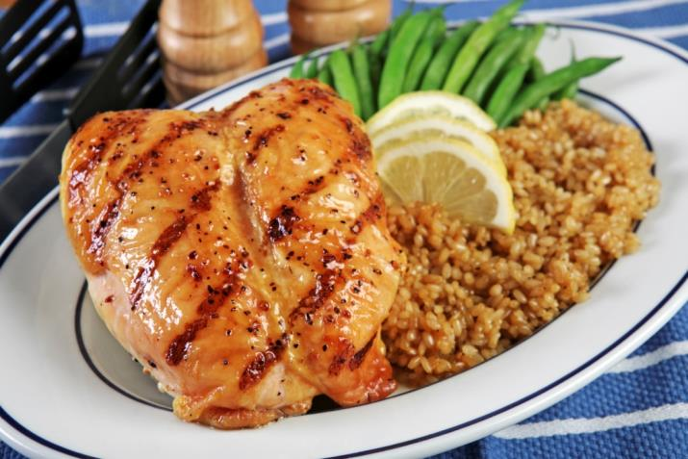
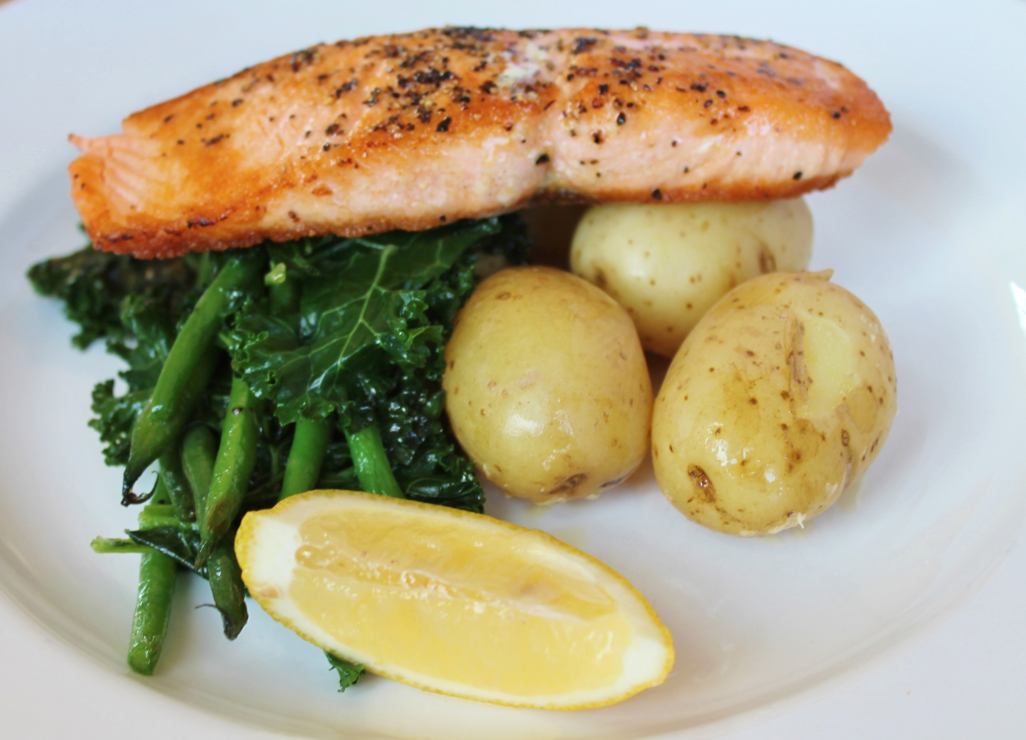
Energy
Energy is provided by the carbohydrate, protein and fat in the food and drink we consume.
These are known as macronutrients.
The amount of energy that each of these macronutrients provides varies.

Slide 5
Energy
Carbohydrate (starch and sugars) provides 3.75 kcal (16 kJ) per gram (for the purposes of food labelling this is rounded up to 4 kcal (17kJ) per gram).
Protein provides 4kcal (17kJ) per gram.
Fat is the most energy dense nutrient, providing 9kcal (37kJ) per gram.
Energy intake can be estimated by applying these figures to the amount of carbohydrate, protein and fat we consume from food and drink.
Alcohol also provides energy at 7kcal (29kJ) per gram.

Slide 6
Energy in food and drinks
Per gram, fat provides more than twice the energy of carbohydrate.

Slide 7
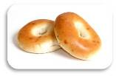
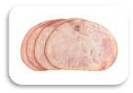
Energy in food and drinks
Which of these foods do you think contributes the most energy per 100g?
Bagel
Ham
Oil
Total Energy: 1135.5kJ
Carbohydrate 982.6kJ
Protein 170.0kJ
Fat 66.6kJ
Total Energy: 3696.0kJ
Carbohydrate 0.0kJ
Protein 0.0kJ
Fat 3696.0kJ
Total Energy: 450.9kJ
Carbohydrate 17.0kJ
Protein 312.8kJ
Fat 122.1kJ

Slide 8
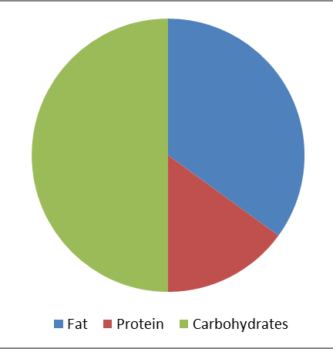
Dietary reference values
Experts have estimated the average requirements for energy for different types of people.
These figures are known as Estimated Average Requirements (EAR)
for energy.
It is also recommended that:
about 50% of our energy intake should come from carbohydrate;
no more than 35% of our energy intake should come from fat.
That means around 15% of our energy intake should come from protein.

Slide 9
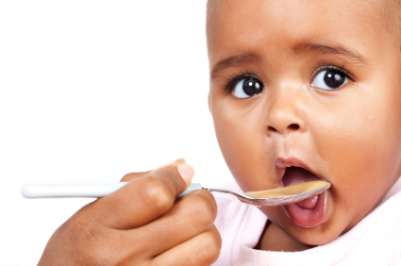
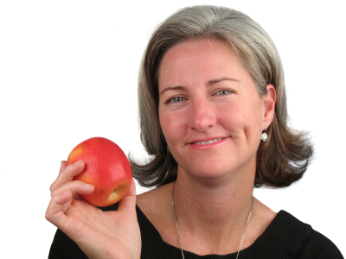
Estimated average requirements
Estimated average requirements (EARs) vary throughout life.
Babies, young children and teenagers need more energy in relation to their size to grow and be active.
After the age of 18, energy requirements decrease and remain the same until 50, but actual needs depend on people’s activity levels.
Energy requirements for older adults decrease as activity levels fall, and there is a reduction in the basal metabolic rate.

Slide 10
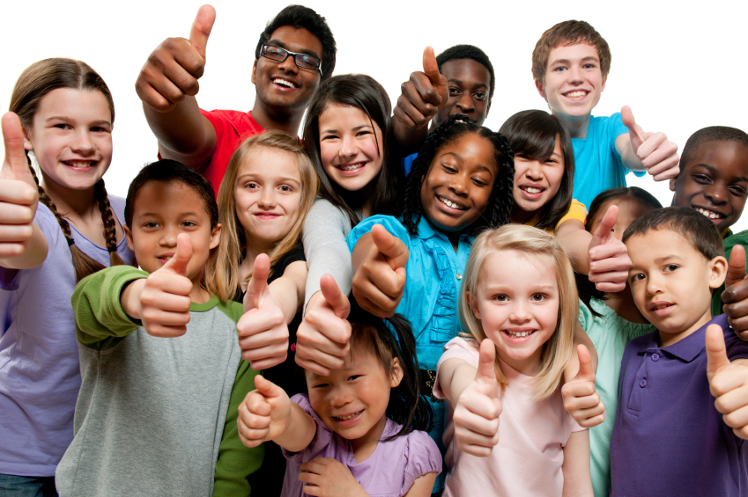
EARs - children
 | Breast-fed
Months | Boys (MJ) | Boys (kcal) | Girls (MJ) | Girls (kcal)
1-2 | 2.2 | 526 | 2.0 | 478
3-4 | 2.4 | 574 | 2.2 | 526
5-6 | 2.5 | 598 | 2.3 | 550
7-12 | 2.9 | 694 | 2.7 | 646
The Scientific Advisory Committee on Nutrition (SACN) has published reference values for daily energy requirements as follows:
Years | Boys (MJ) | Boys (kcal) | Girls (MJ) | Girls (kcal)
1 | 3.2 | 765 | 3.0 | 717
2 | 4.2 | 1004 | 3.9 | 932
3 | 4.9 | 1171 | 4.5 | 1076
4 | 5.8 | 1386 | 5.4 | 1291
5 | 6.2 | 1482 | 5.7 | 1362
6 | 6.6 | 1577 | 6.2 | 1482
7 | 6.9 | 1649 | 6.4 | 1530
8 | 7.3 | 1745 | 6.8 | 1625
9 | 7.7 | 1840 | 7.2 | 1721
10 | 8.5 | 2032 | 8.1 | 1936
11 | 8.9 | 2127 | 8.5 | 2032
12 | 9.4 | 2247 | 8.8 | 2103
13 | 10.1 | 2414 | 9.3 | 2223
14 | 11.0 | 2629 | 9.8 | 2342
15 | 11.8 | 2820 | 10.0 | 2390
16 | 12.4 | 2964 | 10.1 | 2414
17 | 12.9 | 3083 | 10.3 | 2462
18 | 13.2 | 3155 | 10.3 | 2462

Slide 11
EARs - adults
Years | Men (MJ) | Men (kcal) | Women (MJ) | Women (kcal)
19-24 | 11.6 | 2772 | 9.1 | 2175
25-34 | 11.5 | 2749 | 9.1 | 2175
35-44 | 11.0 | 2629 | 8.8 | 2103
45-54 | 10.8 | 2581 | 8.8 | 2103
55-64 | 10.8 | 2581 | 8.7 | 2079
65-74 | 9.8 | 2342 | 8.0 | 1912
75+ | 9.6 | 2294 | 7.7 | 1840
Why do you think there is a difference in requirements for males and females?
What effect would increasing activity levels have on the energy requirements?

Slide 12
Energy
Energy intake is measured in joules (J) or kilojoules (kJ), but many people
are more familiar with Calories (kcal).
1 kilojoule (kJ) = 1,000 joules
1 megajoule (MJ) = 1,000,000 joules
1 kilocalorie (kcal) = 1,000 calories
To convert from one unit to another:
1 kcal = 4.184 kJ
Therefore, a 2000-kcal diet provides 8.368 MJ or 8368 kJ
1 MJ = 239 kcal

Slide 13
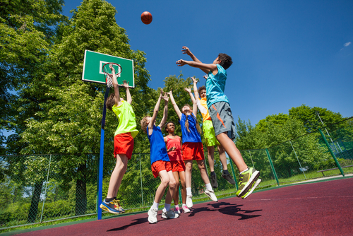
How much energy do we need?
Energy requirements vary from person to person, depending on the Basal Metabolic Rate (BMR) and Physical Activity Level (PAL).
Total energy expenditure (TEE) =
BMR x PAL

Slide 14
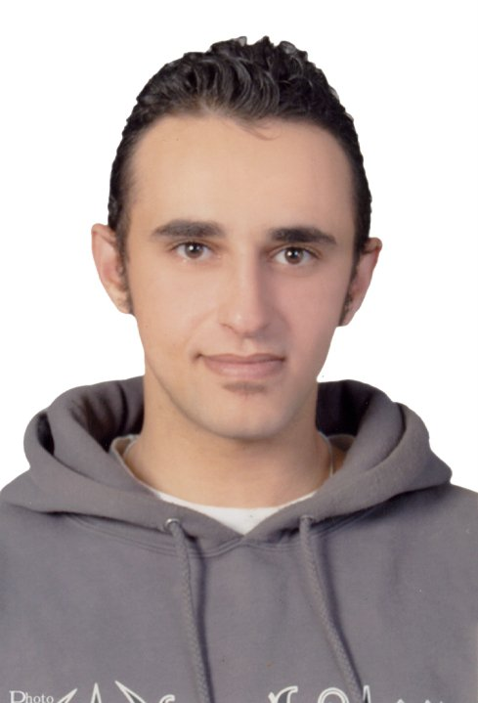
What is basal metabolic rate?
Basal metabolic rate (BMR) is the rate at which a person uses energy to maintain the basic functions of the body when it is at complete rest, such as:
breathing;
keeping warm;
keeping the heart beating

Slide 15
Did you know?
An average adult will use around 1.1kcal each minute just to maintain basic functions.
BMR differs from person to person across the population.
Infants and young children tend to have a proportionately high BMR for their size due to their rapid growth and development.
Men usually have a higher BMR than women as they tend to have more muscle.
Older adults usually have a lower BMR than younger people since their muscle mass tends to decrease with age.

Slide 16
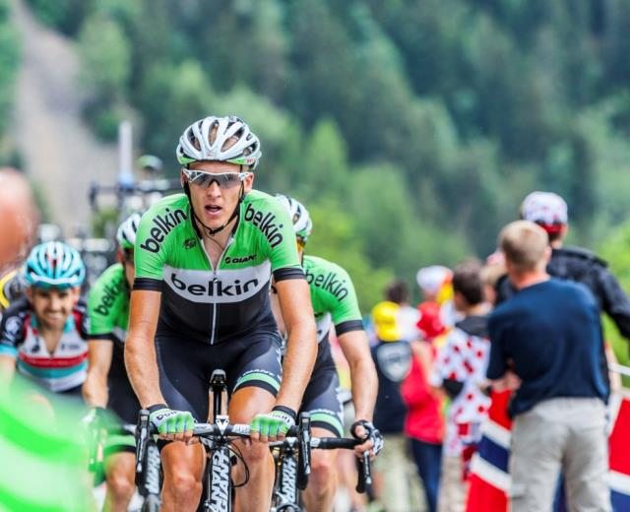
Physical activity
In addition to their BMR, people also use energy for movement of all types, expressed as Physical Activity Level (PAL).
The amount of energy a person uses to perform daily tasks varies.

Slide 17
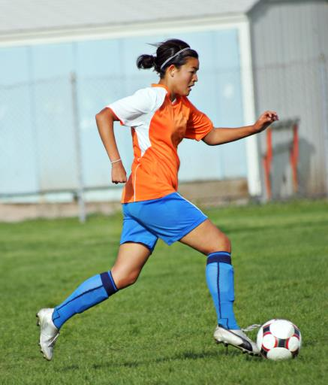
Physical Activity Level
A PAL of 1.4 is associated with a low level of physical activity at work or during leisure time.
This applies to a large proportion of the UK population.
A PAL of 1.6 for women or 1.7 for men represents moderate intensity activity.
Values of 1.8 for women or 1.9 for men represent high levels of physical activity.

Slide 18
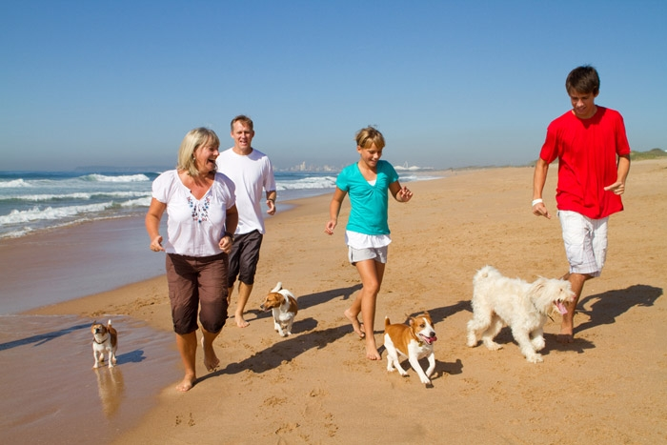
Physical activity
Physical activity should be an important part of our daily energy expenditure.
Many different types of activity contribute to our total physical activity, all of which form part of everyday life.
What do you think physical activity includes?
Activity at work, e.g. use the stairs not the lift.
Household chores, e.g. vacuuming.
Looking after others.
Leisure-time activities, e.g. gardening.
Transport (walking or cycling to school or work).
Sport.

Slide 19
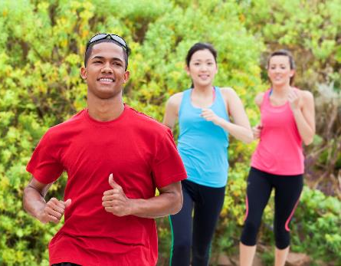
Physical activity guidelines
Children and young people are recommended to do at least 60 minutes of moderate intensity exercise every day.
Adults are recommended to do at least 150 minutes of moderate aerobic activity every week or 75 minutes of vigorous aerobic activity.
They are also recommended to do strength exercises on two or more days a week that work all the major muscles.
The activity does not have to be taken all at once – 3 brisk walks of 10 minutes each would be just as good as a 30 minute brisk walk.

Slide 20
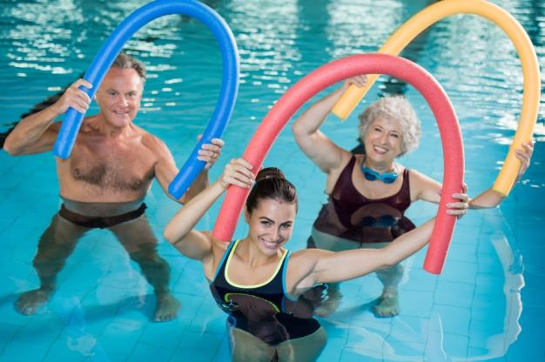
Moderate aerobic activity
Moderate aerobic activity is defined as a level of activity that will:
lead to an increase in breathing rate;
lead to an increase in heart rate;
lead to a feeling of increased warmth.
This includes:
brisk walking;
water aerobics;
pushing a lawn mower;
hiking;
skateboarding;
rollerblading;
basketball.

Slide 21
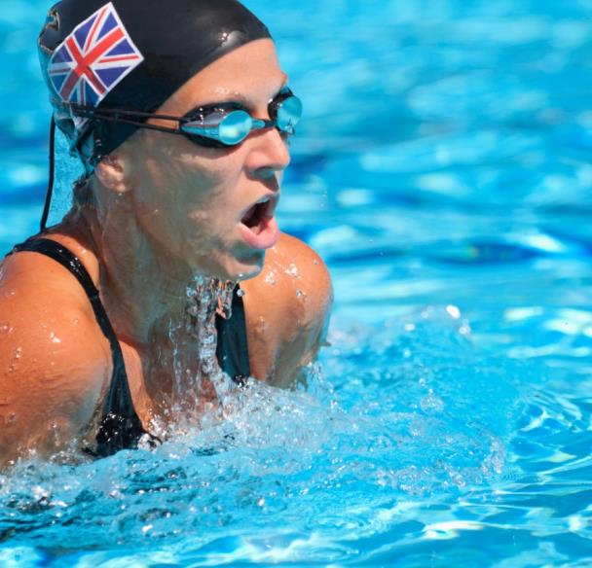
Vigorous activity
Vigorous activity makes you breathe hard and fast. If you're working at this level, you won't be able to say more than a few words without pausing for breath.
This includes;
jogging or running
swimming fast
riding a bike fast or on hills
singles tennis
football
rugby
skipping rope
hockey

Slide 22
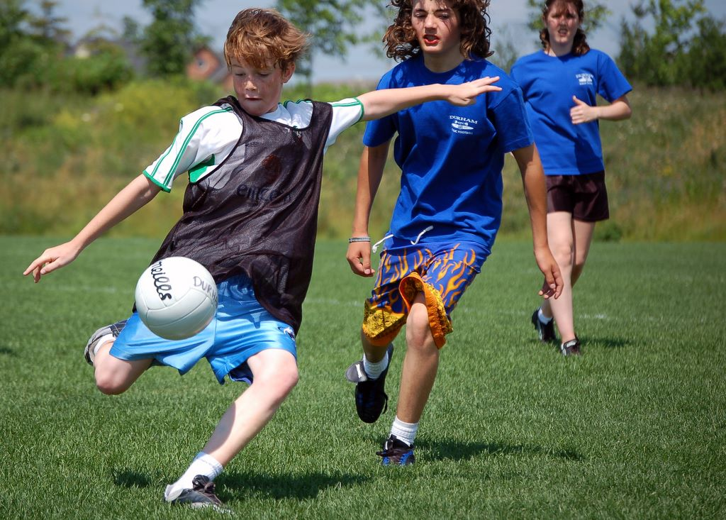
Average physical activity levels
Average physical activity levels in the UK are lower than recommendations. Most adults, older children and teenagers do not meet the targets.
According to Statistics on Obesity, Physical Activity and Diet published in 2018, only 23% of boys and 20% girls meet the physical activity guidelines and 21% of adult men, and 25% of adult women are classified as inactive (they do fewer than 30 minutes physical activity a week).
Statistics on Obesity, Physical Activity and Diet 2018

Slide 23
Body mass index (BMI)
Body Mass Index (BMI) can be used to identify if an adult is a correct weight for height.
BMI can be calculated as follows:
BMI = weight (kg)
(height in m)²
Recommended BMI range (adults)
Less than 18.5 Underweight 18.5 to 25 Desirable or healthy
range 25-30 Overweight 30-35 Obese (Class I) 35-40 Obese (Class II) Over 40 Morbidly or severely
obese (Class III)

Slide 24
BMI calculation
Calculate the BMI. Click the colour blocks to reveal the answers.
51kg 82kg 78kg
1.7m x 1.7m 1.95m x 1.95m 1.63m x 1.63m
= 17.6 BMI = 21.6 BMI = 29.4 BMI
Underweight healthy weight overweight
Samantha
Height: 1.70m
Weight: 51kg
2. Dale
Height: 1.95m
Weight: 82kg
3. Ruth
Height: 1.63m
Weight: 78kg

Slide 25
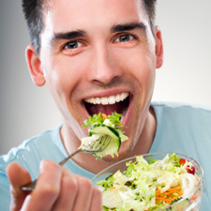
Energy balance
To maintain body weight it is necessary to balance energy intake (from food and drink) with energy expenditure (from activity).
This is called energy balance.
When energy intake is higher than energy output, over time this will lead to weight gain (positive energy balance).
When energy intake is lower than energy output, over time this will lead to weight loss (negative energy balance).

Slide 26
Positive energy balance
A person is said to be in positive energy balance when the diet provides more energy than is needed to meet energy demands of the body. Energy is stored as fat and the person puts on weight over time.
People who achieve a positive energy balance over an extended period of time are likely to become overweight or obese.
Being overweight or obese is associated with an increased risk of developing certain cancers, cardiovascular disease and type 2 diabetes.
Energy out: activity
Energy in: food and drinks
Energy in > Energy out = Weight gain

Slide 27
Negative energy balance
A person is said to be in negative energy balance when there is insufficient energy from the diet to meet energy demands of the body. Energy is derived from energy stores and the person loses weight.
People who achieve a negative energy balance over an extended period of time are likely to become underweight.
Being underweight is associated with health problems, such as osteoporosis (low bone mass), infertility (difficulty to conceive) and even heart failure.
Energy out: activity
Energy in: food and drinks
Energy out > Energy in = Weight loss

Slide 28
Energy balance
Energy balance can be maintained by:
regulating energy intake through the diet;
adjusting physical activity levels;
a combination of both.
Energy in: food and drinks
Energy out: activity
Energy in = Energy out = Energy balance

Slide 29
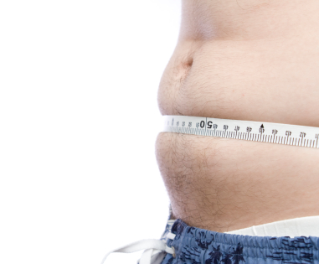
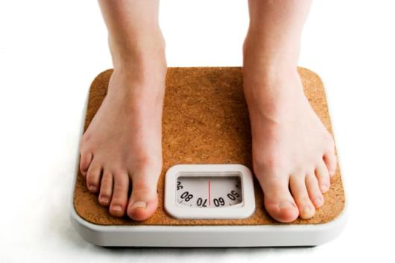
Overweight and obesity
In the UK and many other developed countries, overweight and obesity rates in adults and children have been increasing over the years.
According to Statistics on Obesity, Physical Activity and Diet published in 2018, 57% of adult women and 66% of adult men are overweight or obese.
It is important to lead an active lifestyle and make healthier food choices.
Statistics on Obesity, Physical Activity and Diet published in 2018

Slide 30
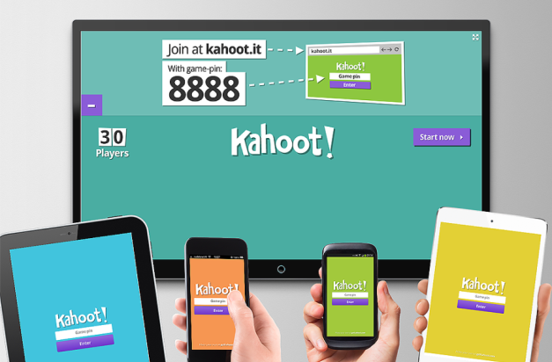
Quiz - Kahoot
Open the link below on the main screen and get students to log onto kahoot.it on their tablets or smartphones.
They can then enter the code (that will come up on the main screen when you start the game) and their own nickname.
They can then play along with the quiz choosing the multiple choice answers that correspond with the questions on the main screen. There will then be a leaderboard of the scores after each question and at the end.
https://create.kahoot.it/share/energy-requirements/cbee242c-a83c-40d0-9320-a6929747184f

Slide 31
Energy
For further information, go to:
www.foodafactoflife.org.uk

