Slide 1
GCSE Networks and Cyber Security
Session 4 Devices

Slide 2
Activity
5 minutes to discuss and feedback on the following using a post stick note:
What is a computer network?
Write down all the words / phrases / acronyms you already know about computer networking.
What are the benefits of computer networks
Notes:
DURATION 1 MINUTE
Key Point
Unless computers are connected sharing of data is almost impossible. Management very challenging without networks and central control
BUT risks are significant – security and costs

Slide 3
GCSE Networks and Cyber Security
Wired and Wireless Network

Slide 4
Learning Intentions
LAN and WAN
The hardware needed to connect stand-alone computers into a Local Area Network
Client-server and peer-peer
Topology
Virtual networks
Packet switching and circuit switching
Notes:
DURATION 1 MINUTE
Explain that there are some common misunderstandings amongst students relating to these topics and this session will address these.

Slide 5
Networking - LANs
What is a Computer Network?
Two or more computers connected together to share information and resources.
(this can involve physical or wireless connections, or both)

Slide 6
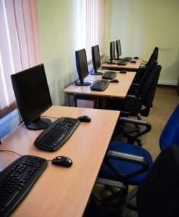
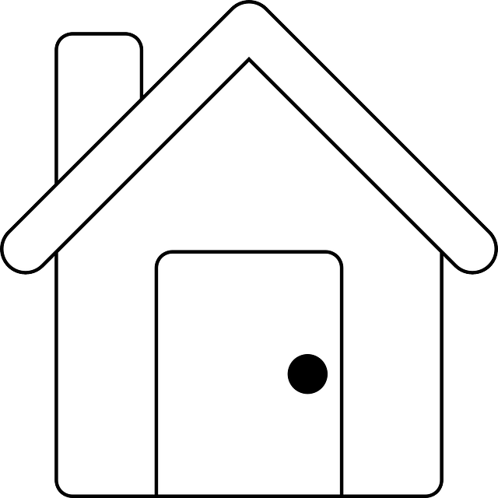
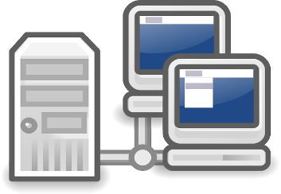
Networking - LANs
A school network
An office network
A home network

Slide 7
Networking - LANs
Learning Check?
So What is a Computer Network?
Two or more computers connected together to share information and resources.

Slide 8
Networking - LANs
What is a LAN?
A LAN is a Local Area Network.
It is a connection of computers and devices in a small geographical area.
Each device on a network is known as a node (e.g. computer, printer, etc.)
A LAN is confined to one site or small geographical area.
It’s therefore relatively small
All network infrastructure is the property of the organisation

Slide 9
Local Area Network (LAN)
Advantages of LAN
It enables digital communication between people
It enables the sharing of digital information
It enables the sharing of peripheral devices such as printers and scanners
It enables computers to be updated with the latest software from a central point
It enables distributed processing – the ability for a single program to be run simultaneously at various computers.
It allows user to log on and any devices within the network

Slide 10
Local Area Network (LAN)
Disadvantages
There requires a bit of ‘expertise’ to install and maintain a large network which can be costly.
There are a number of security issues from unauthorised access to data
Measures to secure a network include:
Passwords – strong passwords use a range of character types
Not allowing users to install software
With wireless access, use encryption
Changing passwords frequently

Slide 11
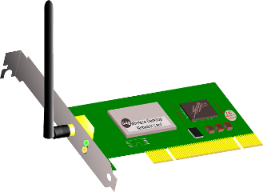
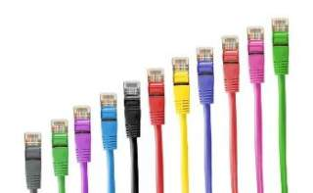
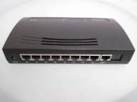
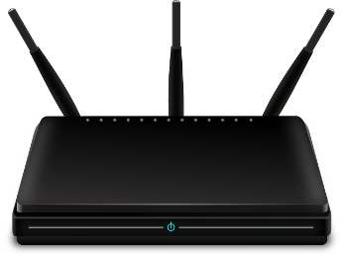
Networking - LANs
What are the hardware needed to make a LAN?
Networking Equipment

Slide 12
Hardware Needed
+
At least two computers (Nodes)
Each having a NIC – network interface card (either wired or wireless)
The NICs convert the data signals from the nodes into data signals that can be transferred across the network.

Slide 13
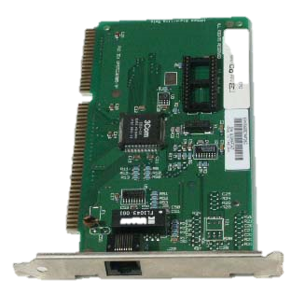
Network Interface Cards (NICs)
They are now mostly integrated into the motherboard of PC or laptop.
20 years ago most PCs had a slot on the motherboard where the NIC would be inserted
This NIC has a twisted pair (UTP) connection
CC License - image created by Jonas Bjork (https://www.flickr.com/photos/51036506@N05/)
Notes:
DURATION 1 MINUTES
The NIC will receive frames from the wire and inspect the destination MAC address, if this is the local address or the broadcast address the frame will be passed on to the CPU for further processing. If there is another destination MAC address the frame will be discarded.

Slide 14
Hardware Needed: Wires and Wireless
Data Transfer Media
Wires – Ethernet Cable (RJ45 connector)
The most common type of connection is a Cat-5 (Category 5), also known as twisted pair.
Wireless Technology
Wireless connections on computers tend to be referred to by their standard.
802.11.N is currently the fastest wireless which can support speeds of up to 100Mbit/s.
The lower the letter after 802.11 the slower the connection with a being the slowest.
In order for wireless to work you need a wireless access point.

Slide 15
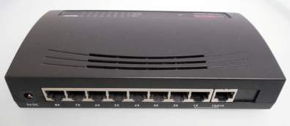
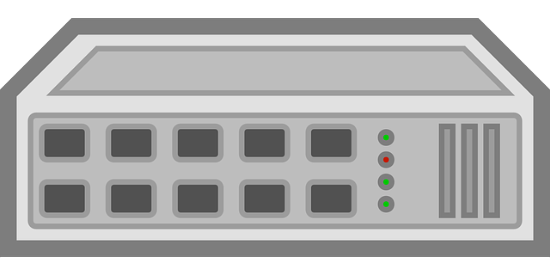
Hardware Needed
OR
Switch
A device that connects nodes together.
An intelligent device that can create and connect to different segments of the network.
This reduces network traffic because data packets are sent to the nodes or segment where they are needed rather than being broadcast to the whole network.
Hub
A device that connects
nodes together.
Makes all connected nodes
act as a single segment.
Not intelligent – data
packets are transmitted
across the whole of the
network.
Cheap devices – USB hubs
useful in home computer
installations.

Slide 16
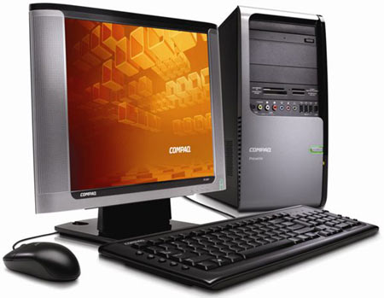
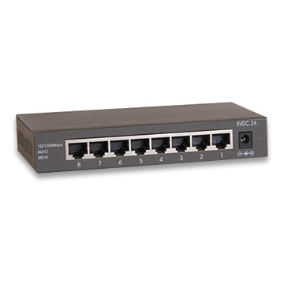
Hub in Practice
Packet
A packet is sent to one port on the hub.

Slide 17
Hub in Practice
Packet
Packet
Packet
Packet
Packet
The packet is then duplicated and sent to all ports.

Slide 18
Switch in Practice
Packet
A packet is sent to one port on the switch.

Slide 19
Hub in Practice
Packet
The packet is then forwarded onto the destination port only.

Slide 20
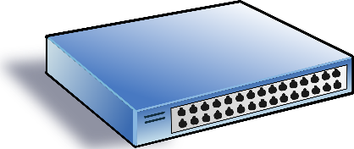
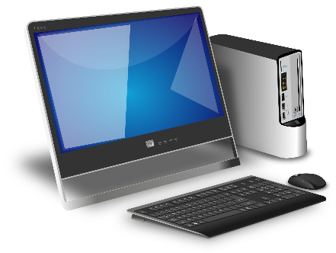
Switch MAC Table
A
Port - 01
Port - 12
1A sends to 1B
1B responds back to 1A
And again 1A sends to 1B
Let’s walk through how the switch table is built up on switch A
MAC – 1B
MAC – 1A
Notes:
DURATION 10 MINUTES
Briefly explain the scenario.
Give out Switch Table Entries document.
Get the participants to work in pairs and agree what should be written in each empty box. Allow 6 minutes
The correct answers are recorded in the document Switch Table Entries Answers.
Discuss what they have recorded and what will actually happen.
Reinforce what happens after a few data exchanges – i.e. data is now only sent out of ports where the computer is connected and not propagated out of all ports.
Ask them now what problems might occur with switches as a way to connect all the devices on the Internet.
They may come up with the problem of loops and broadcasts. If not explain these and then say that these two issues are solved with routers. Coming up in slide 13.
Someone might ask about a time-to-live setting in Ethernet frames with the number being decremented every time it traverses a switch – these don’t exist as switches never alter the data in a frame they just read it. TTL isn’t implemented in Ethernet.

Slide 21
Switches
Switches build a MAC Table as they operate
Something like this
MAC Table
Port | MAC Attached
01 | 1A
02 | F4
03 | 9E
This is a switch
Switches only forward frames out of ports where they know the recipient device is located.
Switches are clever – they remember which MAC address is attached to which port and they forward out of the appropriate port.
They create MAC tables associating specific MAC addresses with particular ports, i.e. they know which physical address is connected to which of its ports (aka as interfaces).
Notes:
DURATION 2 MINUTES
Key points
Switches only forward frames out of ports where they know the recipient device is located. Unless there is no record then the frame is forwarded out of all other ports.
Switches are clever – they remember which MAC address is attached to which port and they forward out of the appropriate port. They create MAC tables associating specific MAC addresses with particular ports, i.e. they know which physical address is connected to which of its ports (aka as interfaces). To do this they have to inspect the data frame as it arrives looking in the header to see the MAC address of the sender and the recipient.
Broadcast frames are propagated out of all other interfaces on a switch so they don’t segment broadcasts at the Physical Layer.

Slide 22
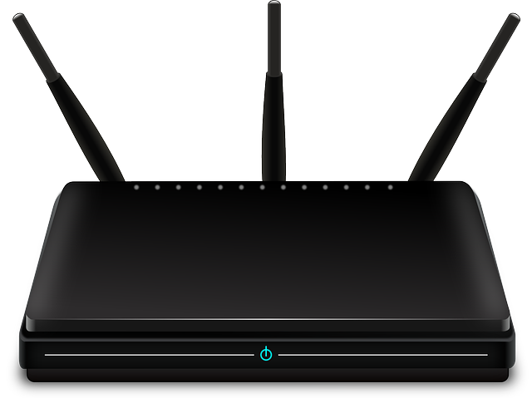
Hardware Needed: Router
If the LAN is to connect to the Internet, a Router is needed.
Routers manage the data packets enabling them to be sent between networks (e.g. over the internet)
Directs packets or data to a destination or a network
Receives packets or data from the network or Internet
Forwards packets or data to other computers on the network or Internet
Connects (different) networks together e.g. joins home network to Internet

Slide 23
Hardware Needed: WAP
Wireless Access Point (WAP)
Wireless technology has many advantages over wired networks:
No need to do building work
Add new node with ease
General public can access network / internet if allowed.
But there are drawbacks:
Wireless transmission is slower than cabled
More devices/users could be connected e.g. mobile phones // increase in traffic
Wireless can be limited by interference such as walls that disrupt the signal or from other wireless
…and security issues too!

Slide 24
Wi-Fi Frequencies
Wi-Fi is a trademarked name for the IEEE 802.11 standard.
It is a medium range wireless technology used to connect devices together.
Wi-Fi uses radio waves to provide a connection to the internet
Examples of Wi-Fi include:
2.4 GHz – ultra-high frequency
5 GHz – super-high frequency
These numbers refer to two different ‘frequency bands' your Wi-Fi can use for its signal.

Slide 25
Wi-Fi Channel
A channel is the range of frequencies that will transmit data
The benefit of wider channels is that more data can be transmitted, resulting in faster Wi-Fi speeds.
However, interference with other 20MHz channels can be an issue.
You may buy a new router and install it in your home.
Ideally the router will use a channel width of 40MHz, which should give you very good network transfer speeds.
However, if there are lots of neighbouring Wi-Fi networks, they may cause too much interference with the 'wide' 40MHz channels.
This interference could result in greatly reduced performance.

Slide 26
Important of Different WIFI Channel
Two devices using the same channels will be subject to interference
Choice of channel allows users to minimize or reduce interference from other devices.

Slide 27
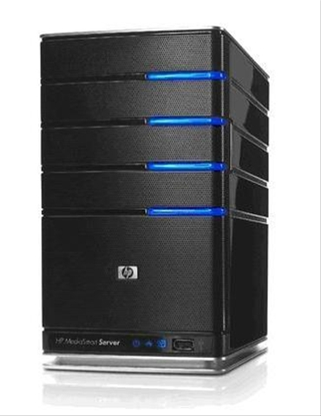
Server
A server is a powerful computer which provides a service on a network.
They tend to have many processors and large amounts of memory and hard drive space.
They have the role of controlling access to shared resources like files and printers.
Since data storage is centralised, security is easier to manage, updates to the data are far easier to administer and it is far easier to backup the data centrally
Typical roles servers play on networks
File server
Web server
Print server
Security / profiles

Slide 28
Activity
Learning Intentions Covered:
Know: why data is represented in computer systems in binary form
Understand what binary logic is
In your Networks folder in your area
Open Networking Booklet
Complete:
All Task in Part 1: Wired and Wireless Network

Slide 29
Activity
Open your book and answer the following question in exam condition
What is a Computer Network
What is a LAN
Explain four benefits of having a LAN
Describe the role of a switch in network
Explain the role of the server in a network?
Define the term Wi-Fi Frequency
Describe the benefit of having different Wi-Fi channels

Slide 30
Networking - LANs
What is a LAN?
A LAN is a Local Area Network.
It is a connection of computers and devices in a small geographical area.
Each device on a network is known as a node (e.g. computer, printer, etc.)
A LAN is confined to one site or small geographical area.
It’s therefore relatively small
All network infrastructure is the property of the organisation

Slide 31
Local Area Network (LAN)
Advantages of LAN
It enables digital communication between people
It enables the sharing of digital information
It enables the sharing of peripheral devices such as printers and scanners
It enables computers to be updated with the latest software from a central point
It enables distributed processing – the ability for a single program to be run simultaneously at various computers.
It allows user to log on and any devices within the network

Slide 32
Answers
1. Describe the role of a switch in network
Connect the devices together
Direct or send data packet only to correct destination using
It uses the MAC addresses of devices connected to it
2. Explain the role of the server in a network?
Server have the role of controlling access to shared resources like files and printers
Server process information and provide services to client computers
3. Define the term Wi-Fi Frequency
The Wi-Fi frequency is measured in GHz
The rate at which signal changes
The number of times the signal repeat per unit of time
4. Describe the benefit of having different Wi-Fi channels
Two devices using the same frequency will be subject to interference
Choice of channel will allow user to reduce or minimise interference from other devices

Slide 33
GCSE Networks and Cyber Security
Types of LAN and Topology

Slide 34
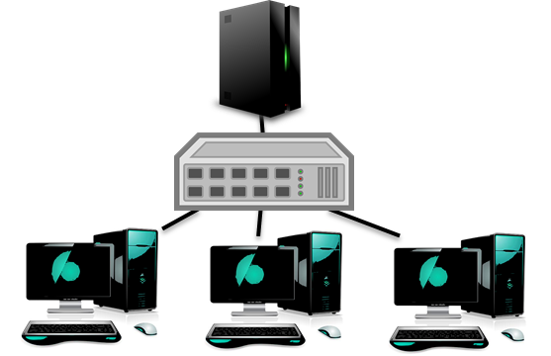
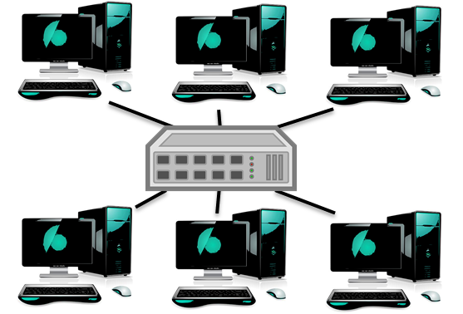
Networking - LANs
Two Types of Network in a LAN:
Peer-to-Peer
Client-Server

Slide 35
Network Types: Peer-to-Peer
All computers have the same status.
Data transfer may be very slow because of
data collisions
shared processor power
Only really suitable for small and low traffic networks.
This is a very popular design for a home network

Slide 36
Peer to Peer
Peer to peer is used by many companies to help reduce the load on their servers.
A good example is blizzard who produce hit games such as StarCraft and World of Warcraft.
You can buy their games online and use peer to peer to download the game clients which tend to be very large files.

Slide 37
Network Types: Client-Server
At least one computer is designated as a server.
This usually needs to be high spec.
It offers services such as software and data to client PCs.
It manages the traffic on the network.
Records what people do.
Gives security.
Clients have to sign in and so their identification is known enabling certain rights to be given to certain people.
Large networks may have many servers to handle the increased network demand.

Slide 38
Web Server Example
request
packet
Home.html
request
packet
Shoes.html
Each PC will request a webpage.
The server has no control over who will request a webpage so will just respond once it receives a request packet.
Every time you access a webpage a request will be sent to a webserver in this way.

Slide 39
Activity
Open your book and answer the following question in exam condition
Describe the two differences between Peer-to-Peer and Client-Server Network
Describe two benefit of Client-Server Network
Describe two drawback of Client-Server Network

Slide 40
Activity
Open your book and answer the following question in exam condition
Describe the two differences between Peer-to-Peer and Client-Server Network
In a Peer-to-Peer all computers have the same status. While in a Client-Server at least one computer is designated as a server.
If a the server goes down in a Client-Server, the whole network is down
Peer-to-peer is suitable for small network, while client-server suitable for large network
Describe two benefit of Client-Server Network
Security can be managed centrally from the server
Easy to installation and maintenance can be manage centrally
Describe two drawback of Client-Server Network
If a the server goes down in a Client-Server, the whole network is goes down
It is more expensive compare to peer-to-peer as you will need to buy a server

Slide 41
STARTER
Open Student Portal
Click on Fafl
Click on Year 11
Click on Add Note
Answer the following question;
Describe the purpose of a Router in a home network [2 marks]
Describe the purpose of a Switch in a network [2 marks]
Explain three benefits of LAN [3 marks]
Describe three differences between Peer-to-Peer and Client-Server Network [3 marks]

Slide 42
STARTER
Describe the purpose of a Router in a home network [2 marks]
Directs packets or data to a destination or a network
Receives packets or data from the network or Internet
Forwards packets or data to other computers on the network or Internet
Connects (different) networks together e.g. joins home network to Internet
Describe the purpose of a Switch in a network [2 marks]
Connect the devices together
Direct or send data packet only to correct destination using
It uses the MAC addresses of devices connected to it

Slide 43
Answer
Explain three benefits of LAN [3 marks]
It enables digital communication between people
It enables the sharing of digital information
It enables the sharing of peripheral devices such as printers and scanners
It enables computers to be updated with the latest software from a central point
Describe three differences between Peer-to-Peer and Client-Server Network [3 marks]
In a Peer-to-Peer all computers have the same status. While in a Client-Server at least one computer is designated as a server.
If a the server goes down in a Client-Server, the whole network is down
Peer-to-peer is suitable for small network, while client-server suitable for large network

Slide 44
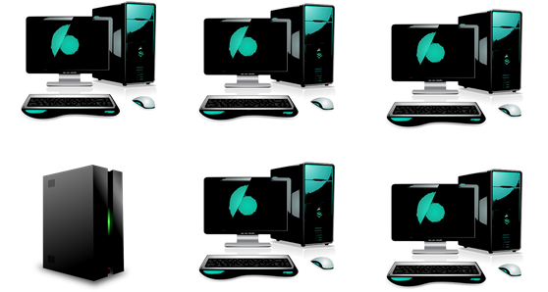
Networking - LANs
Different ways that LANs can be set up:
…these network setups are known as topologies
Bus
Ring
Mesh
Star

Slide 45
Network Topology
The topology is the way in which a network is laid out.
The topology of a network affects:
cost,
performance,
ease of set-up.
…lets see how…

Slide 46
Bus Topology
There is only one cable which all nodes are connected to
It is therefore very cheap due to little cabling
But:
Because data travels both ways along one cable, data collides which slows the network
If the cable has a
fault the whole
network may suffer
Only really useful
over small areas

Slide 47
Bus Network
Packet
A packet will travel down the bus and be read by the PC it is intended for.
The packet will travel past each PC but will be ignored unless the IP address’s match.

Slide 48
Collision in BUS
Packet
Packet
Packets might be sent by 2 computers at the same time.
This could lead to a collision. This would destroy both packets!

Slide 49
Bus Network – Easily Broken
Packet
If the cable breaks then the whole bus network is broken.
This means packets can not get to their destination.
Packets placed onto a broken bus will be lost.
It does not matter where the break in the cable is, all PC’s on the bus will be broken.

Slide 50
Ring Topology
Again, only one cable
But this time data travels
in only one direction
This means no collisions
BUT:
Again if the cable breaks then the whole network may go down.

Slide 51
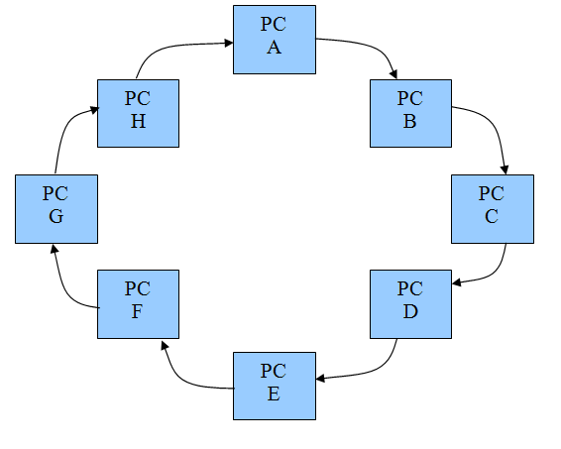
Token Past Around
Packet
The token is past around from PC to PC.
When a PC gets the token it may transmit packets.
Each PC is only allowed to transmit packets for a short amount of time.

Slide 52
Problem with Ring Networks
Ring networks never have collisions.
However if a cable breaks and the ring is broken then the network will stop working.

Slide 53
Star Topology
All cables connect to a hub or a switch and therefore data doesn’t share one cable
This results in fewer data collisions and therefore a fast network
BUT – the most expensive topology as it requires the most cable

Slide 54
Mesh Topology
This is a fully connected network;
Every node is connected to all others;
This means that if a cable breaks or if there is heavy traffic on one area, there are other routes for the data to take
BUT:
It can be a very expensive set up due to the cabling required

Slide 55
Topology
Physical v Logical
Bus
Notes:
DURATION 2 MINUTES
It is likely that participants understanding of difference between logical and physical topologies is not absolutely clear. Logical – how the connections function
Physical – how the wires appear to be connected
In this example shown on the slide, physically the stack of switches is a bus topology, but the stack functions as single piece of networking equipment and so logically the whole system is a star network.

Slide 56
More Topology
Virtual circuit
Virtual circuit
Notes:
DURATION 1 MINUTE
When a switch has learned the connected MAC addresses then each device connecting to another device has a virtual circuit between the two. There is a direct route from one to the other.
Logically this would be described as a point-to-point connection.

Slide 57
Factors Affecting Performance of Network
The following are the factors that can affect the performance of a network
Bandwidth available (amount of data that can be transferred in a given time
Number of users (using the network at the same time)
Number of data collisions
Interference by other obstacle such e.g. walls, other signals
Distance data has to travel or signal strength
Amount of data being transferred
Applications being used
Server/CPU performance
Using a hub instead of a switch

Slide 58
Starter – Exam Style Question
Answer the following questions in your book or PowerPoint
What is a Computer Network?
Two or more computers connected together to share information and resources.
(this can involve physical or wireless connections, or both)
Describe three advantages of LAN?
It enables digital communication between people
It enables the sharing of digital information
It enables the sharing of peripheral devices such as printers and scanners
What is the Different between Hub and Switch
HUB is not intelligent – data packets are transmitted across the whole of the network. While Switch is intelligent data is sent to intended node in the network
What is a Network Topology?
The topology is the physical way in which a network is laid out.
List down four Network Topology
BUS, RING, STAR and MESH

Slide 59
GCSE Networks and Cyber Security
WANs and Virtual Networks

Slide 60
In pairs, discuss:
Networking - WANs
What is a Wide Area Network (WAN)?
How does it differ from a LAN?

Slide 61
Networking - WANs
If a LAN is…
…a Local Area Network.
…a connected set of computers and other devices in small geographical area.
…installed on one site.
relatively small
hardware owned by the organisation
What do you think a WAN might be then?

Slide 62
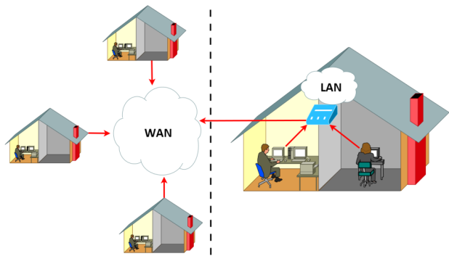
Networking - WANs
WAN
Wide Area Network
Covers a large geographical area – may be worldwide
Devices may be provided by telecoms companies like phone lines and satellites.
LAN
Local Area Network
Located on small geographical area (one site)
Owner of network owns the network devices (cables, switches, etc..)

Slide 63
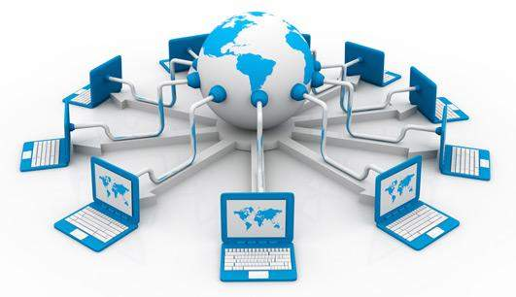
Wide Area Networks
What do you think is the biggest WAN on the planet?
The Internet

Slide 64
So what is the Internet?
The internet is a massive network of networks.
A ginormous collection of connected computers.

Slide 65
Networking - WANs
Web Hosting
A host is a computer on a network which offers to serve users from another location, using the internet.
Web hosting, in particular, is a service provided by various companies (UK Fast).
These companies ‘host’ websites on their servers so that people around the world can access them 24/7.
They will often charge a small fee for the rental of hard drive space, site security and back up services.
It is of course possible for anyone (with a little knowhow) to host their own websites on their home PC, but for the price and risk, it is often more cost effective and less risky to pay for a specialist company to do this for you.

Slide 66
Exam Style Question
Answer the following questions in your booklet in exam conditions
What is an IP Address
What is MAC Address
What is a Packet
What is URL
Describe two differences between IP Address and MAC address.
Give one benefit to Hugh’s customers of accessing the website using a URL rather than using an IP address.

Slide 67
Stater - Exam Style Question
Answer the following questions in your booklet in exam conditions
What is an IP Address
This means INTERNET PROTOCAL ADDRESS
It is a unique number given to every computer on the internet
What is MAC Address
A MAC address is a unique code which is built into a network device
What is a Packet
A packet is a small piece of data that transmitted over a network
What is URL
This means UNIFORM RESOURCE LOCATOR
This is simply a fancy name for a web address, such as www.bbc.co.uk
Describe two differences between IP Address and MAC address.
IP address can change while MAC address is permanent
IP is made up of numbers only while MAC address is made up of numbers and text
IP address is software based address while MAC is hardware based address
Give one benefit to Hugh’s customers of accessing the website using a URL rather than using an IP address.
It is easier to remember URL than IP Address

Slide 68
Activity
Use the internet or revision note to write the definition of the following in your own words;
IP Address
MAC Address
Packet
You can do this in your book or PowerPoint or Word

Slide 69
Learning intentions re-cap
To understand…
WAN (Wide Area Network)
The internet as a worldwide collection of computer networks:
DNS (Domain Name Server)
Hosting
The concept of virtual networks.

Slide 70
Networking - WANs
Web Hosting and DNS
Over the next few slides, we will take a look at what happens when we try to access websites on the internet.
But in order to do this we need to understand a few key pieces of terminology:
IP Address
MAC Address
Packet
ISP
URL
DNS

Slide 71
Networking - WANs
IP Address
This means INTERNET PROTOCAL ADDRESS
It is a unique number given to every computer on the internet – no two computers can have the same address.
E.g. 324.45.321.23
Its just like a postal address – used to identify a house – no two houses have the same address!
A device’s IP address will not necessarily remain the same each time it joins a network or goes on-line

Slide 72
An Example IP Address
192.168.1.23

Slide 73
Activity 1 - IP Addresses
Use the website “What is my IP address” to find your IP address
It maybe the same as another students. why?
What class is the IP address.

Slide 74
IP Address
Data travelling on a Network are sent as packets
Each device on the internet has a unique IP address which is sent with the packets to identify which computer to send the data to.
The address is broken down into four numbers which can represent a number between 0 and 255 separated by a full stop.

Slide 75
IP Address Four Octets
An IP Address is made up of four octets, for example
102.68.221.75
Each octet is a binary number with 8 bits, for example the first octet above would be –
Each 1 or 0 has a decimal value shown here
So the octet above would include these decimals
The total will be 64+32+4+2 = 102
0 | 1 | 1 | 0 | 0 | 1 | 1 | 0
128 | 64 | 32 | 16 | 8 | 4 | 2 | 1
 | 64 | 32 |  |  | 4 | 2
Notes:
DURATION 2 MINUTES
Key points
Make sure that the participants have a sound grasp of binary by showing how each octet can be converted to a decimal in steps:
Convert each bit into the decimal value represented at that place in the octet
Add all these decimals to make the total decimal value for that particular octet

Slide 76
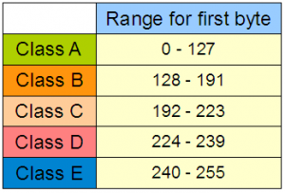
IP Classes
IP addresses also have different classes which identify the class of Network that the user is on.
This indicates the number of total possible users and the purpose of the network

Slide 77
STARTER
Open Student Portal
Click on Fafl
Click on Year 11
Read the feedback from your Teacher;
Click on Add Note
Response to the feedback
Answer the questions on the Target section
All question must be answered in exam condition
Answer all question as detail as you can.

Slide 78
Packet Switching
Imagine that you have a large LEGO model to post through a letter box but, it does not fit.
What could you do?
What if you could take the model apart and then post it through the letter box and then reassembly it?
This is packet switching

Slide 79
Packet Switching
Now image you want to email a photo, first it is broken down into small packets of data
Each packet is then given a header which contains the IP address of the network and device that it is being sent to.
It also contains the IP address of the network that it was sent from
Destination IP
192.168.0.25
Source IP
192.168.0.21
Data!
Header

Slide 80
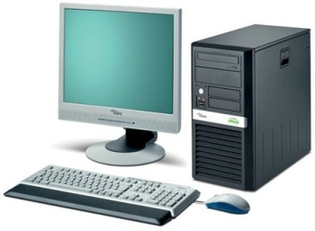
How Packet Switching Works
Large music file
A large file needs to be sent from computer A to B. Each one has it’s own IP address.
A
B
IP – 192.168.5.28
IP – 192.168.5.64

Slide 81
How Packet Switching Works
Large music file
Chunk 1
Chunk 2
Chunk 3
Chunk 4
Chunk 5
Chunk 6
The file needs to be split up into small chunks. Chunk 6 will not be full of data.
A
B
IP – 192.168.5.28
IP – 192.168.5.64

Slide 82
How Packet Switching Works
The first chunk is prepared by adding the source and destination IP address on.
Source
192.168.5.28
Destination 192.168.5.64
Chunk 1
A
B
IP – 192.168.5.28
IP – 192.168.5.64

Slide 83
How Packet Switching Works
The packet is then sent from computer A to computer B
A
B
S
D
Chunk 1
IP – 192.168.5.28
IP – 192.168.5.64

Slide 84
How Packet Switching Works
The second chunk is then sent and so on until the whole file has been sent.
A
B
S
D
Chunk 2
IP – 192.168.5.28
IP – 192.168.5.64

Slide 85
Packet Switching
The header also contains the packet number as well as the total number of packets, for example packet 4 of 60, packet 45 of 60.
When the packets arrive at the destination this information is used to reassemble the data.
Packets can be lost so sometimes the computer request the packet to be sent again, if a packet never arrives then it is deleted by the router.

Slide 86
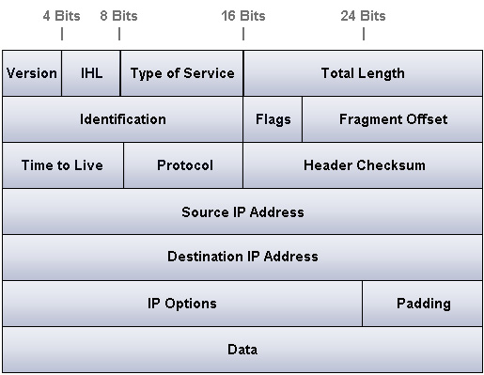
An Example Packet
http://optimus5.com/index.php?page=search/images&search=tcp+ip+packet&type=images&startpage=4

Slide 87
Activity
Bill needs to send a document across a network to Ben.
Write an algorithm to show how packets are used to send the document, starting from when Bill clicks send (sending), and finishing when Ben reads the document (receiving).

Slide 88
Answer
Sending
Bill Click on Send
Bill's computer splits data into equal sizes packets
Each packet is given a header
Each header include (Packet Number, Sources and Destination IP address and error checking data)
The packets are sent across the network
Receiving;
Ben's computer checks if all packets have been received?
If No
Check again
Increment timer
If timer > max wait
Send timeout to Bill's computer
END IF
End IF
ELSE If Yes
Each packet is checked for errors
Reorder packets based on their number
Display the document
Send receipt confirmation
End IF

Slide 89
MAC Address
A MAC address is a hardware address and can not be changed.
It is set up when the network device is created. It is made up of 6 sets of 2 hex values.
Example: 8a-91-BF-1C-8A-FC
MAC addresses are used by network devices, such as a switch, to direct data packets correctly.
MAC addresses are not changeable which means that it is a more accurate way of identifying a PC.
It is very common for security mechanism in networks to use MAC addresses rather than IP addresses.
For example our wireless network has a list of allowed MAC addresses.
All other devices are blocked.
So even if you got the password you would still not be able to access the network on your own laptop!

Slide 90
MAC Address
MAC addresses, or Media Access Control Addresses, uniquely identify a device on a network by identifying the network adapter that the device is using.
This enables you to distinguish between different devices.
Try this!
On a windows computer you can locate your MAC address:
Go to the start menu
Type cmd
Type ipconfig/ all
The MAC address is listed as ‘Physical Address’

Slide 91
MAC Address
The MAC address is embedded into the device when it is manufactured and the owner cannot change it.
A MAC address is a unique code which is built into the Network Interface Card (NIC)
Each address is individual and is made up of 48 bits, usually written in hexadecimal for ease.

Slide 92
Activity
AA-34-G4-44-23-F1
It uses hexadecimal as a number base
Question?!
Why would it use Hexadecimal over Binary?
Hexadecimal is easy to remember
Describe four differences between IP and MAC Address
IP is made up of number entirely while MAC address is made up of number and text
IP Address can change while MAC address does not change
IP address is software based while MAC is Hardware base

Slide 93
Networking - WANs
ISP
This means INTERNET SERVICE PROVIDER
This is simply the company who provide you with your internet connection.
Can you name any ISPs?

Slide 94
Networking - WANs
URL
This means UNIFORM RESOURCE LOCATOR
This is simply a fancy name for a web address, such as:
http://www.bbc.co.uk
http://www.google.com

Slide 95
URL
www.
http://
mysite
.com
/folder/
Index.html

Slide 96
Protocol
www.
http://
mysite
.com
/folder/
Index.html
HTTP stands for “Hyper Text Transfer Protocol” and is the network protocol used to transfer web pages.
Most web browsers will put this in for you!

Slide 97
DNS
www.
http://
mysite
.com
/folder/
Index.html
This part is referred to as the domain name.
It is made up of a series of domains read from right to left (bigger to smaller).
This must be converted to an IP address.

Slide 98
Folder
http://
www.
mysite
.com
/folder/
Index.html
A web server may have multiple folders.
These work in the same way folders work on a standard PC.

Slide 99
Webpage Name
http://
mysite
.com
www.
/folder/
Index.html
The name of the page you are looking for is at the end.
Every website has a default page so if you do not specify a page then you will get the default.
This is commonly known as the home page.

Slide 100
Domains
.com
.uk
.ca
.fr
Here are some top level domains.
“.com” is the American commercial website domain.
“.uk” is UK websites,
“.fr” are French websites and
“.ca” are Canadian websites.

Slide 101
Sub Domains
.com
.uk
.ca
.fr
.gov
.org
.co
.ac
.biz
.gov.uk – UK government websites
.org.uk – UK organisations
.co.uk – UK companies
.ac.uk – UK academic institutions (university)
.biz.uk – UK business websites

Slide 102
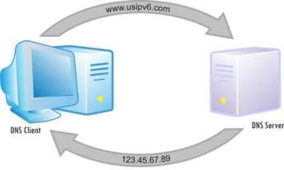
Networking - WANs
DNS: This means DOMAIN NAME SYSTEM
This is the system used to find the computer which hosts the website you are looking for.

Slide 103
Relationship Between URL, IP and DNS
How DNS, URL, IP address and Webserver works together to load up a webpage on a computer
The website is hosted on a webserver
The website/webserver has an IP address
The Browser sends URL to DNS
Every URL has a unique IP linked to it
The DNS finds IP
If DNS cannot find the IP it passes a request to higher DNS, if not found return error
IP address sent back to the browser/computer
The Browser sends request to IP/webserver
Webserver processes request for the website/webpage
Webserver sends the webpage/file/data to the user

Slide 104
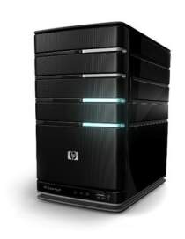
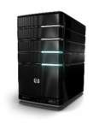
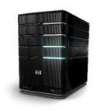
How DNS works
1. You can’t remember the IP address of the computer which hosts the BBC website, so you type in the URL into the browser.
1.
2. The URL is sent to your ISP and they look up the URL in their DNS ‘address book’. They find it and send back to you the websites URL address.
www.bbc.co.uk
3.
2.
3. Now you can communicate with the computer which hosts the website on the internet, directly.
322. 55.24.12
123.45.67.89
174.25.46.77

Slide 105
Networking - WANs
The Cloud
‘The Cloud’ is a network of servers hosted on the internet which offer a range of services to store and process data.
In particular, ‘Cloud Computing’ relates to online services provided by numerous companies.
Examples of cloud computing are:
Office 365 / GoogleDocs
Cloud Storage (GoogleDrive, OneDrive, DropBox, iCloud)
Netflix / Spotify

Slide 106
Networking - WANs
The Cloud
Why would a company use such a service as office365?
They do not need to ‘buy’ and install the software
Any ‘connected’ computer can access the service
There is no need to upgrade the software
Collaboration can occur with multiple people working on the same document at once.
Work is automatically saved / backed up
This generally all leads to lower costs.
BUT…
Sensitive company data may be stored in another country which may not adhere to the same data laws as the country the company is in.
Completely reliant on the network / internet.

Slide 107
Activity
Open Student Portal
Click on Fafl
Click on Year 11
Read the feedback from your Teacher;
Click on Add Note
Response to the feedback
Answer the questions on the Target section
All question must be answered in exam condition
Answer all question as detail as you can.

Slide 108
Networking - WANs
Virtual Networks
We have already seen that:
LANs are a network of computers over a small geographical location.
WANs are a network of computers over a wider geographical area.
For both types of network, they are created through the connection of physical hardware.
A virtual network is one which uses software to subdivide a physical network (LAN or WAN) into smaller ones.

Slide 109
Networking - WANs
Virtual Networks and LANs (VLANs)
For a simple virtual network, software will re-divide a LOCAL AREA NETWORK into a series of smaller networks so that (for example) groups of workers can communicate and share information separately from other members of a company.
Because it is software which enables the network to partitions (hardware remains as it was) it is knows as a VIRTUAL network.

Slide 110
Virtual Network
Virtual networks are software-based network
Virtual network are created by partitioning off some of a physical network’s bandwidth to form a separate network
Several virtual network can exist on the same physical network.
These networks all share the same hardware
Virtual network are very secure as each virtual network has it own security including its own firewall.
This mean virtual network can only be assessed by using certain software or login information.
Other people could used the same physical network and not have access to the virtual network or even know that it exists.
Notes:
DURATION 1 MINUTE
Broadcasts at the link layer and at the IP layer have the potential to overwhelm a network with traffic.
Some protocols are more “shouty” (broadcast more) than others. ARP is a good example, DHCP is also.

Slide 111
Virtual Private Networks and WANs
Virtual Private Networks (VPN) and WANs
Software can also re-divide a WIDE AREA NETWORK into a series of smaller networks so that (for example) groups of workers spread across the country / world can communicate and share information separately from other members of a company.
As the internet is used by all, these networks will need added security and this is done through encryption.
Due to this they are given the name PRIVATE NETWORKS, but of course, because they are created through the use of software, they are known as Virtual Private Networks (VPN).

Slide 112
Virtual Private Network (VPN)
A Virtual Private Network (VPN) is a type of virtual network that can be used to send data securely over a large network such as WAN.
VPN can be used to send data securely between two offices on different sites. Or
Set up a school internet that all students can access from home
A Virtual LAN (VLAN) allows you split a LAN into separate network using the same hardware.
Activity
In your come up with four advantages of Virtual Network
Get ready to share answers with rest of the group.
Notes:
DURATION 1 MINUTE
Broadcasts at the link layer and at the IP layer have the potential to overwhelm a network with traffic.
Some protocols are more “shouty” (broadcast more) than others. ARP is a good example, DHCP is also.

Slide 113
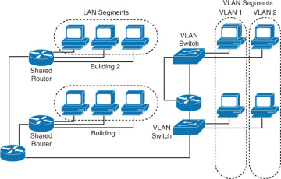
Virtual Private Network (VPN)
Notes:
DURATION 1 MINUTE
Broadcasts at the link layer and at the IP layer have the potential to overwhelm a network with traffic.
Some protocols are more “shouty” (broadcast more) than others. ARP is a good example, DHCP is also.

Slide 114
Benefits of Virtual Network
Advantages of Virtual Networks
Scalability: This allows for the network to be expanded. Users can be connected to different switches but appear as if they are on the same segment of the network.
The Bandwidth is used more efficiently
Security: Users cannot access computers in other VLANS even if they are connected to the same switch.
Cost: You do not need to change the network infrastructure as the business change. No need to buy new hardware.

Slide 115
Virtual Networks (VLANs)
SWITCH 1
Port | VLAN
01 | A
02 | A
03 | C
04 | C
05 | B
06 | E
VLAN | Routes to | Function
A | D | 1st Floor
B | Internet only | Guest Wi-Fi
C | D | 2nd Floor
D | A C | Servers
E | E | Phones
VLANs are software created walls between switch ports
VLANs are created across all switch stacks in a network
Notes:
DURATION 2 MINUTES
VLANs assign particular ports on switches to particular networks and then apply rules about where the data in a particular VLAN can go.
In this (highly simplified example) Switch 1 is configured with ports on 4 VLANs.
A and C are VLANs to limit broadcast traffic to a single floor. B is a VLAN that will have Wi-Fi Access Points attached for guest Internet access. D is the VLAN where all the servers are. E is a completely separate network for the telephone system (Voice Over IP, VOIP).
Explain that the server VLAN D is accessible from both floors (on switch1).

Slide 116
VLAN Example
PC B
PC C
PC | VLAN Port
A | 01
B | 02
C | 02
D | 02
E | 03
F | 01
G | 03
PC D
PC A
PC E
PC F
PC G
In this example all the PCs in VLAN 01 can send and receive data from each other but none of the others
Activity: List the PCs in VLANs 01, 02, and 03
Notes:
DURATION 4 MINUTES
Key Point
In this example all the PCs in VLAN 01 can send and receive data from each other but none of the others
Ask participants to list the PCs in VLANs 01, 02 and 03
Answer
01 – PCs A and F
02 – PCs B, C and D
03 – PCs E and G
Ask can PC A send data to PC G?
Answer – no because it is part of a separate virtual network.
These are virtual networks because what makes them separate local area networks is not a physical separation but a software defined barrier.

Slide 117
VLAN Problem
In groups
You have the network shown in the document VLAN Problem
How would you set up VLANs to allow the connections described?
You have 5 minutes
Switch 01 |  |  | Switch 02 |  |  | Switch 03
Port | VLAN |  | Port | VLAN |  | Port | VLAN
01 | 1 |  | 01 | 2 |  | 01 | 1
02 | 2 |  | 02 | 2 |  | 02 | 1
Notes:
DURATION 8 MINUTES
Groups of 3 -4.
Allow 5 minutes and look at one or two solutions
Click to show correct solution on the slide and ask if anyone needs help understanding this.

Slide 118
Protocols
Network protocols are a set of rules or conventions which control the communication between devices on a network
In order for computers to understand each other they must speak the same language.
Exactly the same as humans! In networking this means they must choose the same protocol.

Slide 119
Protocols Explain
Hey!
Hello!
Can I have your number?
Yes, it is 07123456789
Basic Rules of this Communication are
Only one person is speaking a time – otherwise they will not be able to hear each other
Whenever the guy speaks, a response from the girl is expected
Whenever the guys sends a message, a specific response is expected from the girl
Example, Guy said “Hey” Girl response “Hello” and not “fish”

Slide 120
Protocols Explain
Can I connect to you?
Yes, you have my permission!
GET file bbc.co.uk/index.php
PC
Send file bbc.co.uk/index.php
Server
Basic Rules of this Communication are
The server cannot send a file to PC without the asking
Whenever the PC speaks, a response from the Server is expected
Whenever the PC sends a message, a specific response is expected from the server
https://bbc.co.uk/index.php
Protocol
Server Name
File

Slide 121
Using the Same Protocol
TCP
UDP
TCP
Packet
A protocol must be selected by each PC. When a packet is created the protocol will add some information to the packet.
This is known as a header.

Slide 122
Using the Same Protocol
TCP
UDP
???
TCP
Packet
If the destination PC is using a different protocol then it will not understand the packet!

Slide 123
Using the Same Protocol
TCP
TCP
TCP
Packet
In order for packets to be understood the same protocol must be used. In this case both PC’s are using “TCP”.

Slide 124
Key Protocols You Need to Know
TCP/IP (Transmission Control Protocol/Internet Protocol)
HTTP (Hyper Text Transfer Protocol)
HTTPS (Hyper Text Transfer Protocol Secure)
FTP (File Transfer Protocol)
POP3 (Post Office Protocol version 3)
IMAP (Internet Message Access Protocol)
SMTP (Simple Mail Transfer Protocol)

Slide 125
Do you know your Protocols?
For the exam you need to know the meaning and the role of the following protocol
TCP/IP
HTTP
HTTPS
FTP
POP3
IMAP
SMTP
Task
Briefly research the purpose of each Protocol
Find out their meaning and description of what they do

Slide 126
TCP/IT Most Important Protocols?
TCP/IP is the most important protocol which dictates how data is sent between network (e.g. over the internet)
It is made up of two protocols
Transmission Control Protocol (TCP) – this set the rules for how devices connect on the network.
It is in charge of splitting the data into packets and reassembling the packets back into the original data
Internet Protocol (IP) – this is responsible for packet switching.

Slide 127
Protocol!
Protocol | Meaning | What is it used for?
HTTP
HTTPS
FTP
POP 3
IMAP
SMTP
Hyper Text Transfer Protocol
HTTP is used by web browser to access websites and communicate with web servers
Hyper Text Transfer Protocol Secure
HTTPs is more secure version of HTTP. It encrypts all information sent and received
File Transfer Protocol
FTP is used to access, edit and move files between devices on a network. E.g. to access file on a webserver from a client computer
Post Office Protocol version 3
POP3 is used to retrieve email from a server. The server hold the email until you download it, at which point it is deleted from the server
Internet Message Access Protocol
IMAP is used to retrieve email from a server. The server hold the email until you actual delete it. You only download a copy.
Simple Mail Transfer Protocol
SMPT is used to send email. Also used to transfer email between servers

Slide 128
Activity 2
Briefly research the purpose of each Protocol
Choose one of the protocols and create a poster which explains to the reader what the protocol is, its features. Include a diagram and examples
Share these posters with other students

Slide 129
Explanation Videos
An Overview:
https://www.youtube.com/watch?v=WmymBI-X7Tc
IP
https://www.youtube.com/watch?v=zyL1Fud1Z1c
IMAP vs POP3: https://www.youtube.com/watch?v=BK4ng6Gcits

Slide 130
Layers
As a packet is prepared the data travels through layers where protocols manage it, adding or removing extra information as required.
https://www.youtube.com/watch?v=zyL1Fud1Z1c
What is a Layer
Layer is a division of network functionality

Slide 131
What is a Layer
Layer is a division of network functionality
A layer is a group of protocol which have similar functions
Layers are self-contained – This means protocols in each layers do their jobs without needing to know what’s happening in the other layers.
Each layer server the layer above it – this means it does the hidden work needed for an action on the layer above.
E.g.

Slide 132
The Layers of a Network
For example, if you are accessing a website (HTTP - layer 4),
It requires data to be split into packets and sent across the internet (TCP – layer 3 / IP – layer 2),
which in turns requires the physical transport of data via cables (cables / Wi-Fi – layer 1)

Slide 133
The Layers of a Network
Layer Name | Protocols in this layer Covers | Protocols Example
Layer 4: Application Layer
Layer 3: Transport Layer
Layer 2: Network Layer
Layer 1: Data Link Layer
Turning data into website and other applications such as Outlook vice versa
HTTP, FTP, SMPT
Controlling the data flow – e.g. splitting the data into packet and checking packets are correctly send and delivered.
Packet Switching
TCP
Making connections between networks, directing data packets and handling traffics. Used by routers
IP
Passing data over the physical network. Responsible for how bits are sent as electrical signal over cables, wireless and other hardware
Ethernet

Slide 134
Advantages of Using Layers
It break the network communication into manageable pieces.
This help developers concentrate on only one are of the network without having to worry about the others
Layers are self-contained – This mean they can be changed without affecting the other layers
Having a set rules for each layer forces companies to make compatible or universal hardware and software

Slide 135
Plenary
BBC Online test: http://www.bbc.co.uk/education/guides/zp9jpv4/test

Slide 136
IP Address
A unique string of numbers separated by full stops that identifies each computer using the Internet Protocol to communicate over a network.
They are similar to as a postcode that is used to identify a house in a county on a street.

Slide 137
Routers
Routers build up “routing tables” so they know which subnets are attached to which of their interfaces, and how far away they are, the “distance”
Notes:
DURATION 1 MINUTE
The distance is usually a number of hops, that is the number of intermediary routers
Other metrics are used as will be seen in later slides.
Subnets are tackled in detail in PDE GCSE Networks and Cyber Security 04- Addresses Session
Remember in PDE GCSE Networks and Cyber Security 02- TCPIP Detail Session, RIP was covered. This one example of many routing protocols.

Slide 138
Devices and Layers
Application
Presentation
Session
Transport
Network
Data Link
Physical
NIC
Notes:
DURATION 1 MINUTE
Key point is that a router is a layer 3 device – because?
Answer: because it examines IP addresses and makes decisions based on those.

Slide 139
Routers
When a router gets a packet in an interface that is addressed to a host within the subnet attached to that interface it drops it.
Notes:
DURATION 1 MINUTE
Key point – routers segregate traffic. They prevent proliferation. They drop broadcasts.
Terminology point – usually the network connection on a router is called an interface, could equally be called a port. Sometimes interface is also used for switch ports as well.

Slide 140
Where Does a Broadcast Go?
The PC sends a broadcast. Where does it end up?
A
B
C
D
E
F
Notes:
DURATION 2 MINUTES
Ask the participants to write down on their own a list of devices that receive the broadcast.
Go through letter by letter asking an individual participant if A gets the broadcast, then ask why.
Then ask a different participant if B does and why, and so on.
F will be the only device not to receive the broadcast because it will arrive at the router and then be dropped.

Slide 141
Methods of Routing
Routing Information Protocol (RIP)
Old protocol and limited information is transferred between routers
Every 30 seconds a router sends a broadcast asking for updates
All neighbouring routers send their routing table
Routers exchange the number of hops to networks they know about.
More sophisticated “routing costs” exchanged
Open Shortest Path First (OSPF) enabled routers exchange information about the speed of connections
Notes:
DURATION 2 MINUTES
Key point here is that to route data routers need to build a picture of the networks around them. They do this with a routing protocol. RIP was covered in PDE 3 Slide 9.
Two examples here. The metrics used by different protocols can be very sophisticated.

Slide 142
RIP – Hop Count
From Router C, how many hops to network
192.120.48.0?
From Router C, how many hops to network
192.120.56.0?
Router C
1
Router A
Router B
2
Router E
3
Router D
4
Router G
Router F
Network
192.120.56.0
Router H
5
Router I
Network
192.120.48.0
Router J
Notes:
DURATION 2 MINUTES
Show the animation. This demonstrates how “hop counts” are calculated.
The next slide summarises this by showing hop counts from C and B with a connection added from A to C and from A to B

Slide 143
RIP in Practice 1
Router B
Router A
Router C
Port 1
Port 2
Network | Hop Count
192.120.56.0 | 3
192.120.48.0 | 2
Network | Hop Count
192.120.56.0 | 1
192.120.48.0 | 5
If Router A gets RIP updates from B and C what will the routing table on A show?
Port | Network | Hop Count
1 | 192.120.56.0
1 | 192.120.48.0
2 | 192.120.56.0
2 | 192.120.48.0
Port | Network | Hop Count
1 | 192.120.56.0 | 4
1 | 192.120.48.0 | 3
2 | 192.120.56.0 | 2
2 | 192.120.48.0 | 6
Notes:
DURATION 6 MINUTES
Ask the participants to agree answers in pairs allowing 4 minutes.
Discuss their answers.
Show the correct solution by clicking to animate its appearance.
Note as Router A is a further hop from B and C its table will show one more hop for each destination network.

Slide 144
RIP in Practice 2
Router B
Router A
Router C
Network | Hop Count
192.120.56.0 | 3
192.120.48.0 | 2
Network | Hop Count
192.120.56.0 | 1
192.120.48.0 | 5
If Router A gets RIP updates from B and C
What will it have as the quickest route to network 192.120.48.0?
What will it have as the hop count?
What will it have as the quickest route to 192.120.56.0?
What will it have as the hop count?
Notes:
DURATION 6 MINUTES
Ask the participants to agree answers in pairs allowing 4 minutes.
Discuss their answers.
Note that the hop count at router A will be incremented by 1 compared with the counts at B and C. Make sure they understand why.
Answers
The quickest route will be via Router B as the “cost” is only 2 hops, whereas C is 5 hops.
A will have the hop count (cost) as 3 hops because it is one hop from A to B.
The quickest route will be via Router C as the “cost” is only 1 hop, whereas B is 3 hops.
A will have the hop count (cost) as 2 hops because it is one hop from A to C.

Slide 145
Packet Switching
destination
source
Notes:
DURATION 2 MINUTES
Packet switched networks allow the data to parcelled up and transmitted in these lots and then each piece finds its own way to the destination.
Routing protocols enable routers to know that as network conditions change different routes become more efficient and then less so.
Use the diagram to show how packets can take a number of different routes to travel from the source to the destination. That is that there are a minimum of two hops from source to destination but if those links get congested a greater number of hops may be a faster route to take.
Explore how individual packets could choose different routes if certain connections become congested and very slow during the period of transmission.
For example the first hop from source could be to the router above. If that router then is notified of a slow link between it and the destination it may send the data packet to the router below to the right.
If that router also is notified of a slow link to the destination it could send the data below and to the right. This router may then send the packet to the lowest router that then sends the packet to the destination.
The next packet could simply take two hops across the upper router if it is notified that the link has become much faster.

Slide 146
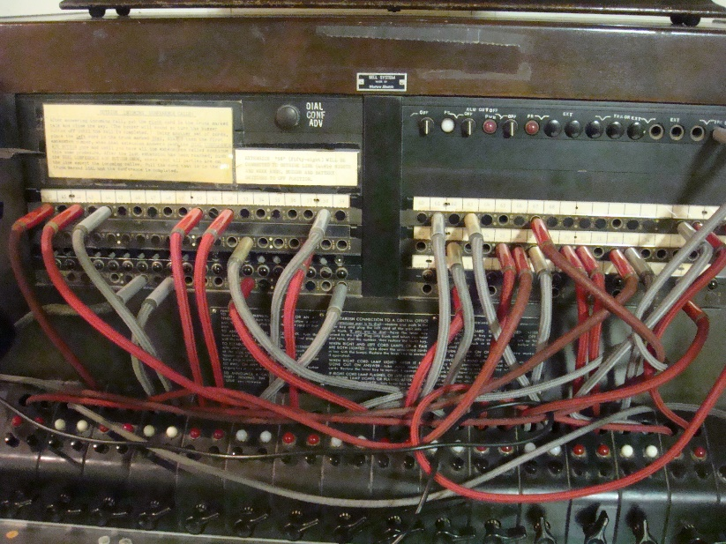
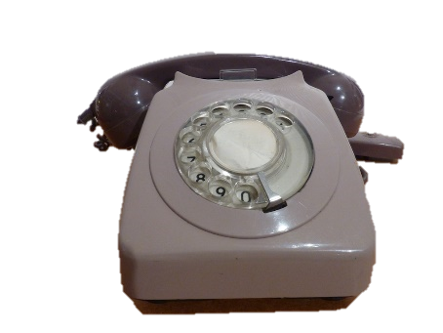
Circuit Switching
Image from Les Chatfield
https://www.flickr.com/photos/elsie/
Image from Jerad Bitner
https://www.flickr.com/photos/sirkitree/
The route from source to destination is fixed for the duration of the connection
Notes:
DURATION 2 MINUTES
Explain that circuit switching establishes a route at the start and sticks to it until the communication session is done, just like the old telephone system.
Ask the participants ( as a whole group); what are the advantages and disadvantages of packet and circuit switched systems.
Record this on a flipchart as shown on Circuit and Packet Switched Compared document. The document shows the main ideas but there may be others.
Note that switches create virtual circuits between two devices connected to the switch as shown in slide 9

Slide 147
Client-Server v. Peer-Peer Networks
These are common misunderstandings
servers are big computers
Peer-to-peer networks are believed to be a network topology, rather than a virtual network implemented at software layers
The difference may be best described as one of hierarchy
Client-Server networks are ruled by servers. They control access to files, what rights users have and how devices connect. Clients are ruled by the servers.
Peer-Peer networks are a community of equals. Each device is in charge of itself and nothing else.
A fascist state v anarchist utopia
Notes:
DURATION 2 MINUTES
Key learning here is that these are differences in the way devices interact not in topology

Slide 148
Types of Networks
Personal Area Network (PAN)
This is a network where personally owned devices connect together
Local Area Network (LAN)
This is a network within (usually) a business in a building or closely connected set of buildings
Wide Area Network (WAN)
A network of connections between LANs over a region or nation or set of nations.
The Internet is a WAN
Notes:
DURATION 2 MINUTES
Key learning here is that these are differences in the way devices interact not in topology
May be worth pointing out that these different network types are not terribly distinct categories. There are some significant grey areas. It seems unlikely that an exam board would ask a question about this very small part of the specification that required candidates to deal with ambiguity. In other words this isn’t worth sweating over.

Slide 149
Types of Networks Practice
Which of the three types are these describing; PAN, LAN or WAN?
A network connecting a doctors digital TV, Wi-Fi, laptop and phone in his home.
A network connecting two buildings of a sewage management company of either sides of a road.
A network in an office room connecting three PCs with a server and broadband connection
A network connecting University buildings across Leeds
Notes:
DURATION 6 MINUTES
Get participants into pairs and give them 4 minutes to decide which is which
Go over these answers but explain that sometimes there are gray areas.
As this is a small domestic network it is obviously a PAN
This is a LAN. It is more than one building but because the geographic area is very limited it isn’t extensive enough to be a WAN. If the buildings were a couple of miles apart it might be a WAN.
This is a LAN as even though it is a very small location it is for a business not a domestic arrangement.
This is a WAN covering a city.

Slide 150
Reflection on Your Learning
In these topics can you identify something you have learned?
The hardware needed to connect stand-alone computers into a Local Area Network
Virtual networks
Packet switching and circuit switching
Client-server and peer-peer
How can you apply that to your professional practice back in school?
Notes:
DURATION 10 MINUTES
Ask the participants to spend 4 minutes discussing these questions in groups of 3 or 4
Get feedback from groups around each
This is time for formal reflection in participant logs

